Slide 1
Global Sourcing & Supply Chain Management
Daniel Hänsch, Gautam Regulagadda & Jessica Schröder

Slide 2
Overview
Timeline
Benetton’s SCM
What Happened?
Benetton’s Change to DSCM
Agility
What Does the Future Hold?

Slide 3
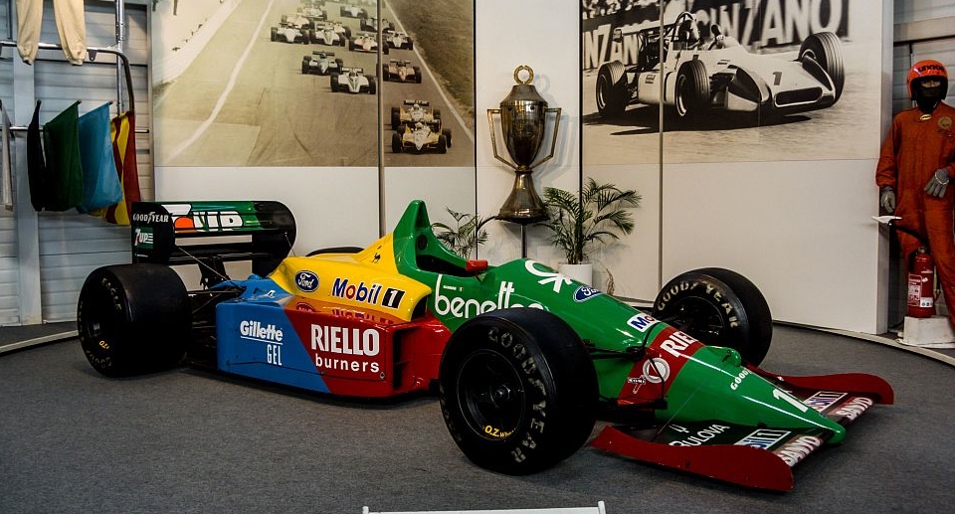
Where Does Benetton Come From?
1965
1978
2002
1968 / 69
1980‘s
2012

Slide 4
WHAT WAS BENETTON‘S SUPPLY CHAIN IN THE 1980s?

Slide 5
Manufacturing Process
Vertically integrated process
Close relationships to contractors
→ High flexibility
Low costs
Competitive environment
Production
Outsourced
Labor Intensive
In-house
Technically intensive parts
Purchasing

Slide 6
30 Weeks from Design-to-Shop
Design Ideas
Order Placement
Delivery
Modification
Postponement: dyeing
Min. obsolete inventory
No flexibility to change according to demand
Lead times too long (table III)

Slide 7
30 Weeks from Design-to-Shop
PROCESS | TIME (IN WEEKS) | CUMULATIVE
Desigining collection & producing samples | 8 | 8
Orders by shopkeepers / partners | 1 | 9
Purchasing raw material (wool/cotton) | 1 | 10
Manufacture & purchase of materials (spinning cotton, producing yarn, weaving) | 10 | 20
Manufacturing garments | 6 | 26
Printing & Dyeng | 2 | 28
Delivery to logistic hub | 1 | 29
Transport from hub to shops | 1 | 30

Slide 8
Well-Integrated Distribution
Chain of companies → global distribution
WIDE: overcome freight forwarding issues
BENLOG: improve efficiency
BENAIR: transport
WIDE
Worldwide Integrated Distribution Enterprises
International forwarding and custom clearance
Benlog
Managing logistics
Focused on production site at Castrette
Benair
Private air transportation.
Setup by Benetton

Slide 9
Franchise Network
Sales-Franchise Model
No direct link to franchisees
Agreements with agents
Stock & sell Benetton only
No return of unsold goods
Benetton
Agent
Franchisee 1
Franchisee 2
Direct Retail Outlet

Slide 10
WHAT WENT WRONG FOR BENETTON?
1990s – early 2000

Slide 11
The Rise of Fast Fashion
Globalization / Computer / Internet …
“World has become a village“
Global trends spread all over the world
Strong individualism in the western world
Constant need for new trendy clothing (esp. Europe)
Short life cycles
High volatility, low predictability
Clothing for the moment
High impulse purchasing

Slide 12
Pioneers of Fast Fashion – Zara / H&M
New ways in SCM
Results
Customer-oriented
Mass production with Pull Strategies
Cross-functional operation strategy / “one rhythm”
High vertical integration vs. outsourced production
Own retail stores with new philosophies (Zara scarcity…)
FAST - from the idea to the product to the customers‘ closets
LEAN – efficient, low cost processes
FLEXIBLE – quick responses to new trends

Slide 13
Benetton‘s Weak Links
Slow, PUSH oriented supply chain
Only two collections per year
No in-season adjustment capacities
Franchise system
Too expensive products
6 CEOs in 12 years (2000-2012)
No consistent management guidance
No clear positioning
→ Market value: $4.3 billion → $720 million (2000-11)

Slide 14
Benetton Failed in Advertising
“THERE ARE NO SHOCKING PICTURES – ONLY SHOCKING REALITY!” (Toscani, August 2010)
“…I CARE A SHIT ABOUT PULLOVERS” (Toscani, June 2015)

Slide 15
Benetton Couldn’t Keep Up

Slide 16
Benetton Couldn’t Keep Up

Slide 17
WHAT WAS BENETTON‘S REACTION?

Slide 18
Dual Supply Chain
Push focused demand = garments supplied before start of season
Pull focused demand = garments supplied during season
Integrated DSCM = focus on delivering trendy wear instead of cost minimization
Dual Supply Chain
Sequential
Acted on Push Focused Demand
Integrated
Acted on Pull focused demand

Slide 19
Increase in Number of Collections
Evergreen
Trends
Contemporary 2
Contemporary 1
Just-in-Time

Slide 20
Results
New products on a more continuous basis
Sales momentum maintained even after season
Built-in flexibility = delivery of products within one week
Better balance between time-to-market and cost
Product Development Unit setup to connect product operations and sales units

Slide 21
TODAY‘S SCM?

Slide 22
Instrumented/ Interconnected/ Intelligent
Process integration
Network based
Virtual
Market sensitive
SCM

Slide 23
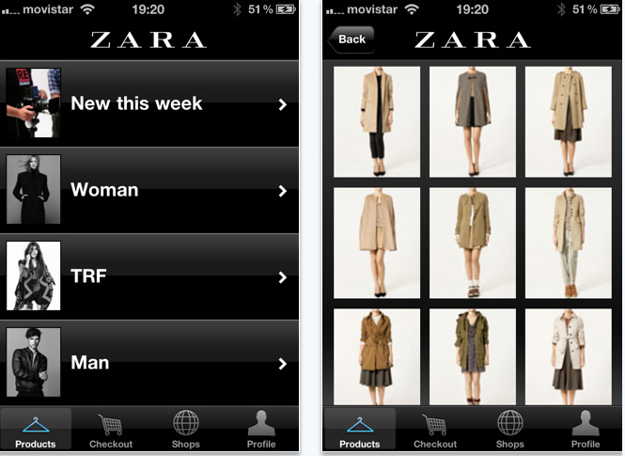
...Further Aspects
“It’s a new era in fashion – there are no rules!” (Alexander McQueen)
Improve customer experience*
Mass-Customization*
Relationship Brand ←→ Customer (Branding, use advertising)

Slide 24
WHAT COULD HAPPEN IN THE FUTURE?

Slide 25
Fast Fashion Will Become More Expensive

Slide 26
Fast Fashion Will Become More Expensive
HIGHER DEMAND 80 million garments produced 2013 (esp. US/EU) China, India etc. are following BUT: limited resources
GREATER FOCUS ON SUSTAINABILITY 2600 l water, x l chemicals for 1 t-shirt Exploitation higher production costs
CONSUMPTION TRENDS “Clean” vs. cheap 3 or 30 t-shirts per year? “Less is more”

Slide 27
WHERE WILL IT LEAD TO?

