Slide 1
Masters multiculturalism
GaBriela Leyva Ceyla Özdemir Lydia Michael Paritosh sharma

Slide 2
Table of contents
History
L'Oréal by the Numbers
Understanding their success factors
Building multicultural teams
Learning by acquiring
Innovating locally
Thinking global, communicating local
Future development
Conclusion

Slide 3
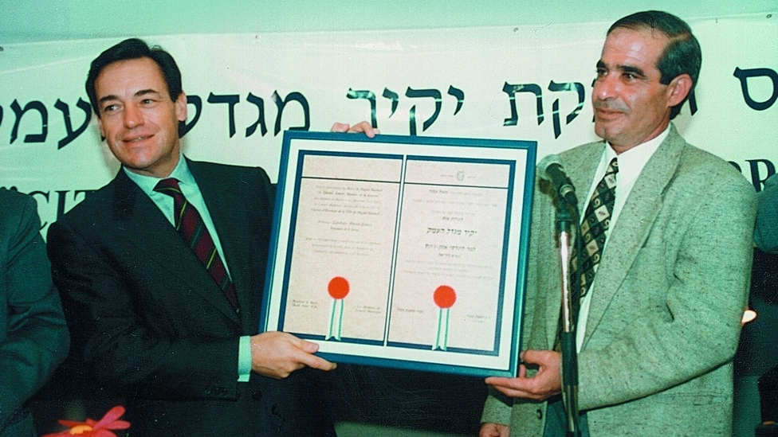
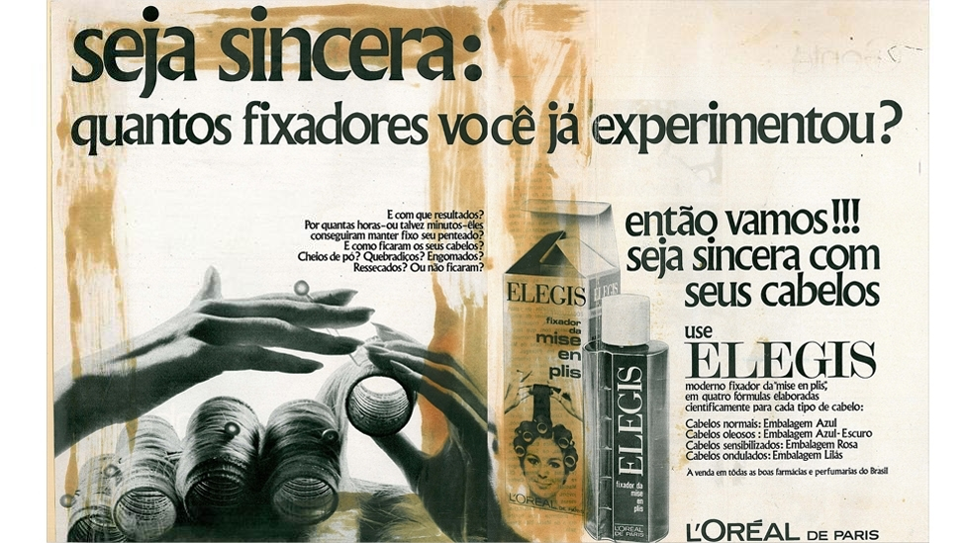
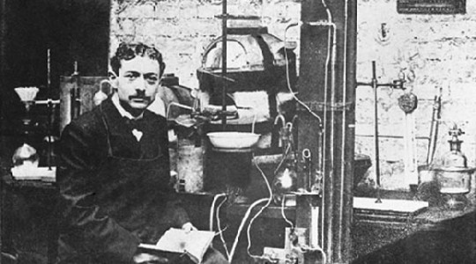
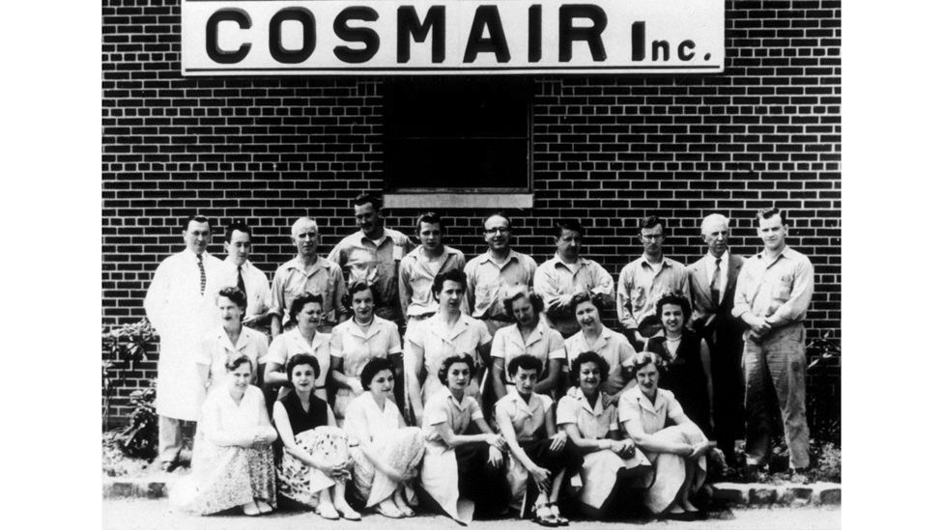
history
1984
1983
1974
1959
1954
1920
1909

Slide 4
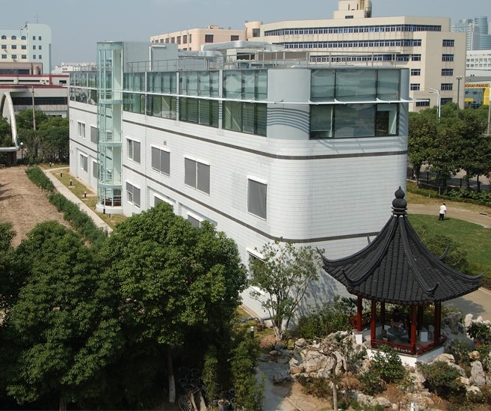
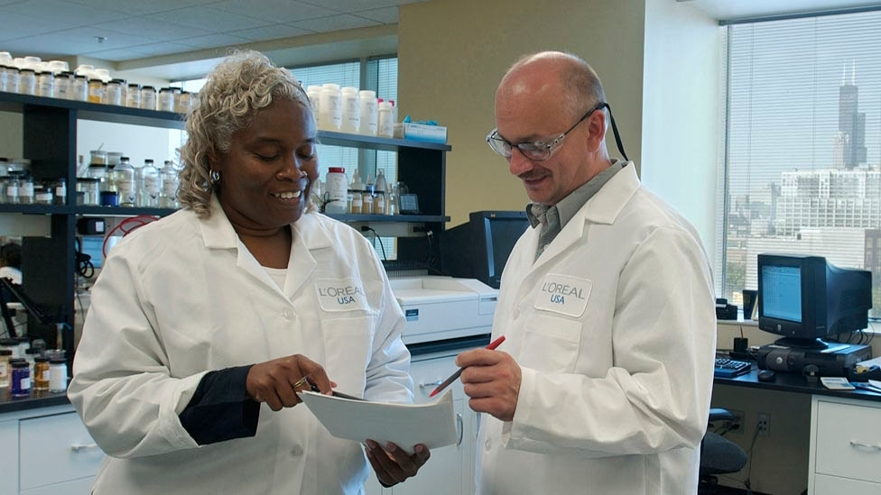
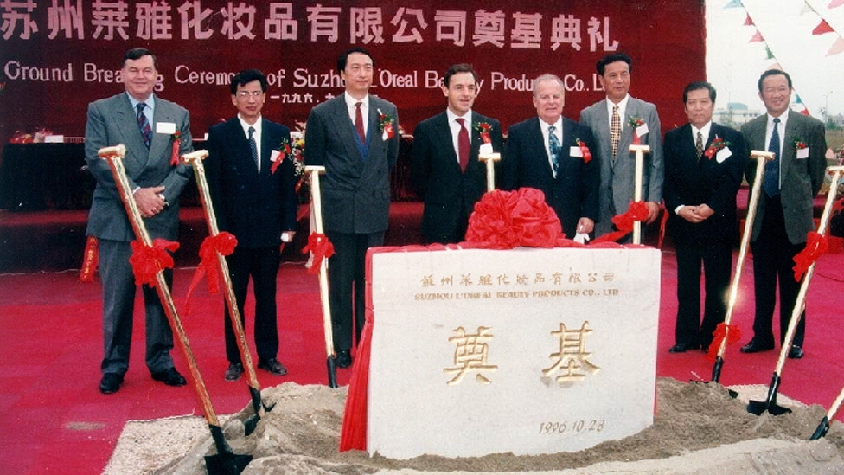
history
2011
2010
2005
2004
2004
2003
1996

Slide 5
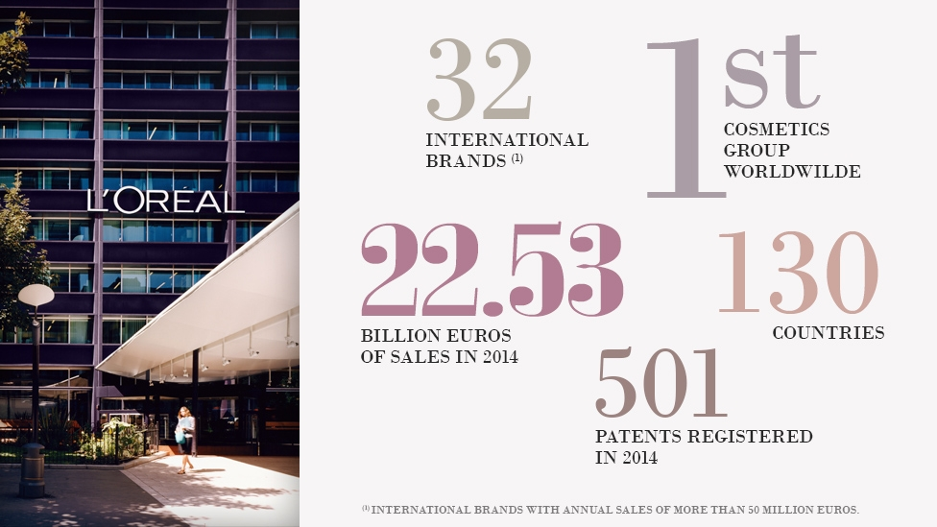
L’oréal by the numbers

Slide 6
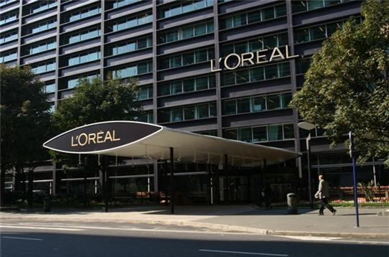
L’oréal by the numbers
78 600 Employees
156 Nationalities
59% female managers
43 Factories 71 DCs

Slide 7
L’oréal by the numbers
1/3
of board directors are not French

Slide 8
Understanding their success Factors

Slide 9
1. Building MULTICULTURAL TEAMS
Management team close to French cultural roots
Since late 90’s, focus is on multiculturalists for new- product-development teams
20% new product development per year
R&D investment of 3.5% of revenue
L’Oreal Paris has 40 product development teams (3-4 people per team that’s 50% multicultural)
→ highly successful in emerging markets

Slide 10
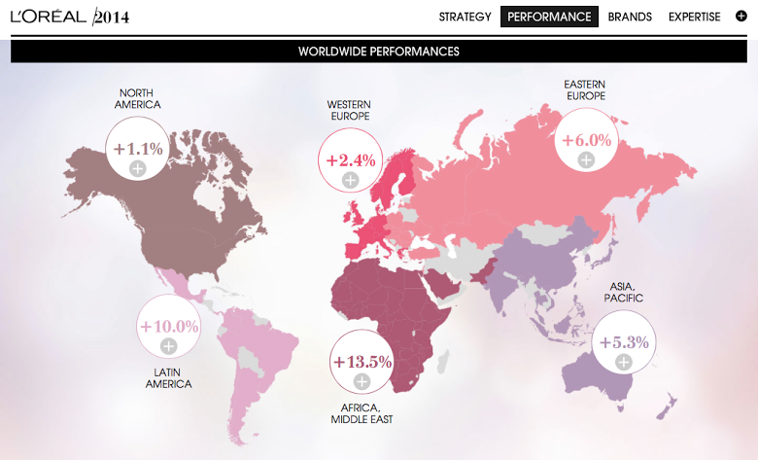
2014 WORLD PERFORMANCE

Slide 11
1. Building MULTICULTURAL TEAMS
Key is to integrate globally but also show local responsiveness by internationalizing the management team
Disruptive to add foreign senior executives or create culturally diverse teams
Hiring and tailoring of teams based on individual managers who can adapt to multiculturalism

Slide 12
1. Building MULTICULTURAL TEAMS
L’Oreal nurtures managers and positions them at the center of regions, brands and functions
Multiculturalism leads to innovation and opportunity discoveries, which leads to success

Slide 13
2. Learning by acquiring

Slide 14
2. Learning by acquiring
Not all acquisitions have global vocation
Brands with regional vocation reinforce presence in main distribution channels
http://magazine.loreal-finance.com/en/strategic-acquisitions.htm

Slide 15
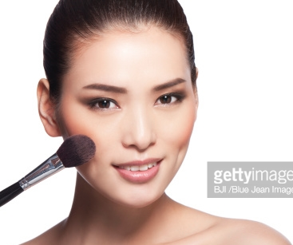
2. Learning by acquiring - china
China’s cosmetics market is the 3rd largest in the world ($25.9bn)
Expected to grow 63% to 2015 (Euromonitor)
L’Oréal was a late entrant – 1990
L’Oréal’s Internationalization strategy, and in return internationalization of Chinese brands
Consolidation in the Chinese cosmetic industry

Slide 16
2. Learning by acquiring - Examples
2003 – Acquisition of Mininurse (Raystar Cosmetics Ltd.)
2004 – Acquisition of Yue-Sai
2014 – Acquisition of Magic Holdings Ltd.

Slide 17
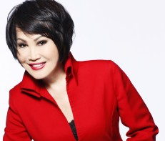
2. Learning by acquiring - examples
Mininurse | Yue-Sai
Sales value US$47 Mi in 2003 | Sales value US$47 Mi in 2003
Full range of product series | Make up brand
Extensive distribution channels | Selective distribution channel
High brand recognition rate 96% among young customers | High recognition, 11% market share in 2002
Affordable products – Mass market brand | Luxury brand
Both owners were asked to retire of the beauty industry

Slide 18
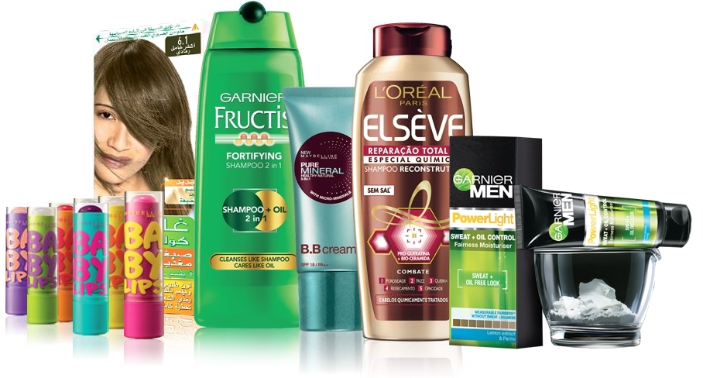
3. Innovating locally - adapting local practices

Slide 19
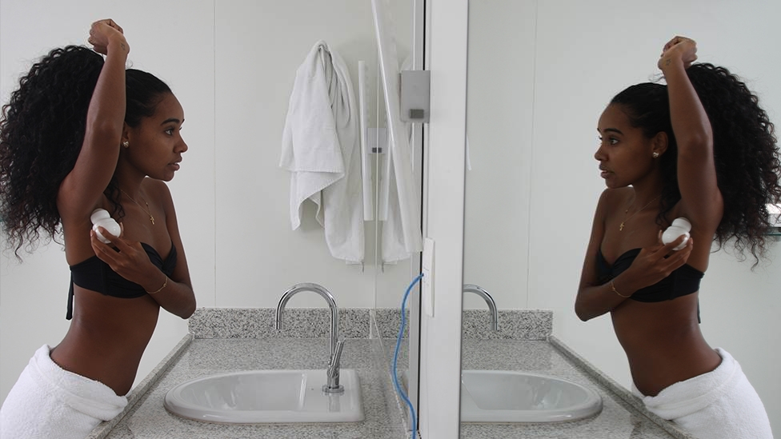
3. Innovating locally - adapting local practices
Developed a science called "geocosmetics"
“Bathroom laboratories" equipped with cameras to study consumer behavior from around the world

Slide 20
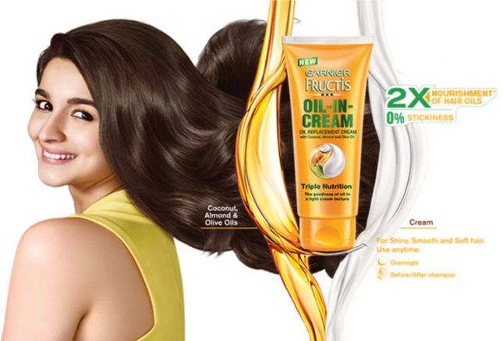
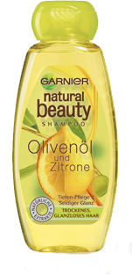
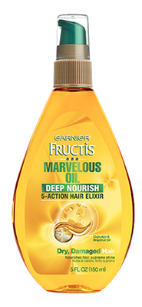
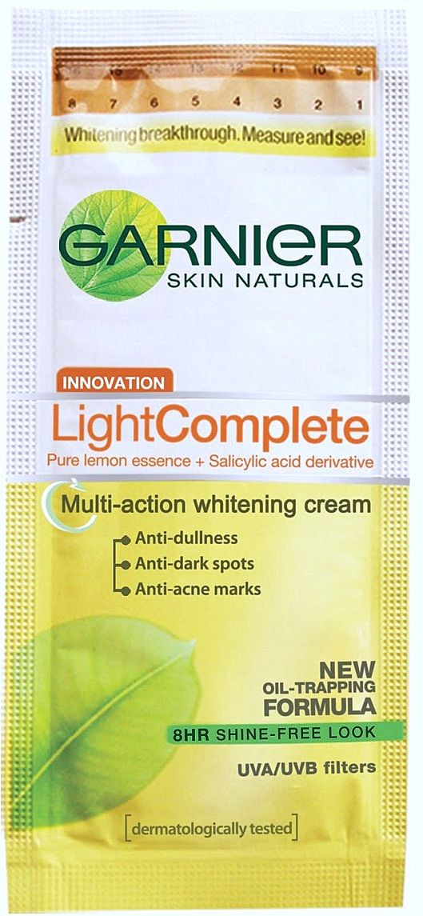
3. Innovating locally - India
India – very elaborate traditions with complex rituals
Applying oil is important for Indian women to fortify and nourish hair
Different packaging to adapt to customer’s budget

Slide 21
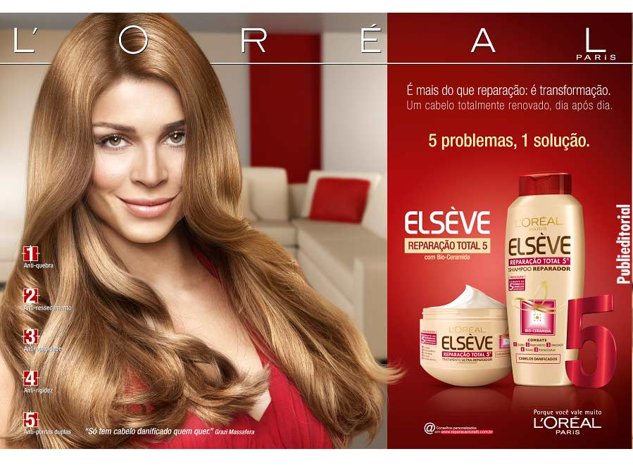
3. Innovating locally - Brazil
2007 - Had about 5% of market share
2008 - #1 product on the market
2009 - Rolled out in Latin America, Western Europe and parts of Asia

Slide 22
4. Thinking global, Communicating Local

Slide 23
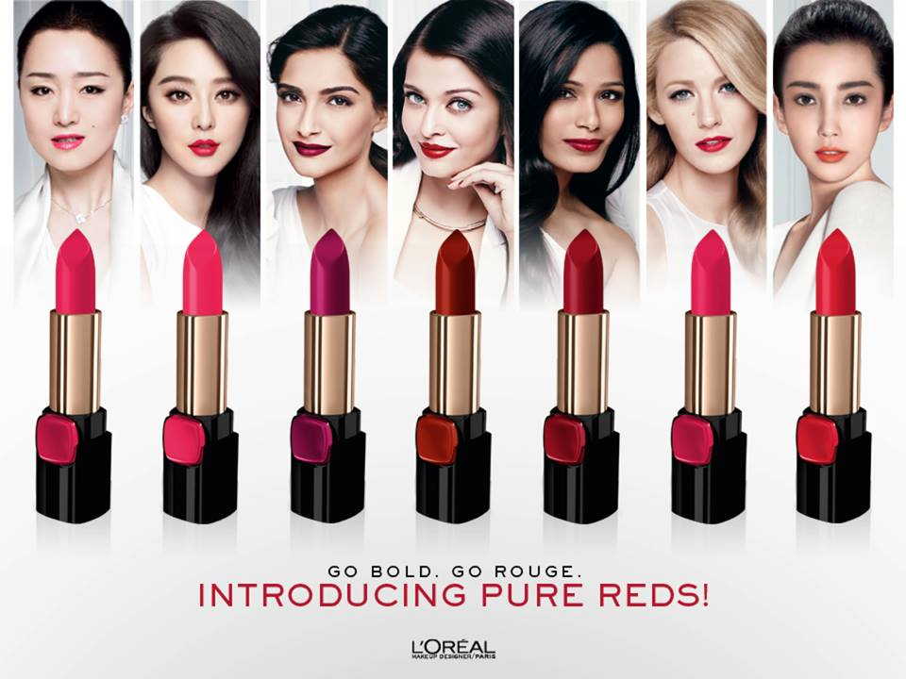
4. Thinking global, communicating local

Slide 24
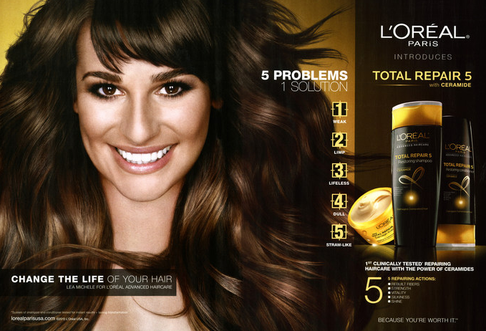
Weak
Limp
Lifeless
Dull
Straw-Like

Slide 25
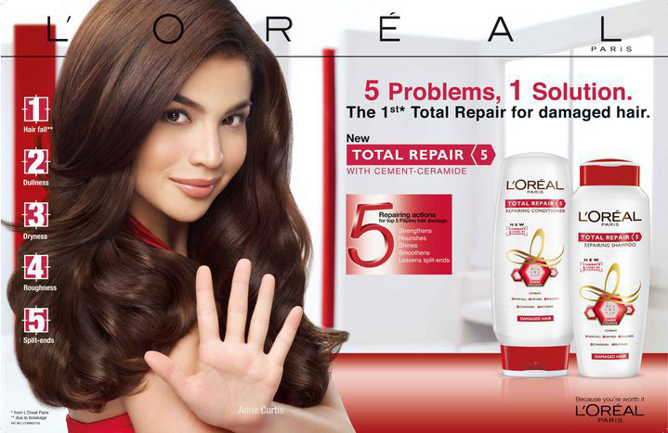
Hair Fall
Dullness
Dryness
Roughness
Split-ends

Slide 27
Future development
R&D Centre in India
African Market
Similar healthcare for employees worldwide

Slide 28
Recommendations
More approachable and relatable campaigns with less idealized beauty images
Greater participation in the organic/natural product category
Continue to invest in understanding foreign cultures and becoming a part of them
Beyond developing products and adapting them in different markets
L’Oréal has understood the business of cultural diversity and is commercializing it globally
Conclusion

Slide 29
references
Euromonitor.com, (2015). Beauty and Personal Care in China. [online] Available at: http://www.euromonitor.com/beauty-and-personal-care-in-china/report [Accessed on 18 May 2015].
Loreal.com, (2003). China: Acquisition Of Mininurse Brand - L’OréalGroup. [online] Available at: http://www.loreal.com/press-releases/china-acquisition-of-mininurse-brand.aspx?mediatype=cp&returnpage= [Accessed on 18 May 2015].

Slide 30
references
Bloomberg.com, (2004). L'Oreal Buys China's Yue-Sai Cosmetics FromCoty (Update5) - Bloomberg. [online] Available at:http://www.bloomberg.com/apps/news ?pid=newsarchive&sid=aBi4EPJZO80Q [Accessed on 18 May 2015].
Wang, Y. (2013). Magic Holdings faces takeover bid from France'sL'Oreal Group. [online] China Daily USA. Available at:http://usa.chinadaily.com.cn/business/2013-08/17/content_16901140.html [Accessed on 18 May 2015].

Slide 31
references
The Universalization of L’Oreal, (2012). [online] Harvard Business Review. Available at: https://hbr.org/product/the-universalization-of-l-oreal/513001-PDF-ENG [Accessed on 10 May 2015].
L’Oreal Masters Multiculturalism, (2013). [online] Harvard Business Review. Available at: https://hbr.org/2013/06/loreal-masters-multiculturalism [Accessed on 10 May 2015].
Loreal.com, History. [online] Available at: http://www.loreal.com/group/history.aspx [Accessed on 10 May 2015].

Slide 32
references
Forbes.com (2014); L'Oreal: Africa can be an important market to help achieve it's 2 billion user base target Part1. Available at: http://www.forbes.com/sites/greatspeculations/2014/12/26/loreal-africa-can-be-an-important-market-to-help-achieve-its-2-billion-user-base-target-part-1/ [Accessed on 14 May 2015].
Trefis.com (2013), How New Markets will Shape L'Oreals Future, [Online]. Available at: http://www.trefis.com/stock/lrlcy/articles/190251/how-new-markets-will-shape-loreals-future/2013-06-06 [Accessed on 14 May 2015].

Slide 33
references
Loreal.com, (2003). L'Oreal Announces its new sustainability commitment or 2020 sharing beauty with all, L’Oréal Group. [online] Available at: http://www.loreal.com/press-releases/loreal-announces-its-new-sustainability-commitment-for-2020-sharing-beauty-with-all.aspx[Accessed on 14 May 2015]. [Accessed on 14 May 2015].

Slide 34
Questions?

