Slide 1
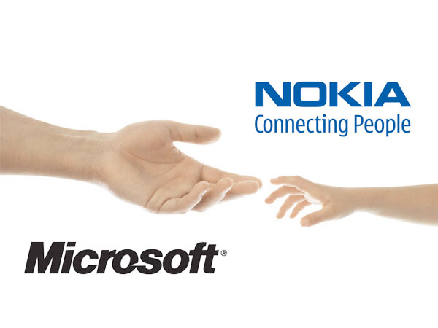
Microsoft – New Wine in an Old Bottle
Soumyashree Sarangi
Nirmal Joseph
Prithwish Sarkar
Sibi Othaloor

Slide 2
Table of Contents
Microsoft – Overview.
Nokia– Overview.
Microsoft’s Organizational Culture.
Microsoft and Nokia’s Alliance.
Role of Culture in Acquisitions.
Contrast between US and European Culture.
Impact of culture on the alliance.
Challenges before Satya Nadella and his team.
Suggestions / Conclusions.

Slide 3
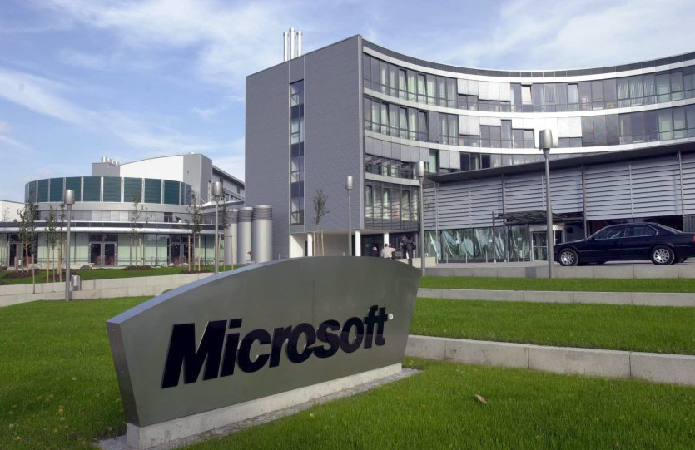
Microsoft – Overview
Head Office – Redmond, Washigton
Current CEO – Satya Nadella
Annual Revenue – Close to $87 Billion in 2014
Products portfolio
Operating System
Office Suite
Servers
Cloud Services
Entertainment Console
Web Services
Mobiles and Tablets

Slide 4
Microsoft – Timeline
1975
Microsoft is founded by Bill Gates and Paul Allen.
1978
Microsoft becomes global with its first overseas office in Japan.
1985
The first version of Windows OS is launched.
1989
Introduction of the earliest version of office suite.
2000
Bill Gates steps down and Steve Ballmer named the President and CEO.
2001
Introduction of the first gaming console, Xbox.
2012
Microsoft launches Surface.
2013
Microsoft acquires Nokia’s devices and services business.
2014
Steve Ballmer steps down and Satya Nadella named the CEO.

Slide 5
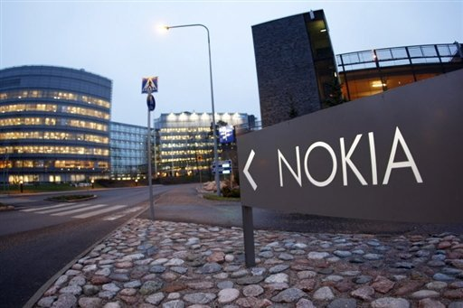
Nokia – Overview
Head Office – Espoo, Finland
Produced different type of products which included paper products, tires, rubber products, cables etc. before entering the telecommunication industry
CEO – Stephen Elop
Annual Revenue – Close to €12.7 Billion in 2013
Products portfolio
Mobiles Phones
Consumer Services
Security Services
Consumer Electronics

Slide 6
Nokia – Timeline
1871
Nokia founded by Fredrik Idestam as a wood-pulp mill.
1963
Enters into the telecommunication market with radio telephones.
1987
Launches its first handheld mobile phone, the Mobira Cityman.
1999
Nokia releases 3210, one of the most successful phones, 160 Million units sold.
2003
Nokia releases 1100, the best-selling mobile phone ever, 200 Million units sold.
2005
Nokia introduces N series smart phones on Symbian platform.
2010
Partnership with Intel and announcement of Meego initiative.
2011
Strategic partnership with Microsoft.
2012
Samsung overtakes Nokia as the world's largest maker of mobile phones.
2013
Microsoft acquires Nokia’s devices and services business.
Celebrated sales of 1 billion devices.
Nokia hires former Microsoft executive Stephen Elop as chief executive.
Decision to gradually phase-out of Symbian and Mego.

Slide 7
Microsoft’s Organizational Structure
“Stack ranking system” – Reward oriented system
Objective of the stack ranking system was to balance creativity and discipline
Disparity between “Old employees” and Newcomers
Success in the company depended on mastery of politics
Systems and procedures to analyze every facet of the organization
Teams were devised based on each type of product

Slide 8
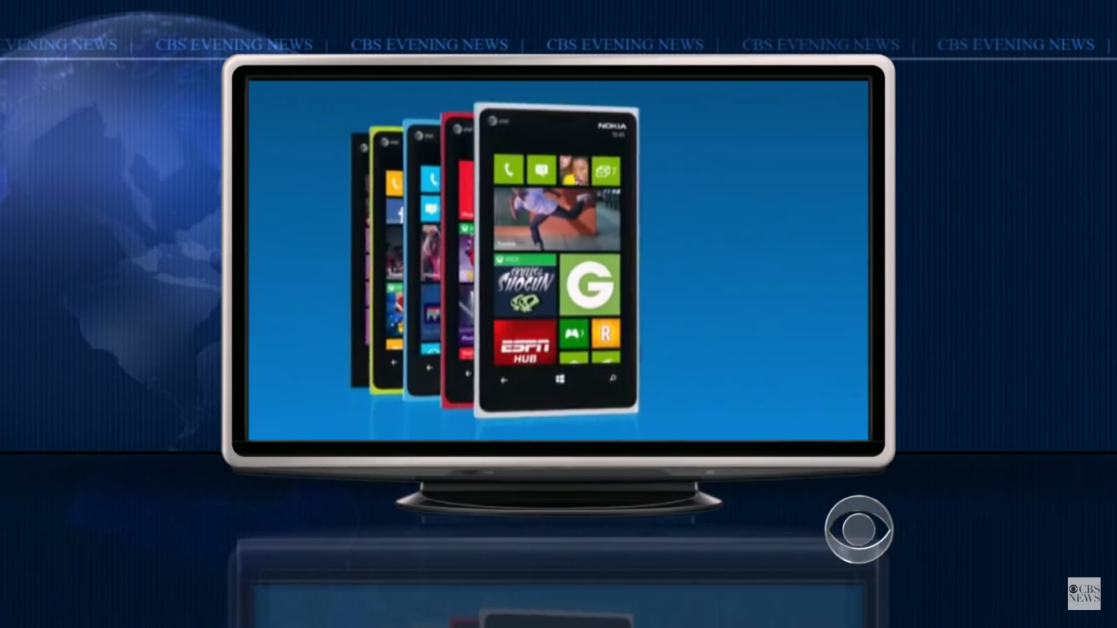
Microsoft and Nokia’s Alliance
https://www.youtube.com/watch?v=zulmzPz7ODA

Slide 9
Microsoft and Nokia’s Alliance
Why Nokia needed Microsoft ?
Nokia’s flagship product , the cell phone, was no longer a market leader
Nokia became inward looking with their own OS “Symbian”
The new CEO, Stephen Elop decided to abandon Android and phase out Symbian & Meego to focus on the Microsoft Windows platform alone
$4 billion in losses incurred by Nokia within a year

Slide 10
Microsoft and Nokia’s Alliance
Why Microsoft needed Nokia ?
Microsoft had a new vision “ Mobile first and Cloud first world”
Desktops fading out ➔Flagship products “OS and Office suite” cannot be relied on
Limited success from other ventures such as the Xbox and Azure
Very distant 3rd in the mobile market itself

Slide 11
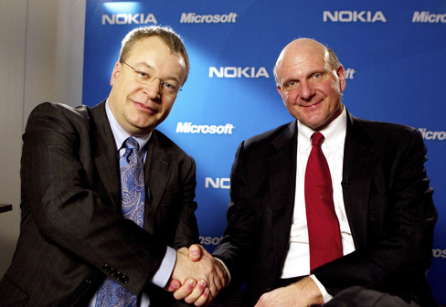
Microsoft and Nokia’s Alliance
Bottom Line
Stephen Elop positioned Nokia in such a way that the Microsoft Windows OS should be its “differentiating” factor
Microsoft’s new vision demanded a substantial shift to mobile devices
Steve Ballmer restructured the company based on functionality rather than devices

Slide 12
Analysis of Cultural Dimensions
Power Distance Index (PDI): The extent to which the less powerful members of institutions and organizations within a country expect and accept that power is distributed unequally.
Individualism versus Collectivism (IDV): The degree of interdependence a society maintains among its members.
Masculinity versus Femininity (MAS): The fundamental issue here is what motivates people, wanting to be the best (masculine) or liking what you do (feminine).

Slide 13
Analysis of Cultural Dimensions
4. Uncertainty Avoidance Index (UAI): The extent to which the members of a culture feel threatened by ambiguous or unknown situations and have created beliefs and institutions that try to avoid these.
5. Long Term Orientation versus Short Term (LTO): How every society has to maintain some links with its own past while dealing with the challenges of the present and future.
6. Indulgence versus Restraint (IND): The extent to which people try to control their desires and impulses.

Slide 14
Cultural Contrast of USA and EU
Using Hofstede’s cultural dimensions theory we take a look at how the US and EU business cultures fare.

Slide 15
Major differences in Cultural Dimensions of USA and Finland

Slide 16
Role & Impact of Cultural Dimensions on Acquisitions and Mergers
Organizational culture and social culture differences can decide the success or failure of a merger or acquisition
Impact of Social Culture
Preoccupation
“How is this going to impact me?“
Trust
Result oriented
”Short term and long term results”

Slide 17
Impact of Cultural Dimensions on Acquisitions and Mergers
How do companies adapt to cultural differences?
Cultural fit
Acculturation
Social Constructive
What is happening in this acquisition ?
Acculturation in Microsoft – Nokia
Stephen Elop – “Trojan Horse”
Microsoft reorganization - a plan to easily integrate Nokia.

Slide 18
Impact of Cultural Dimensions on Acquisitions and Mergers
https://www.youtube.com/watch?v=VekycJYSYZA

Slide 19
Challenges before Satya Nadella and his team
Verify whether Balmer’s reorganization tactic is in line with the company’s vision
Understanding and handling Nokia employees’ – Legal and Culture
Handling layoffs and pay cuts
Handling relationship with previous “partners”
To make the Windows ecosystem more appreciable to developers
Integration with Nokia increased the complexity of cultural change Microsoft was aiming for

Slide 20
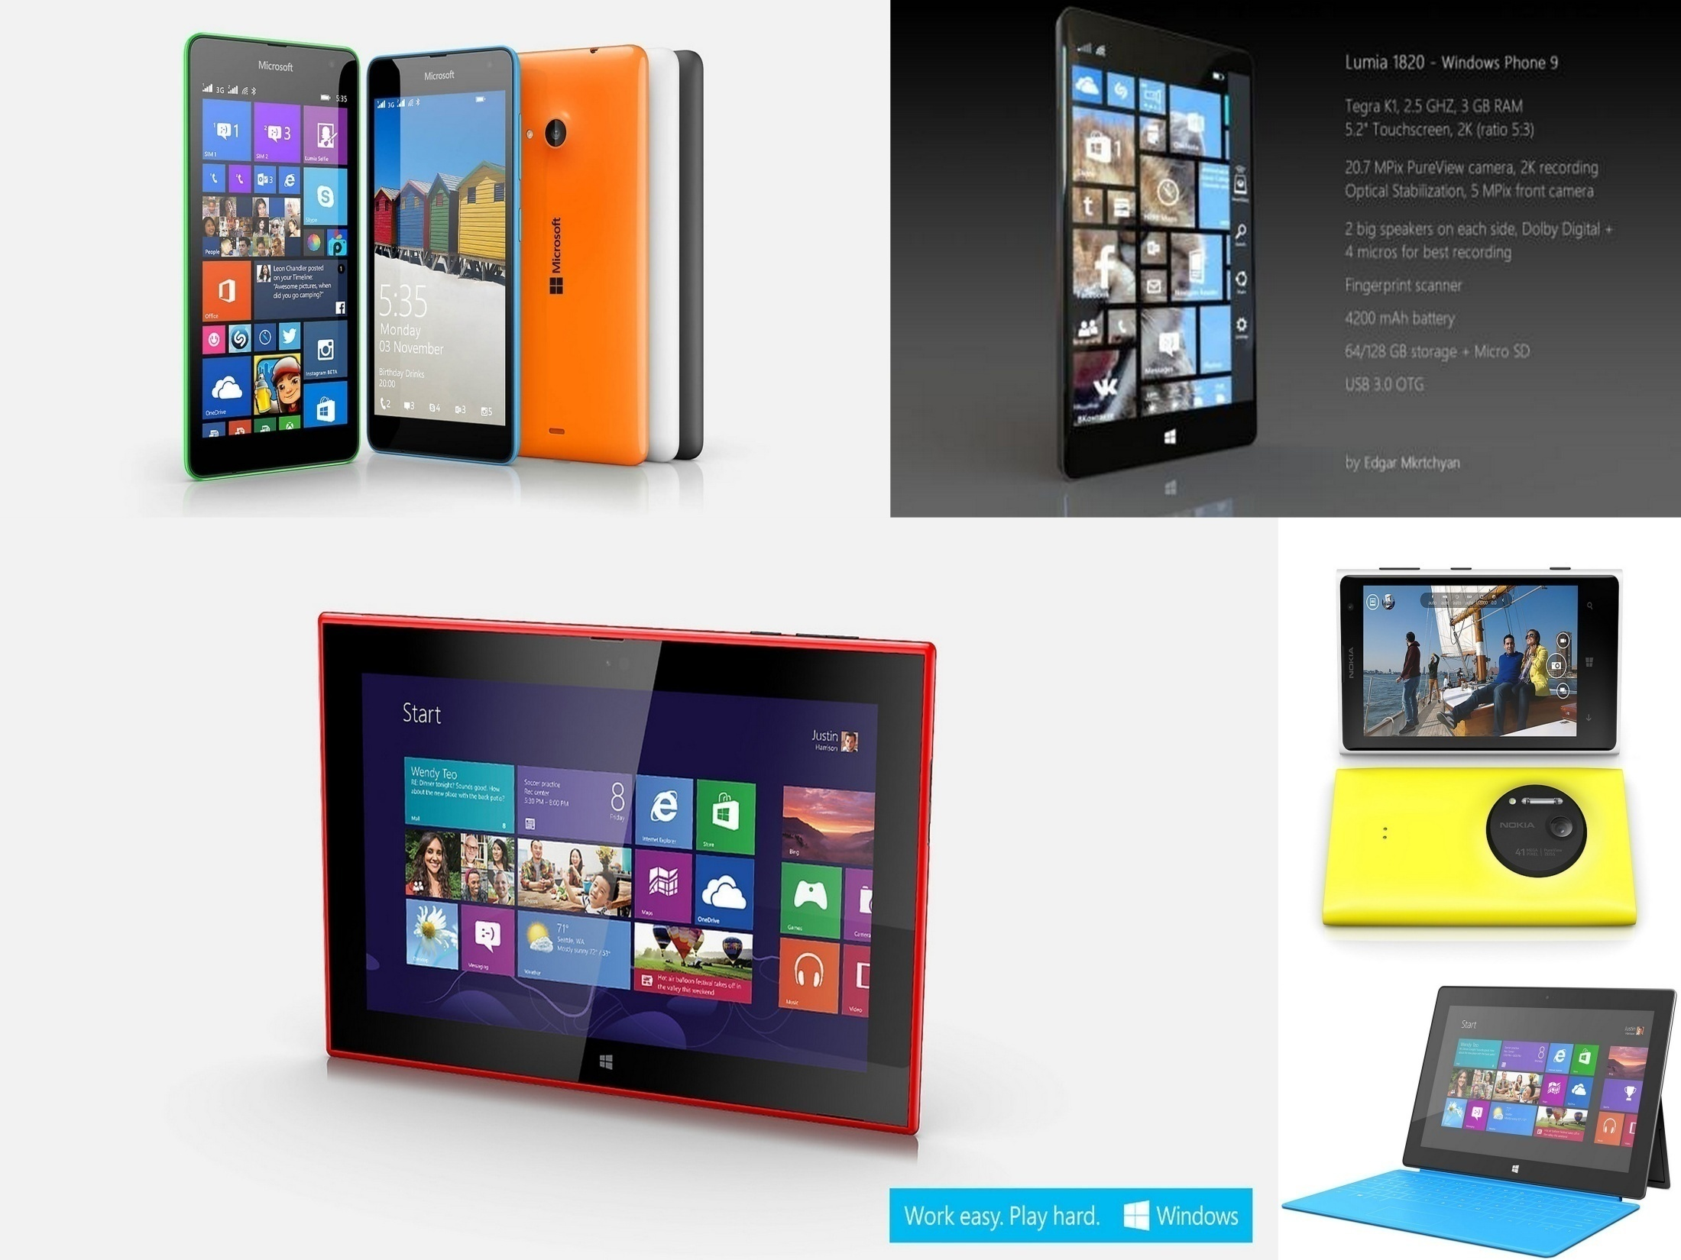
Lumia 535
Lumia 1820
Lumia 1020
Microsoft Surface
Lumia 2520 - Tablet

Slide 21
Conclusion
Nokia’s strategy to focus on the Windows platform was good but not handled well due to cross cultural misunderstandings.
Microsoft’s reorganized structure, strategy and culture provides a good start for the road to recovery.
Even though seamless cultural integration is necessary, Microsoft’s focus should be mainly on innovation
Culture should be placed at the heart of integration strategies

Slide 22
References
http://www.telegraph.co.uk/technology/nokia/10282657/Nokia-a-timeline-in-pictures.html

