Slide 1
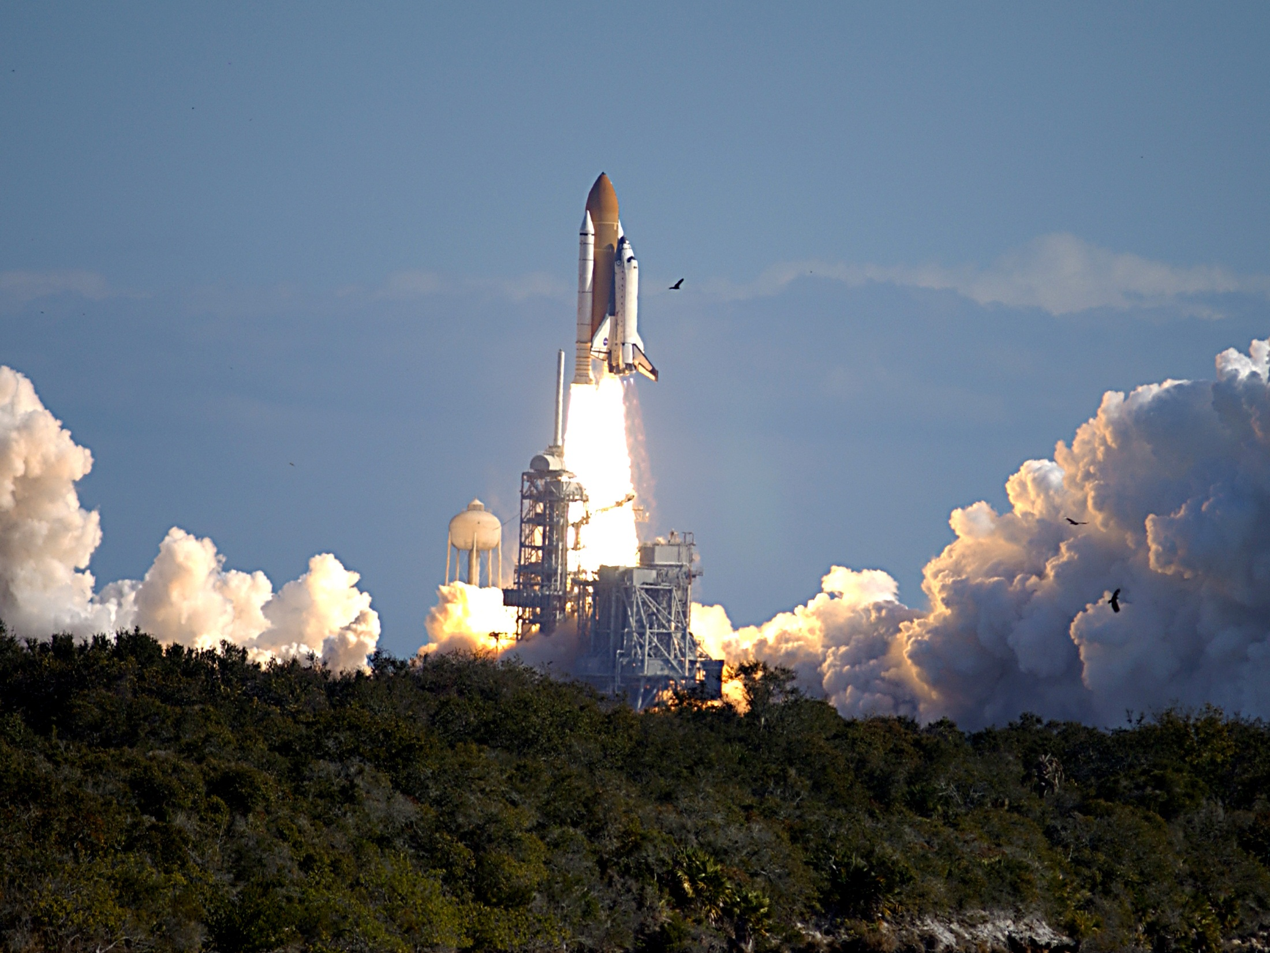
Columbia’s
Final
Mission
Evan Hahn
Brian Painting
March 26, 2011

Slide 2
Documentary

Slide 3
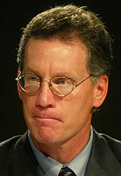
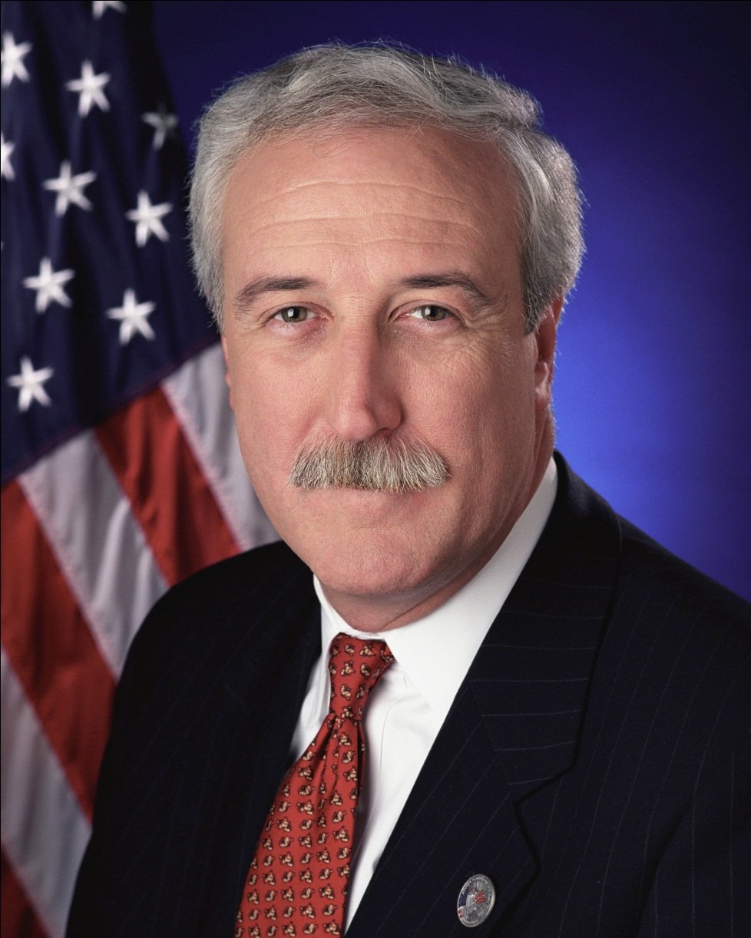
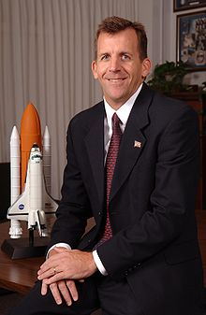
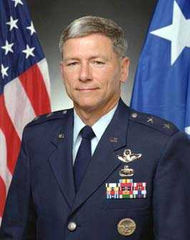
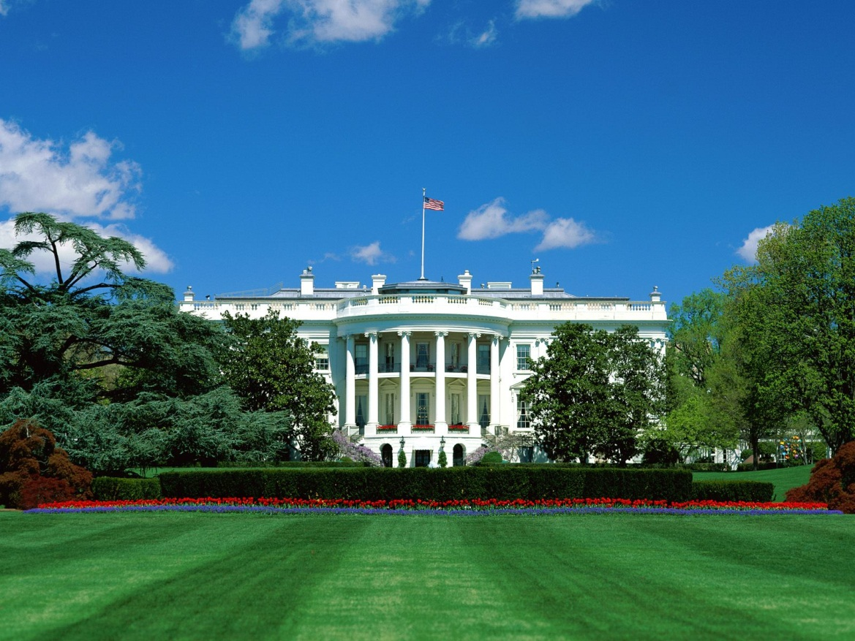
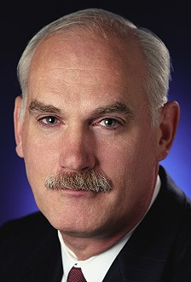
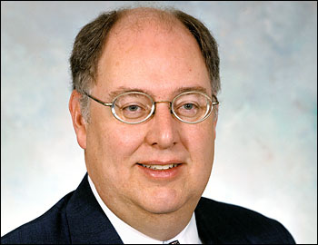
Columbia – Who’s to blame?
Michael Kostelnik
Leroy Cain
Ron Dittemore
William Readdy
Sean O’Keefe – NASA Administrator 2001 - 2005
Linda Ham
Wayne Hale

Slide 4
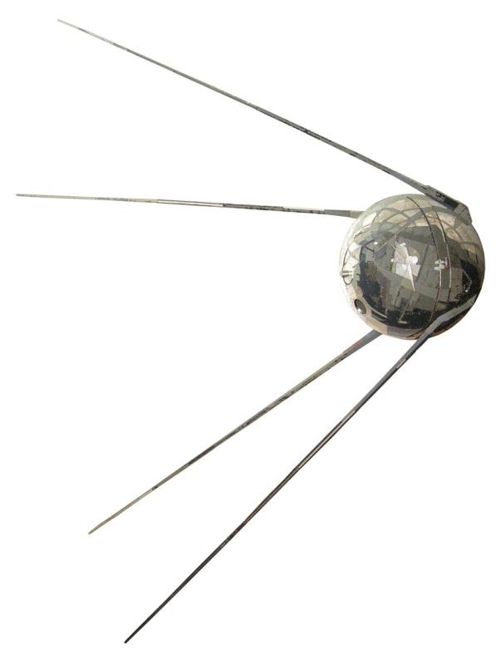
NASA – The Beginning
Cold War
“Sputnik Crisis”
Space Race
October 1958 NASA is formed
Commitment from Congress
Clear, established and supported goal

Slide 5
NASA – The Beginning
Project Mercury
Tasks: Can man survive in space?
Results: Alan Shepherd’s flight
Project Gemini
Tasks: Further research for lunar missions
Results: Groundwork established for future space travel

Slide 6
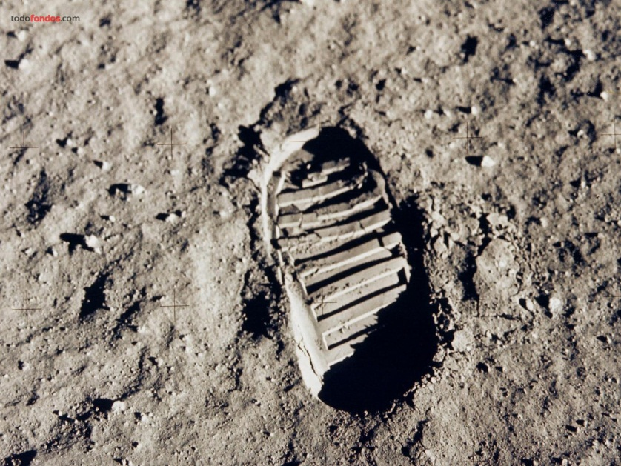
NASA – The Beginning
May 1961 – President John F. Kennedy
"First, I believe that this nation should commit itself to achieving the goal, before this decade is out, of landing a man on the Moon and returning him safely to the earth.”
“That’s one small step for man, one giant leap for mankind” - Neil Armstrong, July 20, 1969

Slide 7
Apollo 13 “The Successful Failure”
Launch April 11, 1970
Explosion onboard 2 days after launch
Mission to walk on the moon aborted
Primary goal – Return the crew home safely
“Tiger Team” established at Mission Control
April 17, 1970 – Safe return to Earth

Slide 8
Post Apollo – What now?
NASA’s Vision
Orbiting outpost for 12 by 1975
Reusable Space Craft
Increasingly Larger Outposts
Other stations in orbit around Earth and Moon
Land based lunar outpost
Manned Mars Exploration

Slide 9
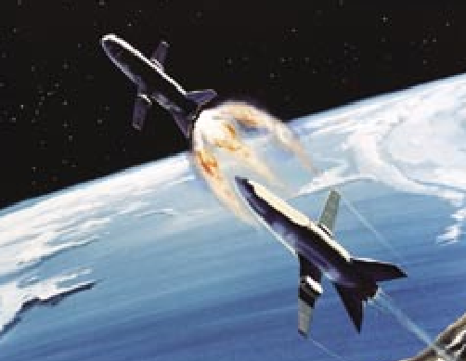
NASA’S Vision - NTCP
Technology
Super-high-tech
High-tech
Medium-tech
Array
Assembly
System
Low-tech
Complexity
Novelty
Regular
Platform
Derivative
Breakthrough
Fast/Competitive
Time-critical
Blitz
Pace
Image courtesy of CAIB

Slide 10
Evolution of the Space Shuttle
Initial Ambitions
Lack of Federal Support
Revised Objectives
Proposed two-stage vehicle to access space stations
Reliable and safe as commercial airliner
Fully reusable to keep operational costs low
Congress denies funding, domestic issues taking budgetary priority
NASA’s vision of interplanetary exploration not shared
Desire to minimize NASA budget following costly Apollo program
Continuation of human spaceflight on economic grounds
Meet public and private sector demands
Make low-earth orbit “routine”

Slide 11
Shuttle Design
Solid Rocket Boosters
No Escape System
Developing Culture of Complacency and False Confidence
“…fully operational, ready to provide economical and routine access to space…”
– President Reagan
Notes:
- Delta wings for military requirements, brand new technology
370kms of wiring, 2.5 million parts. 24,305 tiles glued by hand.
61m tall, over 2 million kilos, 90% fuel.
- Reagan speech after 4th launch, many engineers felt vehicle was still in developmental stage

Slide 12
Selling the Concept
 | 1975 Estimates pitched to Congress | Status as of 1985
Cost per flight | $7.7 million | $140 million
Turn-around Time | 10 days | 67 days
Missions per Year | 50 | 24 Total (’81-’85)
Total Missions per vehicle | 100 | 39 - Discovery
Notes:
Missing Targets, need for positive PR
Continued to get funding despite missed targets, reinforced bad habits

Slide 13
Challenger
“It had become for them an acceptable risk, and it was something that was normal, not deviant, to them” – Diane Vaughan
Notes:
Generally referring to NASA’s self-assuring organizational culture
Issue downgraded prior to launch
“Prove to me that it’s right” , O-Ring

Slide 14
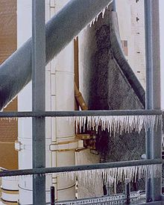
Decision to Launch
Political Pressure/ Scheduling
Morton/Thiokol engineers warn of O-Ring vulnerability to cold temperatures (<40 F)
Contractor and NASA agree to launch, O-Rings deemed an “acceptable flight risk”. Senior flight management not aware
Notes:
- Re-design of O-Rings was currently underway, shuttle program not grounded.
- “Acceptable flight risk”
- Likened to an “airliner continuing to fly although its wing is about to fall off”

Slide 15
Rogers Commission
“Perfect Place” Culture of past success
Optimistic Confidence based on past success
Tightening Budget, increasingly bureaucratic
Ineffective Communication, Safety Oversight
Successful mission, reinforces habits and practices
Notes:
- The approval process of the Shuttle program produced unreasonable expectations, even myths, about the Shuttleʼs future performance that NASA tried futilely to fulfill as the Shuttle became “operational” in 1982.
- A contractor had to prove that it was not safe to launch, rather than proving it was safe

Slide 16
Addressing the Issues
Review of Shuttle Program Structure. Project managers felt more accountable to their center management than to the Shuttle program organization.
Shuttle Program moved to NASA HQ in Washington to create management structure eliminating communication issues between individual space centers and contractors
NASA must establish a flight rate that is consistent with its resources, not what it promised it could do
Notes:
- Cancellation of Defense Contracts
- Still in “R&D Phase”

Slide 17
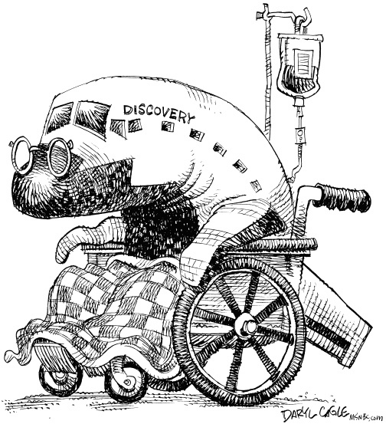
The 90’s – Lack of Commitment
Aging Shuttle Fleet
Launch Schedule Pressure
High Maintenance Costs
Declining Contractor Support
Declining Congressional Support
Deteriorating Infrastructure

Slide 18
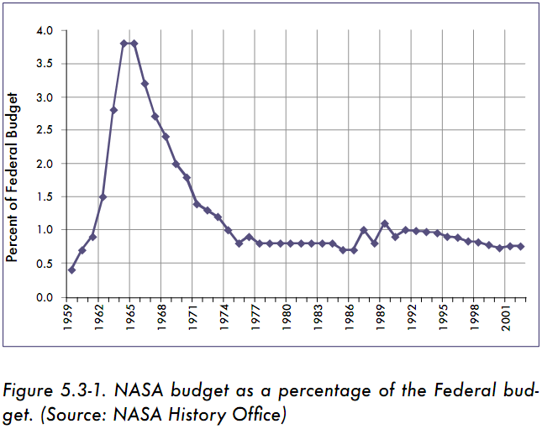
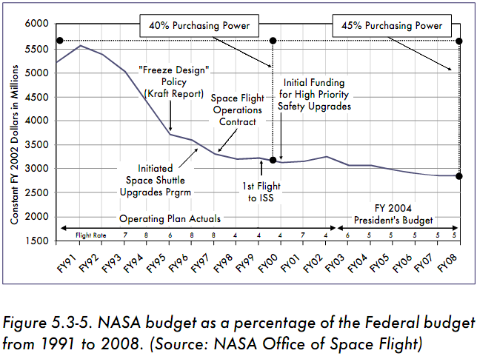
The 90’s – Lack of Commitment
Source: CAIB

Slide 19
The 90’s – Lack of Commitment
1990 White House chartered “Augustine Review”
Response to recent issues
10% increase in annual budget through 2000 →
$40 billion in 2000
Actual budget in 2000: $13.6 billion
“NASA is currently over committed in terms of program obligations relative to resources available–in short, it is trying to do too much, and allowing too little margin for the unexpected.” – Augustine Review, 1990

Slide 20
The 90’s – Times of Change
New NASA Administrator – Daniel S. Goldin
“space exploration (manned and unmanned) as NASAʼs principal purpose with Mars as a destiny”
New Management style – Never proven in a government agency
Checks and balances → unnecessary!
High personal, individual responsibility
“faster, better, cheaper” became motto of the 90’s
“When I ask for the budget to be cut, I'm told it's going to impact safety on the Space Shuttle … I think that's a bunch of crap.”
Daniel S. Goldin

Slide 21
Faster, better, cheaper…
Committed to existing Projects
High resistance to closing Locations
Space Shuttle

Slide 22
Faster, better, cheaper…
NASA Shuttle Employment
4,031 in 1991
2,959 in 1994
2,195 in 1997
Contractor Shuttle Employment
28,394 in 1991
22,387 in 1994
17,281 in 1997

Slide 23
Kraft Report vs. NASA
Kraft Report
“mature & reliable system”
Contractor management style possible
NASA Aerospace Safety Advisory Panel
Can never be treated as a mature system
Report “dismisses concerns of many credible sources”
Current problems → too many contractors
consolidate under a single business entity
should freeze current shuttle design
“restructure and reduce the overall Safety, Reliability and Quality Assurance elements – without reducing safety”
Some opinions were labeled as a “safety shield”
Prompted KSC Senior Engineer to write a letter to President Clinton
Biggest threat to safety of crew is “currently underway”

Slide 24
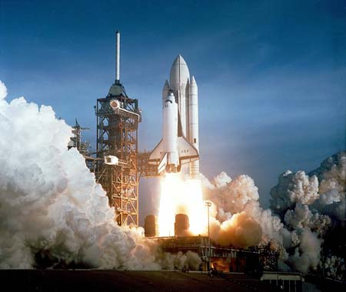
Space Shuttle Columbia
First Shuttle launched into Orbit (12.04.1981)
27 successful missions prior to 2003
Only Shuttle Orbiter not designed to dock with ISS
Notes:
Named after famous early-American fur-trading ship
Tailored for scientific missions and satellite launches, heaviest orbiter, workhorse of the fleet
Hangar Queen, Tough to launch, easy to fly

Slide 25
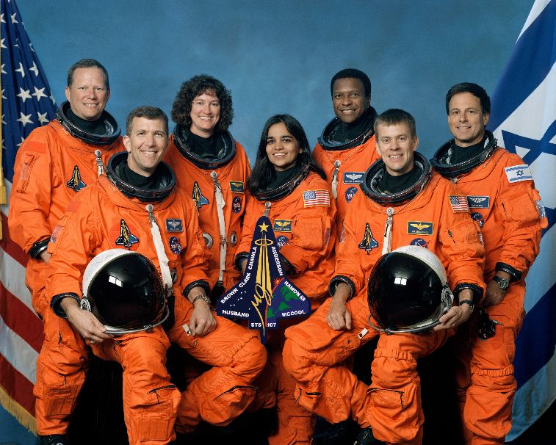
Columbia STS-107
Notes:
No price on human lives. Safety trumps all other considerations

Slide 26
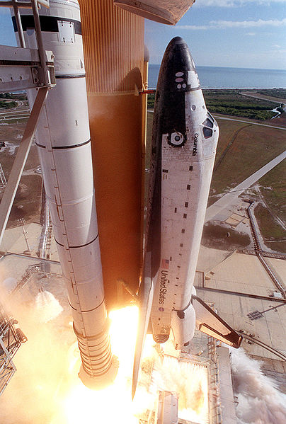
The Accident
Foam Strike 83 seconds after launch
Flawed investigation into severity of foam impact
Shuttle Breaks up upon re-entry into atmosphere
Notes:
Foam strikes leading edge of wing
Foam insulation sprayed to protect against ice from condensation
Insufficient camera angles
Hot atmospheric gasses tear through wing and fuselage of orbiter travelling at several times the speed of sound

Slide 27
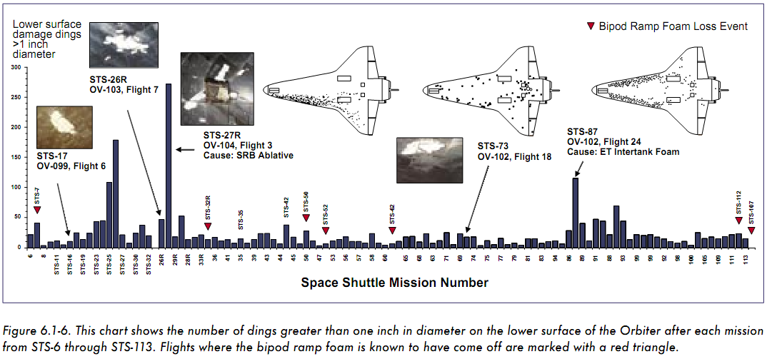
Foam Shedding History

Slide 28
Predetermined Seriousness
In Family
Out of Family
Accepted Risk
No Safety-of-Flight Issue
“More troubling, the pressure of maintaining the flight schedule created a management atmosphere that increasingly accepted less-than-specification performance of various components and systems, on the grounds that such deviations had not interfered with the success of previous flights.”
Continuous successful missions reduced criticality of issue to “In-Family”
“Expected” soon became “Accepted”
Notes:
65 of 79 flights with imagery showed foam loss
Rogers report expressed concern

Slide 29
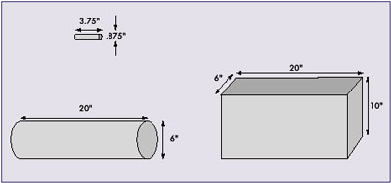
Damage Assessment
“By the eve of the Columbia accident, institutional practices that were in effect at the time of the Challenger accident – such as inadequate concern over deviations from expected performance, a silent safety program, and schedule pressure – had returned to NASA.”
Notes:
Inadequate Crater program suggests no issue exists, debris was 600x larger than program was designed to analyze

Slide 30
Debris Assessment Team
Initially classified as “Out- of-Family”
Managers logged issue as “low concern”
Ad-hoc DAT put together instead of Tiger Team
No direct communication between DAT and Mission Management
Vertical operation hindered information exchange
Requested further imagery to determine location of foam strike
Notes:
Combination of engineers from both NASA and USA

Slide 31
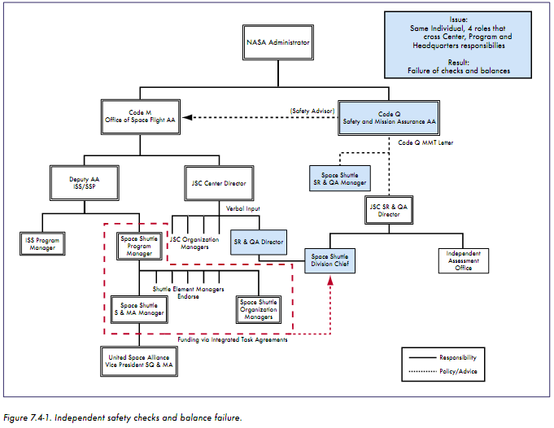
“The detached nature of the support provided by the Space Shuttle Division Chief … confuses lines of authority, responsibility, and accountability in a manner that almost defies explanation.”

Slide 32
Flawed Safety Culture
Foam loss, shouldn’t be an issue
Known issue, “let us know if it’s worse than normal”
Criticality of Issue Expressed to Superiors
“Organizations that deal with high-risk operations must always have a healthy fear of failure – operations must be proved safe, rather than the other way around. NASA inverted this burden of proof.”
Notes:
Top managers missing key information, unable to look down the ladder to determine seriousness of inquiry

Slide 33
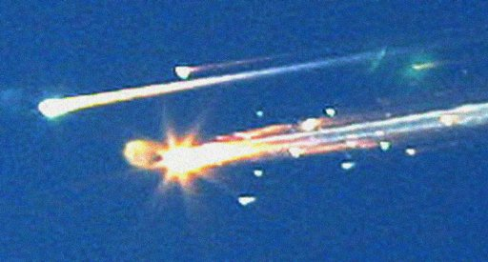
“Absolutely No Concern”
DAT requests further imagery, supervisors make informal request
Manager is notified of image requests, cannot trace origin, cancels requests
Crew of Columbia notified, emphasis on mildness of issue
DAT goes to the top, concerns acknowledged and dropped
No further mention of foam after flight day 8
Notes:
Timeline of events

Slide 34
Successful Safety Culture

Slide 35
NASA’s Safety Track Record
As a close observer of NASAʼs organizational culture has observed, “Cultural norms tend to be fairly resilient … The norms bounce back into shape after being stretched or bent. Beliefs held in common throughout the organization resist alteration.”

Slide 36
CAIB Recommendations
Office of Safety and Mission Assurance should have direct line authority over the entire Space Shuttle Program safety organization
Adopt and maintain a Shuttle flight schedule that is consistent with available resources.
Implement an expanded training program in which the Mission Management Team faces potential crew and vehicle safety contingencies beyond launch and ascent.
Initiate an aggressive program to eliminate all External Tank Thermal Protection System debris-shedding at the source and increase the Orbiterʼs ability to sustain minor debris damage
Improve imaging capabilities for inspection on launch and while on-orbit

Slide 37
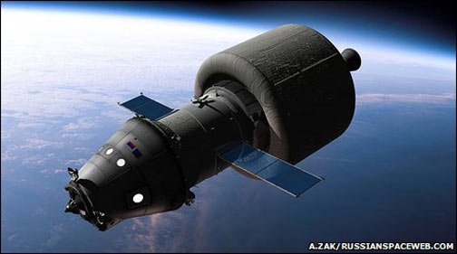
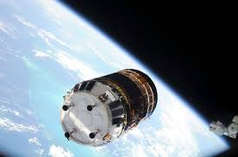
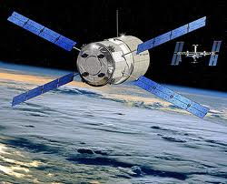
Post Space Shuttle – What’s Next?
Manned space flight to ISS:
Shuttle (1 to 2 more missions)
Russian Soyuz vehicle
Resupply the ISS
Russian Progress vehicle
Japanese HTV
European ATV

Slide 38
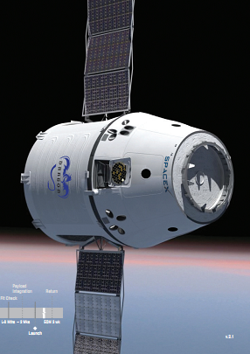
Post Space Shuttle – What’s Next?
Dragon
Falcon 9
Images courtesy of SpaceX

Slide 39
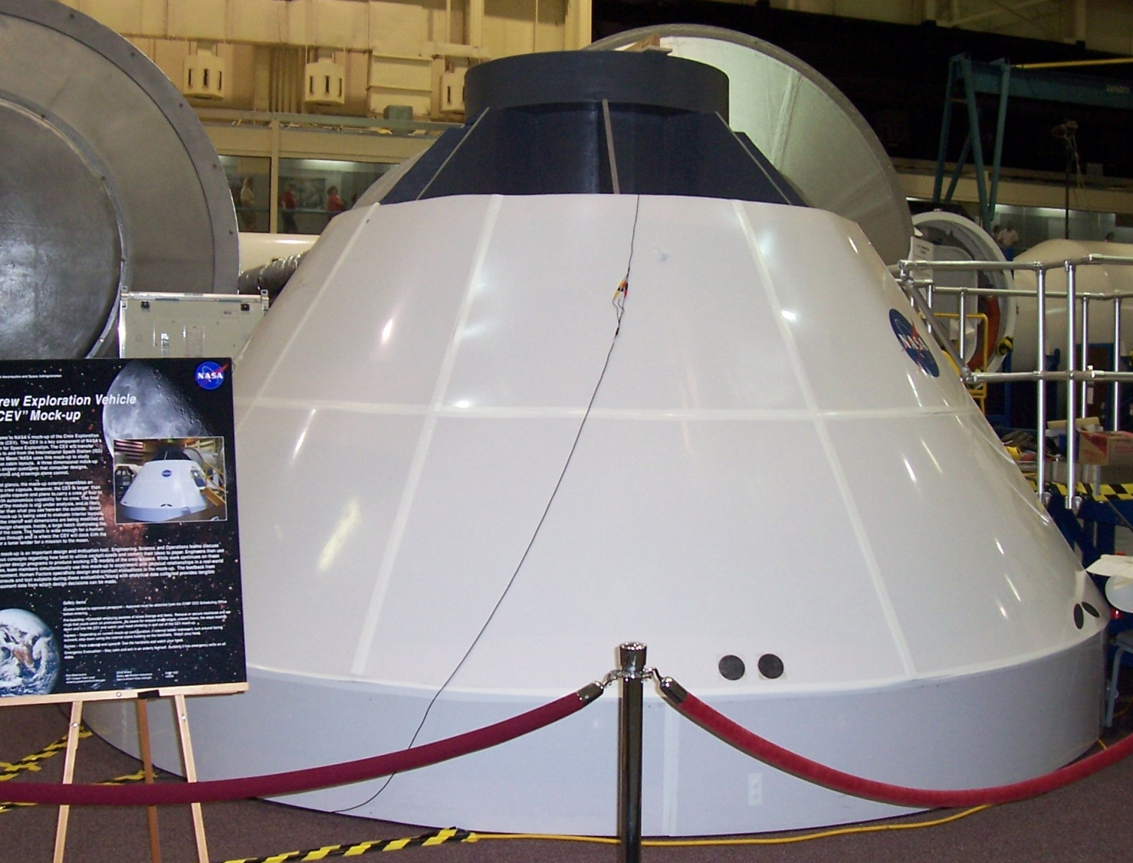
The Future of NASA
June 2006 Houston visit
“Constellation” Program
Crew Exploration Vehicle (CEV)

Slide 40
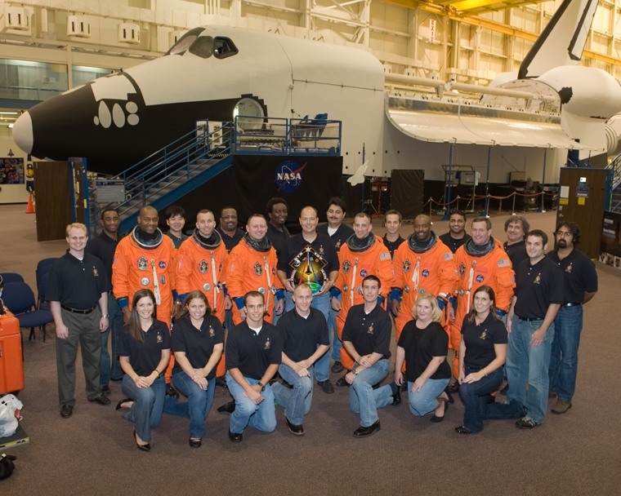
The Future of NASA
Question: What's the future of manned space flight? What is the story with the Constellation program and CEV?
“The big picture here is that with the Augustine Review a couple of years ago it was revealed that there legitimately were a lot of problems happening with the Constellation program. The program and goals themselves were good, but there were many times where the original budget for the program would be cut but the goals of the program were not decreased. This meant that in the end we were attempting to accomplish a lot of ground-breaking work on not nearly enough money and with not nearly enough time.”
-Kristen Painting

Slide 41
The Future of NASA
Development of “exploration systems”
Not going back to the Moon
Focus on R&D for future vehicles and travel
Goal: Development and proof of concept first
NASA is “enabler of manned spaceflight”

Slide 42
Shuttle Program – Another Successful Failure?
Lack of defined goals throughout lifetime
Different outlooks for Shuttle Program
Change of management styles
Non-supportive work culture
Tight budget constraints

Slide 43
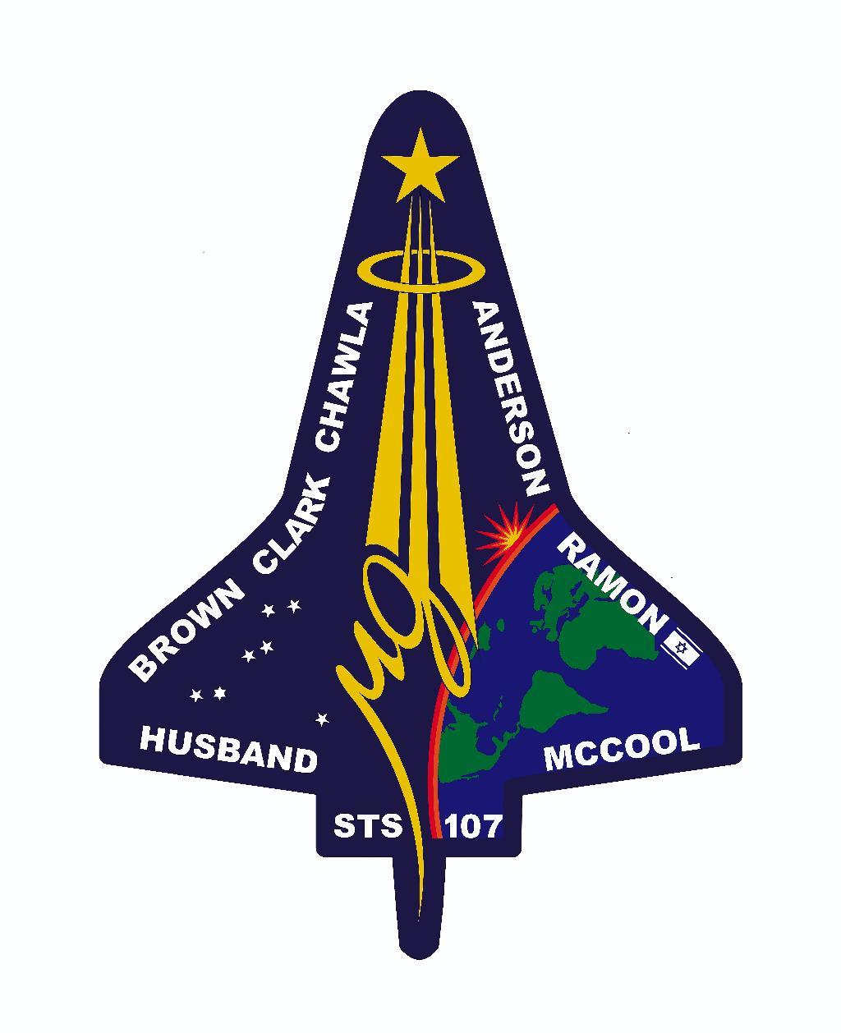
Acknowledgements
Christopher Feng
Space Shuttle Mechanical Systems Flight Controller; NASA Johnson Space Center
Kristen Painting
Instructor for ISS crew and flight controllers;
NASA Johnson Space Center

