Slide 1
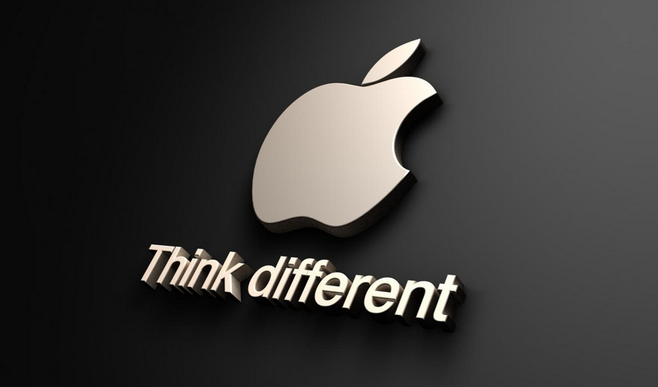
Strategy Apple Inc.

Slide 2
Strategy development
The core competences are quality and innovation
Apple is the worldwide innovation leader for consumer electronics, computer software and computer services
→ computer, smartphones, tablets, apple store, etc.
Being the most innovative company in this industry, paired with a leading and improving quality justifies Apple’s success

Slide 3
Advantage against competitors
Being innovative in IT/consumer electronics means a lot of financial input in research and development
A lot of companies aren’t able to finance the whole costs a new innovation involves
Examples are research and development labs and new factories which can produce components in a good quality and a high amount in a short time
It’s often easier for the competitors to wait until Apple presents a new innovation they can copy

Slide 4
Advantage against competitors
The big companies that are able to finance this big innovation process have another big disadvantage against Apple
Apple uses its capital to pay the costs for a new factory and secures therefore exclusive rights on the produced goods for about 6-36 months, which are ages in this dynamic industry
After this period Apple has still some reductions on the costs
That means Apple has the guarantee to get the best components for their products a long time before other companies get it
Afterwards when the components are buyable for all they still have reductions that decrease the costs

Slide 5
USP Apple
Apple never marketed their USP (“We provide a lifestyle with our products”) or communicated this USP with expensive advertisements; instead they provided the unique selling proposition with their products (iPod, iPhone, iPad), that really spoke for themselves and offered unique characteristics that similar and comparable products of competitors (if existent) did not offer at the time of market introduction. The only time Apple communicated a company motto (which was just remotely an USP) was in 1997 for Apple Computers with their ad campaign “Think Different”.

Slide 6
„Think different“
The core of Apple’s strategy is that they don’t even want to have a direct comparison to competitors. They want to be unique in what they do. And that is why they always refer to their core values; to be different and to change the world to something better. So “think different” got to the central idea of the company. It honors people who changed something by thinking different than everybody else. That’s the core value and the center of every process and every corporate goal.

Slide 7
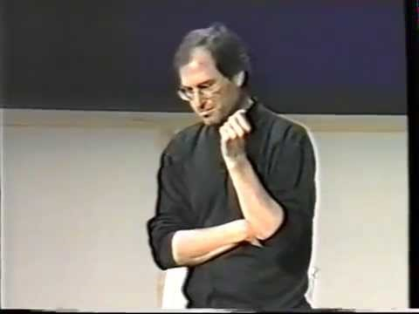
„Think different“ speech, Steve Jobs
https://www.youtube.com/watch?v=9GMQhOm-Dqo

Slide 8
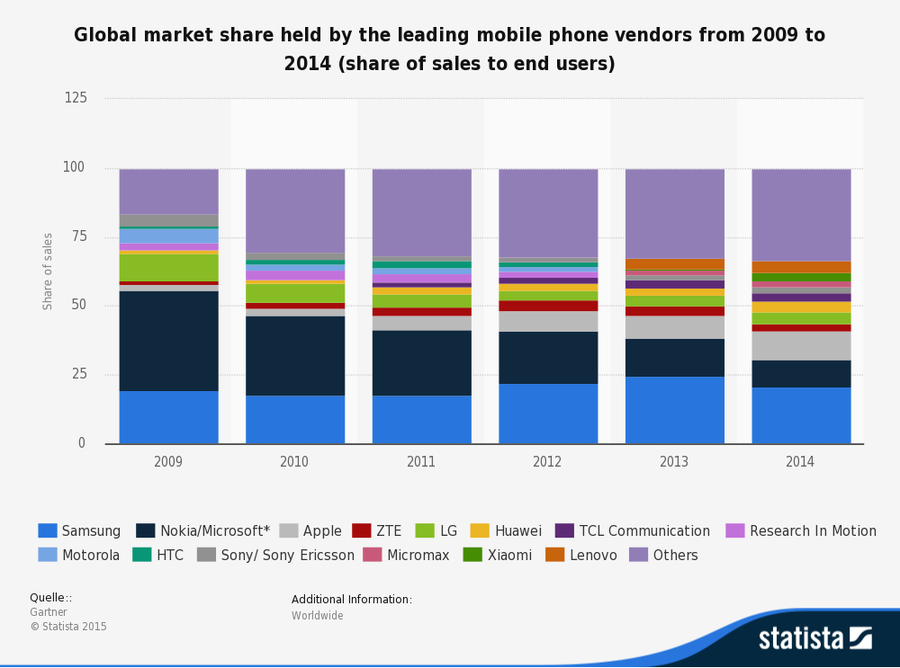

Slide 9
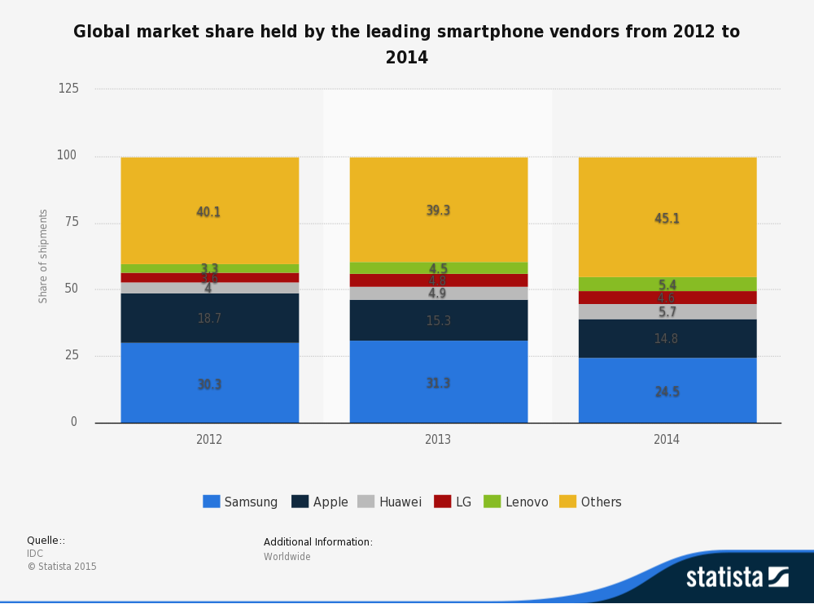

Slide 10
SWOT analysis
Strengths :
Strong brand name
Loyal customers
Innovations
Product popularity
Design capabilities
Wide distribution
Research and development
Weaknesses:
High prices
CSR → exploitation of workers
Product recalls
Absence of Steve Jobs as the charismatic leader
Competitors increase their influence yearly

Slide 11
Opportunities:
Emerging markets
Growth in smartphone and tablet markets
Evolution of digital lifestyle
Sense of pride in owners
Improved standard of living
Outlook for mobile advertisement
Threats:
Intense competition
Dynamic business environment
Risk of international operations
Risk of imitation and piracy

Slide 12
SWOT results
The quality, the strong brand and the customers’ loyalty justify Apples success now and in the future and make sure that the customers pay the high prices for the products and services
But the growth and the market share gets weakened, because the competitors could increase their market share in the last few years by improving their products that are often better in technical characteristics and the majority of competitive products are also cheaper than Apple products.

