Slide 1
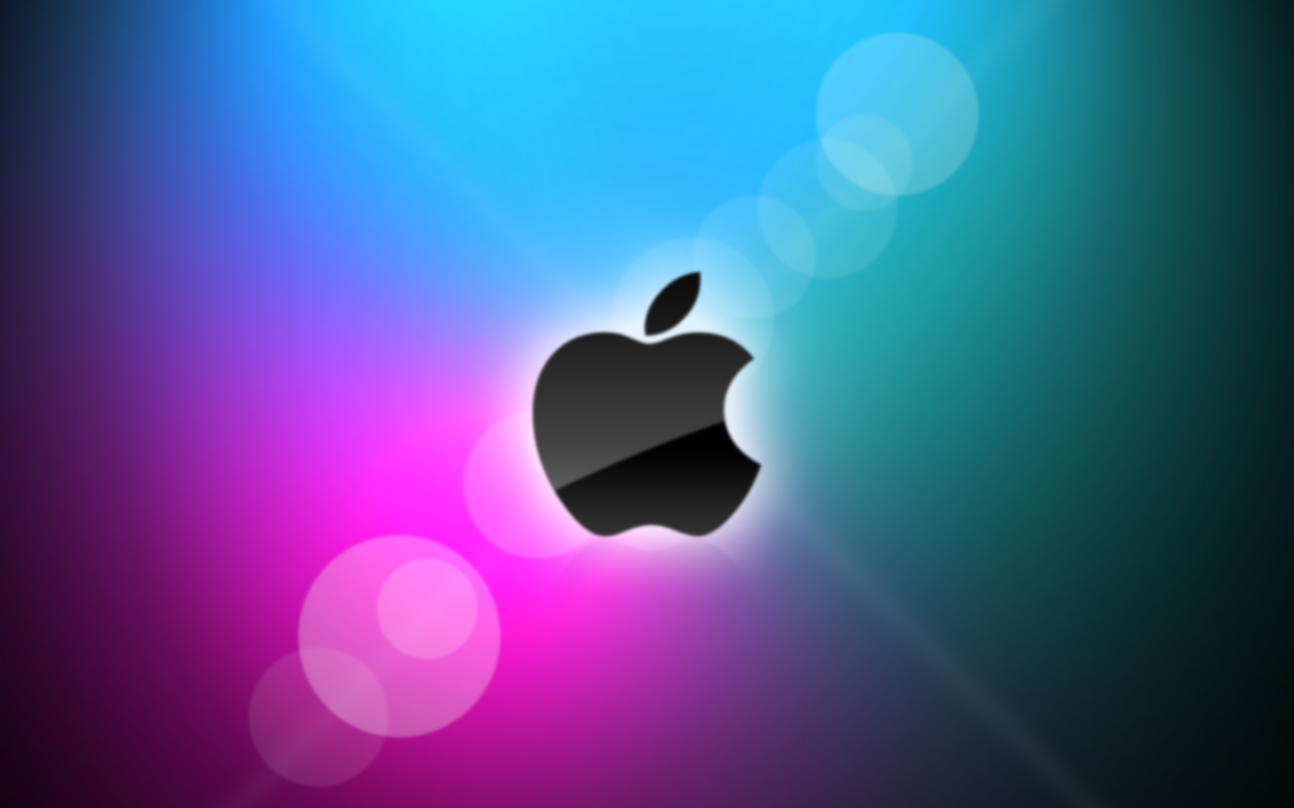
Innovation at Apple
Think
Different
Aswin Venugopal
Anand Iyer
Ashish Chandavarkar

Slide 2
DECIPHERING THE APPLE INNOVATION MODEL
The journey from Apple Computer Inc. to Apple Inc.
Brick by brick - creation of an Apple that defies gravity
Behind the scenes : Breakthrough Innovation
Strategy like no other
The Steve Jobs revolution
Apple after Jobs
Conclusion

Slide 3
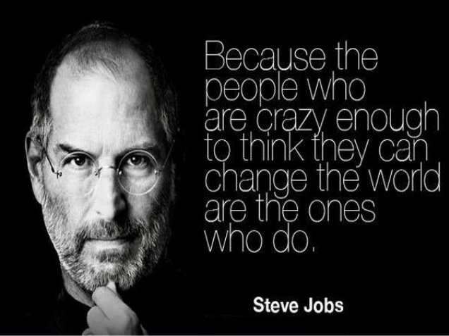
INTRODUCTION
Name | Apple Inc.
Industries served | Computer hardware, Computer software, Consumer electronics, Digital distribution
Geographic areas served | Worldwide
Headquarters | U.S.
Current CEO | Tim Cook
Revenue | $ 156.508 billion (2012)
Profit | $ 41.733 billion (2012)
Employees | 72,800
Main Competitors | Samsung Electronics Co., Ltd., Amazon.com, Inc., International Business Machines Corporation, Cisco Systems, Inc., Google Inc., Microsoft Corporation, Dell Inc., LG Electronics, Lenovo Group Limited, Hewlett-Packard Company, Sony Corporation and many others.
"Apple is committed to bringing the best personal computing experience to students, educators, creative professionals and consumers around the world through its innovative hardware, software and Internet offerings."

Slide 4
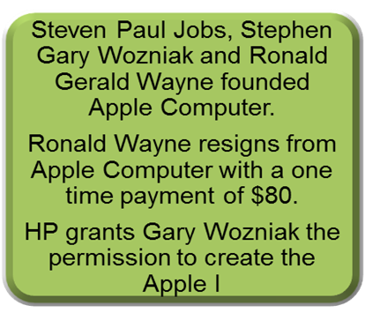
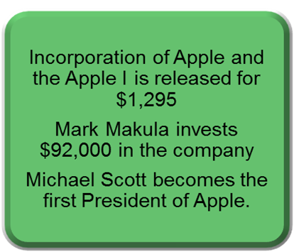
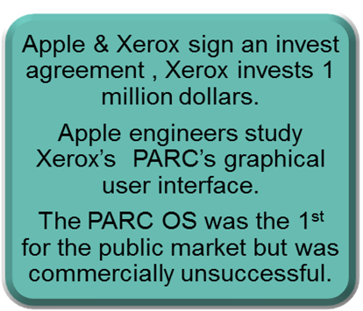





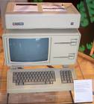


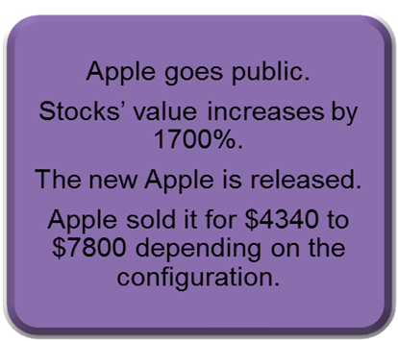
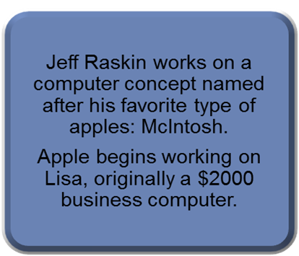
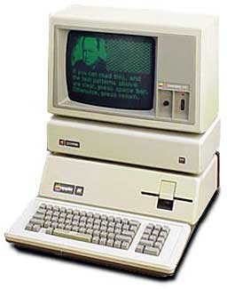
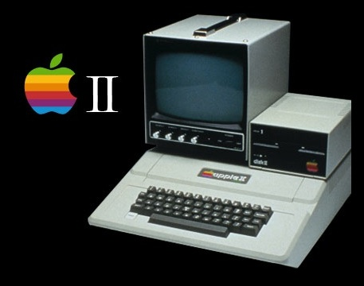

HISTORICAL BACKGROUND OF APPLE INC
1976
1977
1978
1980
1979

Slide 5




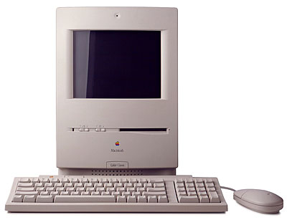



HISTORICAL BACKGROUND OF APPLE INC
Steve Wozniak is injured in a plane & takes time off from Apple and does not return to the Macintosh project.
Michael Scott resigns as president of Apple. Mike Markkula succeeds Scott.
The Lisa’s development is officially finished.
The Lisa is released.
Apple becomes the fastest growing company in history.
John Sculley, former president of Pepsi Co., becomes president & CEO of Apple Computer, Inc.
The Macintosh is released-retailing for $2495
Apple lays off 1200 employees.
Stephen Jobs officially resigns as chairman of Apple.
Apple sues Steve Jobs.
Apple drops suit against Jobs & he founded NeXT, Inc.
Apple tries to make Mac more attractive by releasing “Macintosh Office”.
Apple’s 10th Anniversary.
The Mac SE & the Mac II are introduced.
Apple sues Microsoft & Hewlett Packard accusing them of violating copyrights of Apple.
Lawsuits filed by Apple Corp against Apple
IBM, Motorola & Apple form an alliance.
Apple Computer, Inc. pays Apple Corps $26.5 million.

Slide 6
HISTORICAL BACKGROUND OF APPLE INC
1993-1996
1997-2000
Jobs returns to Apple due to the NeXT Computer, Inc.
2001-2007
Opens first Apple retail store in McLean, VA.
Michael Spindler replaces Sculley as CEO.
Apple releases the first PDA (Newton Message Pad)
Release of 1st Power Macintosh desktop & system 7.5
Apple starts licensing the MacOS.
Apple announces Pippin, a multimedia system
The PowerPC 603e is announced
Apple Computer, Inc. takes over NeXT Computer, Inc. for $430 million.
Apple starts buying back all licenses from Mac-clone manufacturers.
The Power Macintosh G3 & The Apple Store are introduced at “Apple Event”.
The iMac becomes the fastest selling PC in history, being reordered over 150,000 times.
Jobs becomes permanent CEO.
iPod, OS X , iMac G4 all introduced.
iTunes music store opens.
iMac G5
Video iPod launch .1 million videos sold from iTunes.
January of 2007 Apple rechristened as Apple Inc
I-Phone Released.

Slide 7
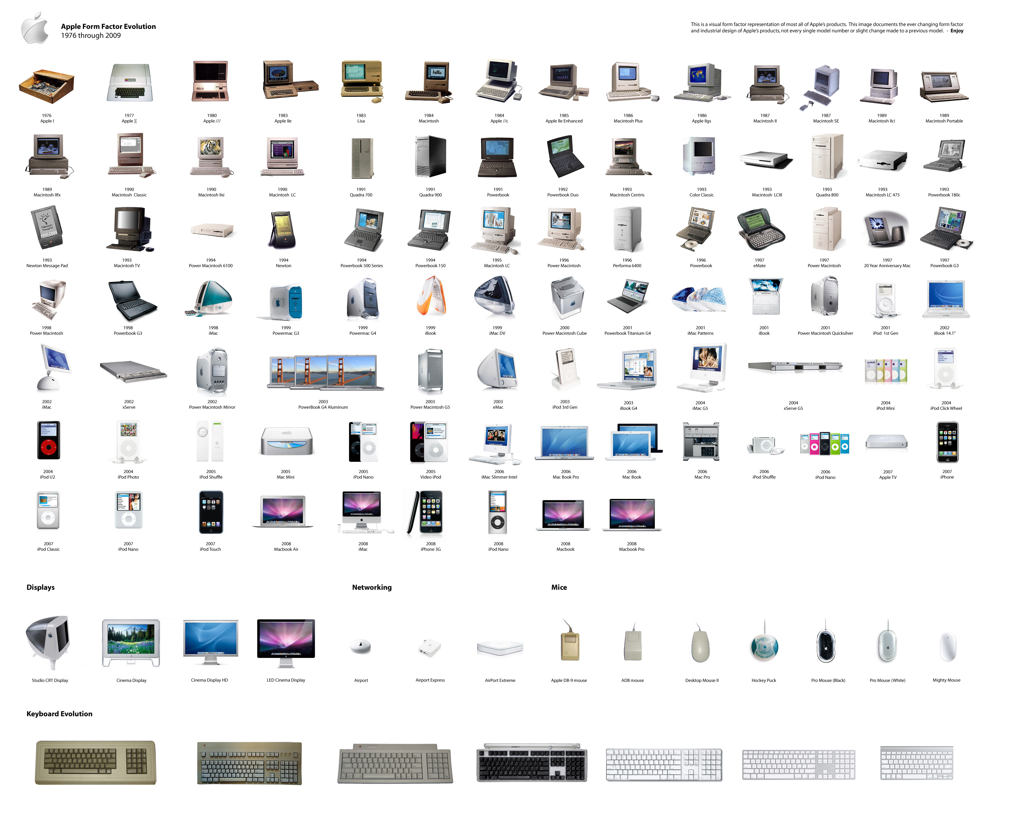
PRODUCT EVOLUTION – 1976 TO 2009

Slide 8
APPLE’S 4 PHASES
Inception Stage (1976-1984)
Jobs & Wozniak got together and set up Apple
Wozniak designed Apple 1 and 2 while Jobs became the figurehead due to his acute marketing acumen
Jerry Mancock came on board as the exterior box designer for Apple
Apple 3 launched in 1980, but turned out to be a failure due to design defects in 1983
Apple launched its IPO in 1980, the biggest since Ford IPO in 1956
Jobs showcased the 1st working model of a GUI
GUI-based Lisa and Mac developed and launched
Mac Office launched creating a complementor to Mac leading to huge sales
Jobs-less Apple (1984-1997)
Jobs had brought in Sculley from PepsiCo in 1983
Sculley was the protagonist in Jobs’ ouster from Apple in 1984 following a Board decision
Jobs sold all his 605 million shares in Apple less 1, as protest
Macintosh was developed into a fully-fledged product line and 1989-1991 was hailed as the golden age of the Macintosh due to stranglehold on the PC market
IBM emerged as the biggest competitor to Apple and in retaliation, Apple launched undifferentiated, commoditized products losing out on its brand equity.
Apple was voted the worst managed company
Apple licensed its Macintosh OS leading to flooding of clones and further damage to Apple’s identity
Apple Rises to the top (1997-201011)
Jobs returned to Apple as the interim CEO after Apple acquired NeXT in 1996/97
The company was floundering and was staring at bankruptcy around this time with an overburdened product portfolio of undifferentiated commoditized products
Jobs came back and de-licensed the Mac OS on the back of a loophole in the contract
NeXT provided the Launchpad for the redesign and development of the brand new Mac OS
Jobs convinced Microsoft to invest in Apple @$150million and a 5 year commitment to develop the Office Suite for Apple
Apple launched the iMac, iBook, iPod, iTunes, iPhone and the iPad over the next 13 years
Post Jobs Era, Apple (2011-Present)
Jobs resigned as Apple CEO in August, 2011
Tim Cook officially took over after Jobs’ death in October
Thus ended Apple’s existence as the pioneer when it came to passionate product development and arrogant marketing techniques
Since, then Apple has been on a slow and steady decline with share price erosion and a lack of innovation plaguing the company
Samsung has emerged as the biggest threat to Apple and has been capturing the market from Apple quite rapidly over the last 2 years

Slide 9
LEADERSHIP @ APPLE
Passion
Reality Distortion & Mental Innovation
Focus on Core
Stay Hungry, Stay Foolish
Charisma & Simplicity
Steve Jobs
Product & Quality Driven
Vision Driven
Innovative Potential
Authoritarian & Firm

Slide 10
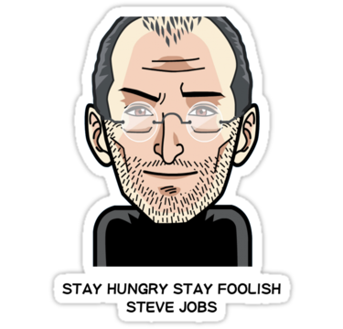
STRATEGY @ APPLE AFTER 1997
Apple managed to convince Bill Gates to invest $150million in Apple which helped it stay afloat a bit more comfortably
Jobs also managed to convince Microsoft to develop the Office suite for Mac with a commitment of 5 years for this initiative
This strategy went a long way in creating the almost unbeatable combination of the Mac OS and the Microsoft Office Suite
Incremental Development was put on a continual, piecemeal basis
Mega Media-Events were reserved for new product launches rather than upgrades
Greater time was afforded to creating the next “insanely great” product which could put Apple on a higher step in the technology ladder
Apple created its own online ordering store after the acquisition of NeXT.
The idea was sourced from DELL’s initiative and Apple managed to gain an advantage here after DELL had to change from the market leader WebObjects technology to Microsoft’s Active Server for hosting its web channel due to Apple not making available WebObjects for external vendors, as it was a NeXT property.
Silent Incremental Development
Online Stores & Going Retail
Protocol Change in Manufacturing
Increased Operational Efficiency
R&D Focus shifted from Science to Product
Losing Small to Win Big (Microsoft Deal)
Apple developed its strategy of “Store within Store” in which Apple products were to displayed separately in a different section of a store which would be manned by employees hired by Apple themselves.
This led to a perceived sense of differentiation among the buyers
Apple reduced its retail partners from 20,000 to 11,000 within a year after Jobs’ return
The sector focused on inventions while Apple took on a different route of “Product Innovation”
Apple tried to focus on the user experience when it came to developing new products
They pioneered the concept of allotting technical experts to scout for commercial technologies and this, at times, led to Apple co-inventing even at the most basic level like chips.
This was the time when Apple moved into the well-documented shroud of secret product innovation and only Jobs and his trusted colleagues knew what exactly was going on.
Apple shifted to a order-based manufacturing strategy rather than the assembly-line system it had previously adopted
This led to reduced inventory levels that were hampering Apple’s profitability earlier
Apple hired Tim Cook, the current CEO as the COO of Apple
He was instrumental in clearing up the clutter that Apple had accumulated over the years due to incorrect demand forecasts & loose cost control mechanisms
Inventory held was reduced from 90 days to 2 days within a year
Cash Interim duration increased from 10 days to 60 days under Cook

Slide 11
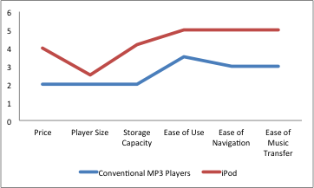
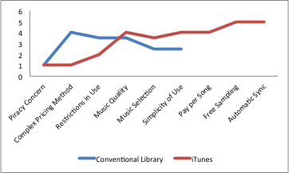
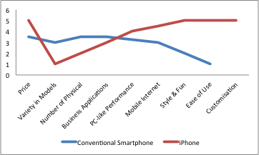
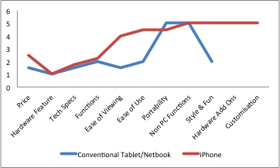
INNOVATION @ APPLE
Apple @ Inception
Original Innovator: APPLE I
Apple II, the first commercially successful computer
Jobs-less Apple
Decline in Innovative Capacity
Inability to make Competition redundant
Jobs returns to Apple
NeXT becomes the next growth engine
Indigenous Innovation became central to Apple, again
Apple III, LISA : Failures
Macintosh: Hit but was misused and turned into a commodity
Incremental Innovation becomes the order of the day @ Apple
Sales Channel Innovation
Launch of “Insanely Great” Products made a comeback
iPod
iTunes
iPhone
iPad
Post Jobs, Apple has again gone back to its era of innovating incrementally. With the demise of Jobs, Apple distinctly looks like it has lost its focus towards creating a product that would be both new but can be used like old.

Slide 12
SUCCESSFUL STRATEGY @ APPLE
Trend Identification
Commoditization of PC Industry & a Digital Boom were key drivers along Apple’s Marketing Campaign
Analyze Competitors
De-licensing led to market share erosion
Innovate
Apple’s design has been unparalleled throughout history
Product Positioning
Brand Awareness
Distribution Optimization
Customer Focus
Apple tied up with Microsoft & Intel to produce software and chips. This allowed it to become even more stronger against competitors
iPod and iTunes were developed keeping these in mind
Apple’s marketing campaigns have also been innovative like Think Different which included all the world’s leading thought agents as their ambassador
Complementors are central to extended life of a computing device
Apple’s App Store has been instrumental in creating the eco-system that has helped position Apple as a premium product
Creative Advertising & Use of Non-Traditional Media Channels helped create the aura of Apple in the minds of potential customers
The use of simple but sophisticated colors has also increased the brand equity of Apple
Move from small regional stores to national chains to increase reach
Individual retail stores were also opened to get 1st hand access to customers
Online selling lead to higher inventory optimization
Apple pioneered the concept of “Participatory Design” in which company executives would observe people and their habits to draw conclusions on how a product should function
Ease of use & product quality were at the forefront of Apple
Macintosh
Restoration of Distribution Channel
Reduction of Number of Product Lines from 16 to 4
Allocating the biggest part of the budget for R&D
Apple’s Philosophy
Timely Product Launches
High Quality Product
Absolute Secrecy during Development
Jobs’ 1st & 2nd Marketing Initiative after his Return
Differentiation Strategy
Creative Advertising
New Website for Managing Sales
Launch of Apple Retail Stores
Focus on Customer Service
iMac
Apple’s Promise
Once launched, Apple products were commercially available in every Apple store worldwide

Slide 13
COMPANY ANALYSIS
During Steve Jobs as CEO
Strengths
Global presence
Brand image
Synergistic portfolio
Strong media content
Weakness
Low returns
Dependency for key components
Opportunities
Wireless products
New digital platform
MP3 player market
Threats
Strong competition
Slow Eurozone economy
Lawsuits
Current 2012-13, After Steve Jobs
Strengths
Branding
Retail Strategy
Superior Quality
Weakness
High price products
Less penetration
Cannibalization
Opportunities
Technology Innovation
Strategic alliance
Fast growing Industry
Threats
Extensive competition
Substitute Products
Technical advancement
Economical factors

Slide 14
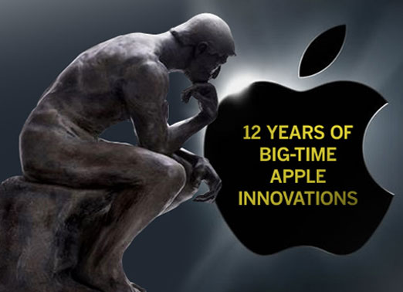

Slide 15
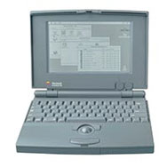
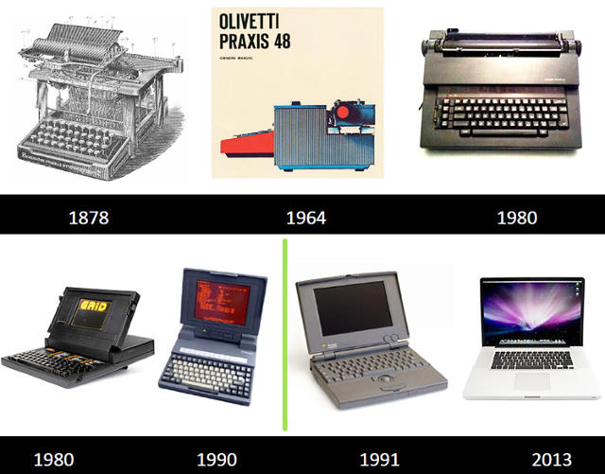
EVOLUTION OF MACBOOK
PowerBook 100 (1991)
Many firsts in this product
Served as a base model to
future laptops
MacBook in 2006 (Intel)

Slide 16
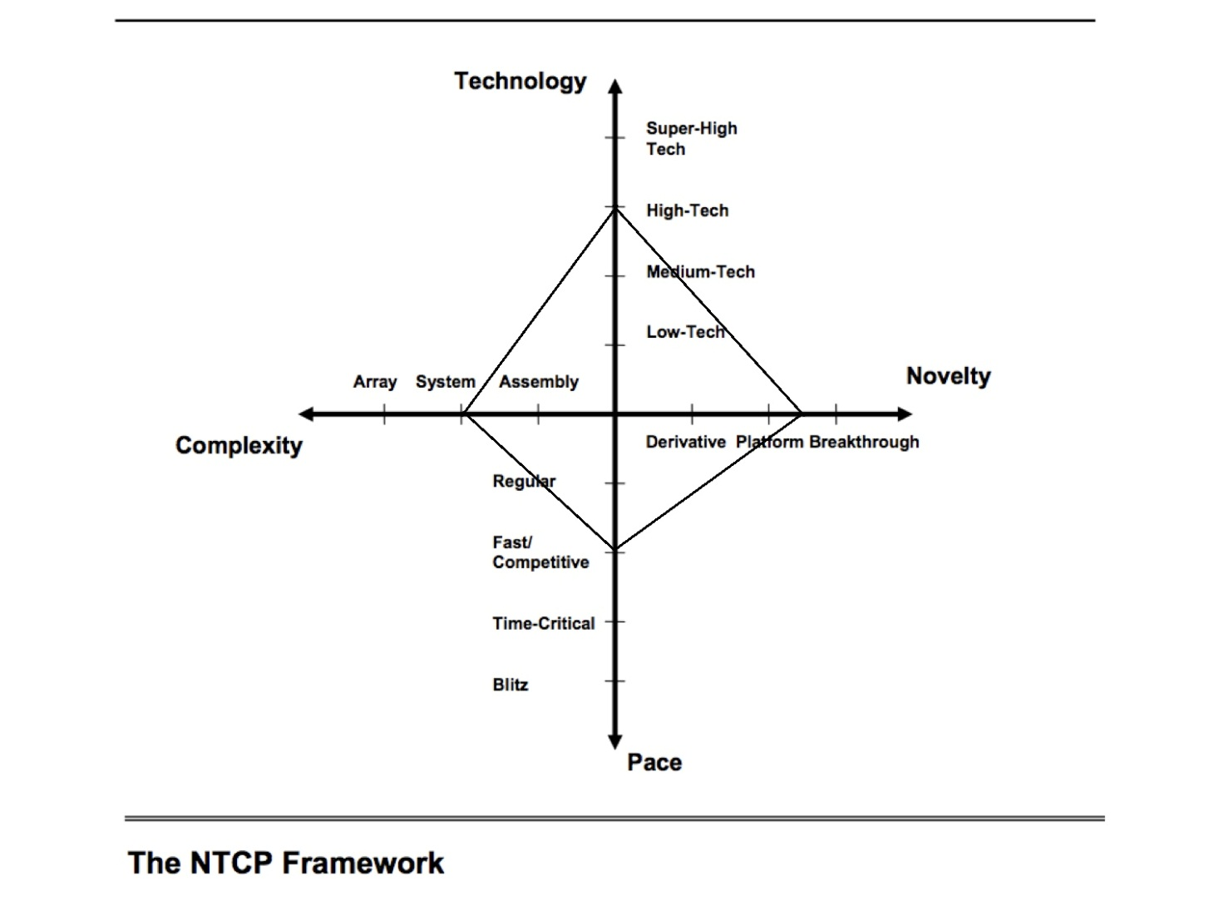
NTCP - MAC PRODUCTLINE

Slide 17
IPOD AND IPHONE
iTunes was released in 2001 which became the major music retailer in 2008 in the US
iPod in 2001 with 5 GB flash drive
(35.8% of total revenue and 90% market share by 2005)
“iPhone is a revolutionary and magical product that is literally five years ahead of any other mobile phone with a revolutionary user interface since the mouse“ – Steve Jobs (2007)

Slide 18
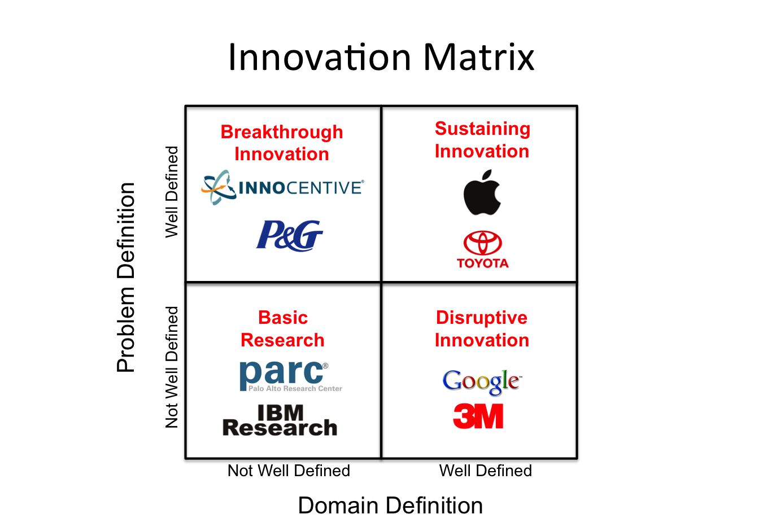
APPLE INNOVATION MATRIX
Source : Innovationexcellence.com

Slide 19
STRATEGIC MOVES
Continuous Innovation
Primary focus on product and not on profit
Perfect timing of product releases
Retail stores and services addon with products
Loyal customer base
Focus on user experience for future development.

Slide 20
APPLE AS A RETAILER
Traditionally, Apple used authorised ressellers for sale
Opened online store in 1997 (product customization)
Apointed former VP of TARGET in a move to open retail store (2001) with another 24 the same year
Main objective was to improve the 5% market share in PC market
Despite public criticism, retail stores were successful with revenue worth US$ 1.19 billion

Slide 21
Careful employee selection and training
3 step sales process : position, permission, probe
Also lead to Channel conflict
Resellers filed multimillion-dollar lawsuit.
By 2006, Apple reached out-of-court settlements with the plaintiffs.

Slide 22
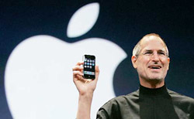
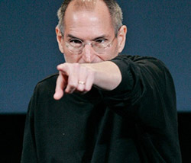

MANAGEMENT STRATEGY
Micromanaging
Expertise
Responsibility
Secrecy
Fear

Slide 23
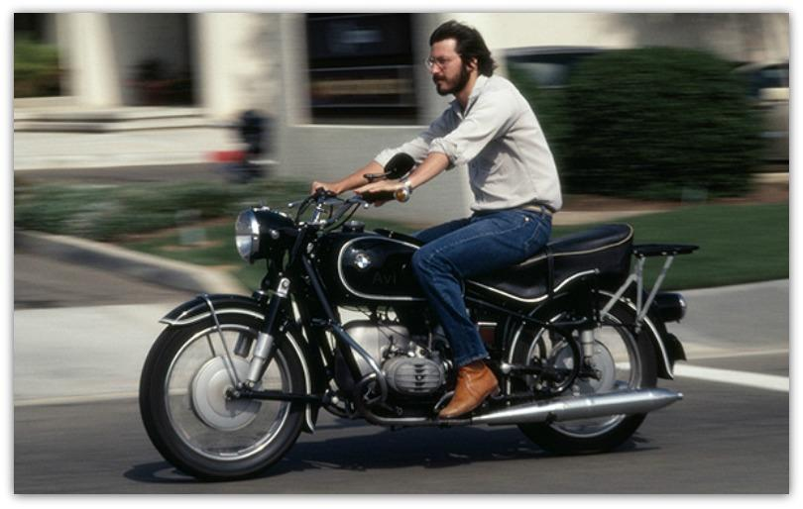
THE STEVE JOBS REVOLUTION

Slide 24
STEVE JOBS - THE MAN HIMSELF
Control freak
Perfectionist
Inspiration and Motivation
“Bending reality”
“Impute”
Focus on detail - with an eye on the big picture
Challenge people

Slide 25
LESSONS IMBIBED AT APPLE INC.
Focus
Simplify
Products before profits
Perfection
Leapfrogging
Taking responsibility end-to-end
Work with the best
Combine humanities and technology

Slide 26
APPLE AFTER JOBS
Leading the masterclass
Slowdown in new product releases
Limitation on innovation in existing products
Investors demand diversification
Home automation - taking over the living room
Future products / services
  Apple TV
  iCloud
  iWatch
  iPay
  Automobile

Slide 27
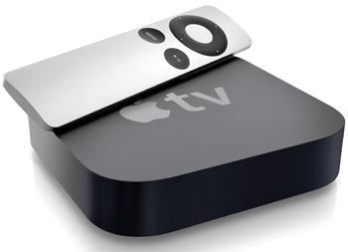
APPLE TV
Sublime interface - simplifying
control experience
Ultimate entertainment
package
Communication hub
Voice control
AirPlay
App Store / Games / Facetime
Home automation

Slide 28
FINANCIAL PROJECTIONS
 | FY 2009 | FY 2010 | FY 2011 | FY 2012 | FY 2013
Revenue | 42.6 B | 65.07 B | 108.6 B | 155.97 B | 170.87 B
Net Profit | 8.24 B | 14.01 B | 25.92 B | 41.73 B | 37.04 B
EPS | 9.22 | 15.41 | 28.05 | 44.64 | 40.03
52 week high | 204.45 | 320.56 | 422.00 | 700.09 | 560.02
Cash reserves of $158b in January 2014
Share buybacks a regular feature. $30b buyback, dividend up by 8%, 7-for-1 stock split
“Apple will be a $610 billion revenue company by 2015 as all their key markets start to experience hyper-growth”

Slide 29
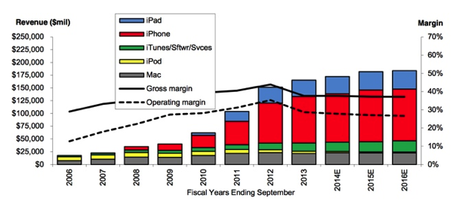

Slide 30
CONCLUSION
Steve Jobs : Heart of Apple
Innovating along the line of his vision
Change in management style
Need to retain project management style
Suggestions
  Attempt break-though innovation
  Diversification

