Slide 1
Columbia‘s Final Mission
By: Kailash Ahuja; Hong Minh Nguy; Pooranan Murugesan

Slide 2
Agenda
Dynamics of Space Shuttle Program
The Columbia Project
The project organisation
Analysis of the problems occured
Cause and effect analysis
Future outlook of the NASA Space Program

Slide 3
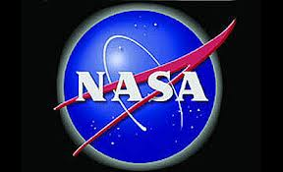
NASA - Historical Background
On 29th July 1958 Nasa i.e. National
Aeronautics and Space Administration was found by the U.S. Congress
It was created in response to the Soviet Union‘s October 4, 1957 launch of ist first satellite, Sputnik 1
Nasa is a civilian agency responsible for coordinating America‘s activities in space

Slide 4
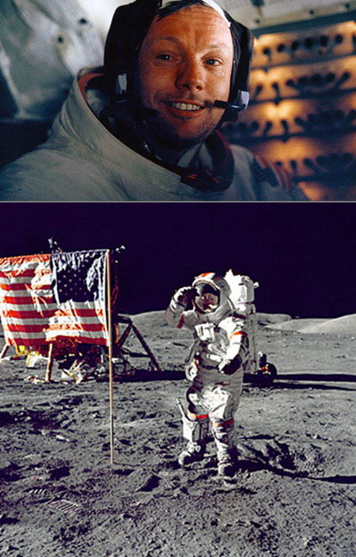
NASA – Initial missions
5th May, 1961: American first human space flight
20th July, 1969: first human presence on the Moon
„That‘s one small step for man, one giant leap for mankind“ – Astronaut Neil Armstrong, the first man walking on the moon.

Slide 5
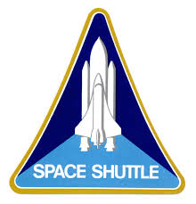
The Space Shuttle Program – Pro gram History
The Space Shuttle Program was established by NASA in January 1972
Space Transportation System (STS) was the United States government‘s manned launched vehicle program from 1972 to 2011
It became the major focus of Nasa in the late 1970s and the 1980s

Slide 6
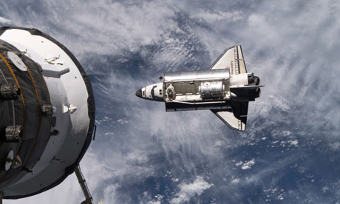
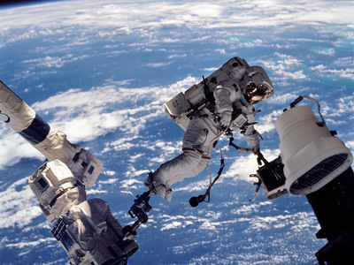
The Space Shuttle Program – Goal
The Space Shuttle Orbiters are designed for:
carrying astronauts to the ISS & other destinationations in low-Earth orbit
scientific research and space applications

Slide 7
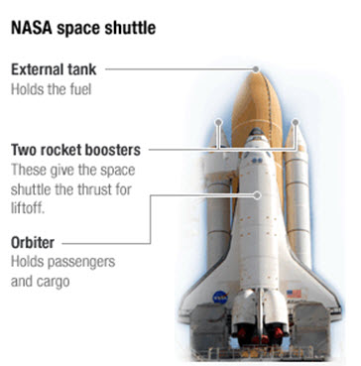
The Space Shuttle Program – Infrastructure
The first spacecraft capable of routinely launching into orbit like rockets and then returning to Earth as gliders.
Primary components:
the orbiter
the expendable external tank filled with liquid fuel
two reusable SRBs

Slide 8
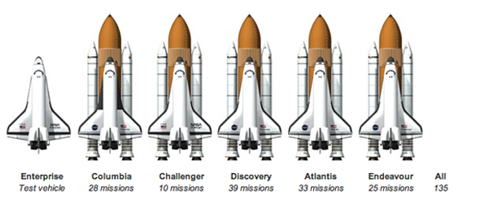
The Space Shuttle Program – Space Shuttle Fleet

Slide 9
The Space Shuttle Program – Mission Summaries
1981 – 2011 : 135 missions were flown, carrying over 350 people into space and travelling more than half a billion miles.
Two Shuttles destroyed during in-flight accidents:
Challenger exploded 73 seconds after liftoff on January 28, 1986
Columbia disintegrated just 16 minutes during re- entry on February 1, 2003
14 astronauts were lost after two disasters
The longest Shuttle mission was STS-80 lasting 17 days, 15 hours
STS-135 was the final flight of the Space Shuttle Program using Atlantis Orbiter

Slide 10
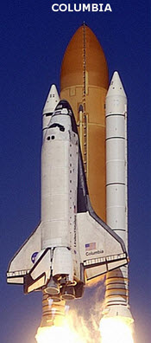
The Columbia Project – Historical Development
Was the first spaceworthy Space Shuttle in NASA‘s orbital fleet.
During 22 years, Space Shuttle Columbia
flew 28 filghts with totaling 125,204,911 miles
spent 300.74 days in space
completed 4,808 orbits

Slide 11
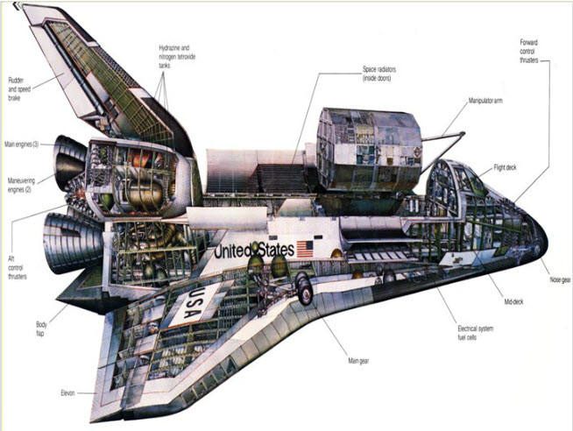
The Columbia Project – Historical Development

Slide 12
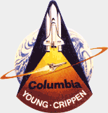
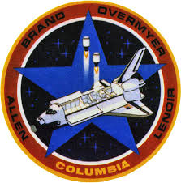
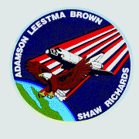
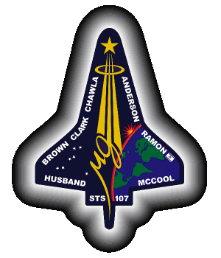
The Columbia Project – Milestones
STS-1:
succesfully launched on April 12, 1981
Commanded by a two-person crew
Mission: test flight
STS-5:
Launched on November 11, 1982
First operational mission, with a four-man crew
STS-28:
Launched on August 8, 1989
First flight after Challenger disaster
Mission: deploying two satellites USA-40 & 41
STS-107:
Final flight of Space Shuttle Columbia
Orbiter exploded during reentry into the Earth‘s atmosphere
All seven crew members were killed

Slide 13
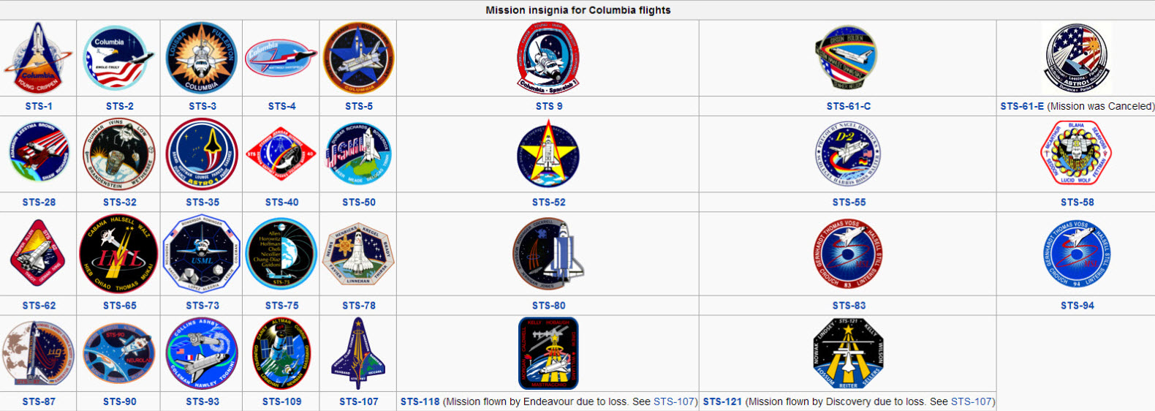
The Columbia Project – Milestones

Slide 14
The Columbia STS 107 – The Mission
16 day mission dedicated to research in physical, life and space sciences
Approximately 80 separate experiments comprising of hundreds of test and sample points
7 member crew had to work in round the clock shifts in 2 teams
Critics called the experiments “childish & elementary”, while the crew called it “leading edge”

Slide 15
Important Terminology
CAIB – Columbia Accident Investigation Board
DAT – Debris Assessment Team
FRR – Flight Readiness Review
MER – Mission Evaluation Room
MMT – Mission Management Team
RCC – Reinforced Carbon Carbon
SRB – Solid Rocket Booster
TPS – Thermal Protection System
Accepted Risk
No Safety of Flight Issue

Slide 16
The Columbia STS 107 – The Tragedy
Loose piece of foam punctured a hole
Extremely hot gases entered the wing during reentry
Structural support was destroyed & the orbiter broke apart

Slide 17
How it all went wrong
The Start Itself was bad
Cameras and images
Request for more imaging went awry
Debris classified as “Out of Family” Event
No “Tiger Team” launched
DAT team formed – but had no idea whom to report to or communicate with

Slide 18
How it all went wrong…
Wrong use of “Crater”
Was never utilized before for an on-orbit mission
The engineers who used it were inexperienced
When warned about the hole – it was not accounted for

Slide 19
How it all went wrong…
“I am the boss !”
The MMT met only 5 times instead of everyday
MMT manager Linda Ham tried to evade responsibility and was concentrating on (her) future
Cancels the request for more images as she had no idea who needed it

Slide 20
How it all went wrong…
“Lack of Communication”
Toooooo centralized … very rule – oriented, very protocol oriented
Lower rung employees were not able to voice their opinion / concern (FRR not perfect)
The astronauts informed only on the 7th day
“No safety to flight issue” confirmed but no one mentioned about the RCC issue

Slide 21
To Sum It Up
“Sticking to the Past”
Use of analytic models for testing and no unmanned test Flights
Bad Finance management
Communication & Team management issues
Arrogant & overconfident attitude

Slide 22
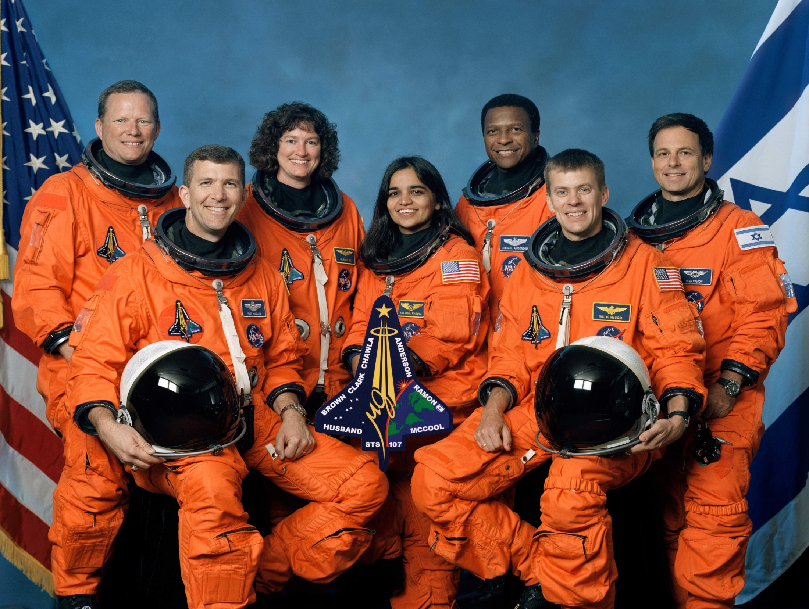
Analysis

Slide 23
Operational Altitude
Operational Altitude of STS(Shuttle Transportation Systems) – 120-600 miles
Distance From Earth
International Space Station - 200-250 miles
Hubble Telescope - 350 miles
Moon - 238,000 miles

Slide 24
Ignored Warnings
Lessons from the Challenger incident-1986
SRB experts had expressed concerns about the safety of the Challenger launch
NASA’s culture prevented these concerns from reaching top decision-makers
Past successes had created an environment of over-confidence within NASA
Extreme pressures to maintain launch schedules may have prompted flawed decision-making
CAIB found disturbing parallels remaining at the time of the Columbia incident(2003)…

Slide 25
Ignored Warnings
Foam strike detected in launch videos on Day 2
Debris Assessment Team (DAT) informally requested inspection by remote photo imagery to DOD.
The engineering team also proposed a space walk to check the wing.
MMT managers discounted foam strike significance
No actions were taken to assess shuttles damage or to prepare emergency plans
Atlantis could have been launched?

Slide 26
Organizational Culture
Cultural traits and organizational practices detrimental to safety were allowed to develop
Reliance on past success as a substitute for sound engineering practices
Organizational barriers that prevented effective communication of critical safety information
“In our view, the NASA organizational culture had as much to do with this accident as the foam.”
CAIB Report, Vol. 1, p. 97
I must emphasize (again) that severe enough damage… could present potentially grave hazards… Remember the NASA safety posters everywhere around stating, “If it’s not safe, say so”? Yes, it’s that serious.
-Composed but never sent

Slide 27
Lives Lost
NASA’s space shuttle program STS(Shuttle Transportation System) killed more people than any other space vehicle in history.
Challenger- 7 people
Columbia – 7 people
Flight Failure rate- 1.5%
Vehicular Failure rate- 40% ( Two Out of Five Shuttles lost- Columbia, Challenger, Discovery, Atlantis, and Endeavor)
Comparison Analysis:
Chinese space program has no casualties
Russia lost 4 cosmonauts in two accidents, Soyuz-1 and Soyuz-11

Slide 28
Cost Overrun
Estimated Cost
US$450 Million / Mission
Total Number of missions - 135
Total Cost - US$192 Billion
Actual Cost Calculation
From 1982 to 2010 - US$1.2 Billion/ Mission
From 1971 to 2010- US$1.5 Billion/ Mission
Comparison:
Russian Soyuz (Rumours) - Around US$45-$80 million/launch
Charges US$63 Million / Seat

Slide 29
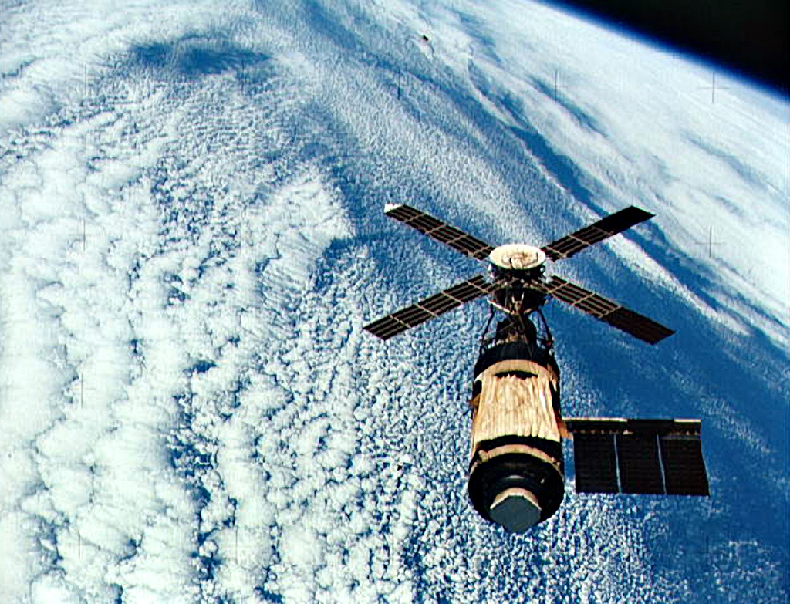
Plan and Execution
Initial Plan – 1972
50 Missions per year
To boost orbit of Skylab
Execution
From 1982-2010
4 Missions per year
In 1979, Loss of US’s first Space Station Skylab due to delay in Shuttle launch.
Shuttles were designed for 10years of life
Life was extended to 30 years

Slide 30
NTCP Model

Slide 31
What Next?
NASA suspended space shuttle flights for more than two years as its Columbia Accident Investigation Board(CAIB), investigated the disaster
External Tank was redesigned
Astronauts used cameras and robotic arm to scan the shuttle's belly for broken tiles
Safety procedures were introduced
In 2004, President Bush announced that the space shuttles would be retired
In August 31, 2011, Space Shuttle Transition and Retirement Office was formed to house all three orbiters and a prototype, Enterprise in museums in California.

Slide 32
Future Outlook
NASA is currently developing Multi-Purpose Crew Vehicle for 21-days missions. And Space Launch System for explorations beyond Earth’s orbit
NASA is also partnering with private companies like SpaceX, Boeing, Blue Origin, Virgin Galactic, Armadillo Aerospace, XCOR, Orbital Sciences to launch commercial vehicles to ISS and beyond.
Current objectives: (As of April 24, 2014)
Manned mission to Mars
Current Budget for NASA- 0.5% of US Spending plan- US$18 Billion
Charles F. Bolden asks for 1% of Budget

