Slide 1
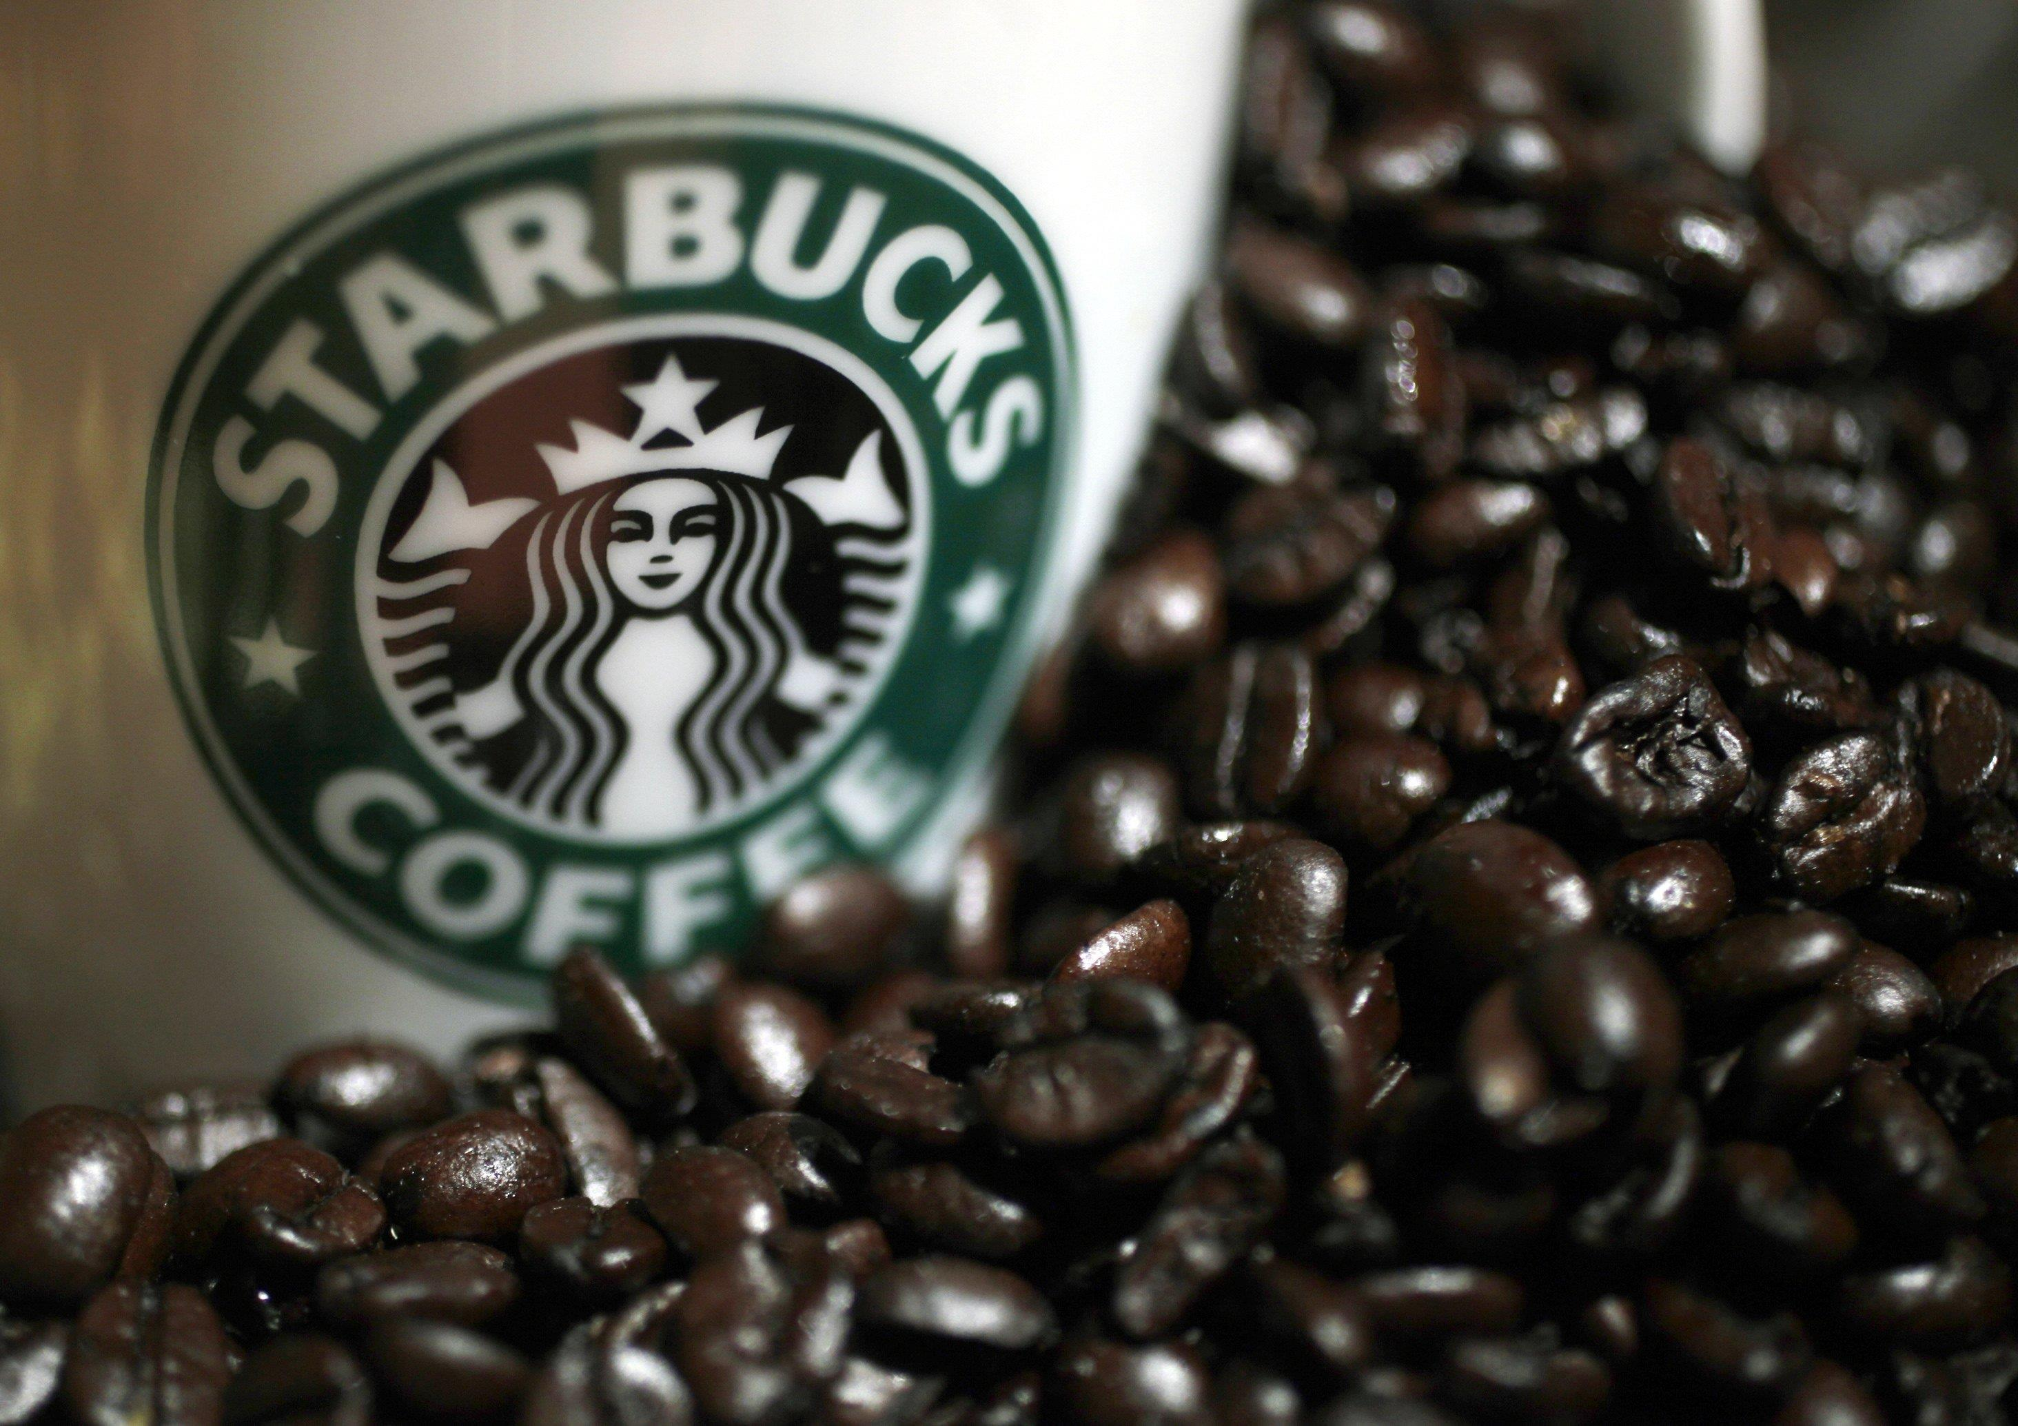
Starbucks Corporation
“Building a Sustainable Supply Chain”
Steindorfer, Frankenreiter, Götter / KHD 14 A 32 / 11.06.2015

Slide 2
The Starbucks success
Simple concept
Every store offers and looks the same
Environmental care
Fair Trade Coffee

Slide 3
Agenda
Historical Background
Coffee Industry
Supply Chain Management at Starbucks
Starbucks Competitors
Starbucks Today
Conclusion

Slide 4
1) Historical Background

Slide 5
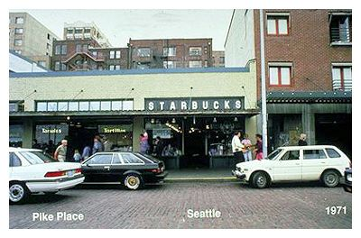
Historical Background
Founded in 1971
Coffee, tea, and spice store
Named in honor of the first mate in Herman Melville‘s Moby Dick

Slide 6
Historical Background
1982: Schultz enters as head of marketing
1987: Howard Schultz became the CEO and began to expand throughout the US
1992: Starbucks Company went public
1996: Starbucks Ice Cream was introduced This made Starbucks the number one brand of coffee ice cream in the U.S.
2000: Worldwide 3500 stores

Slide 7
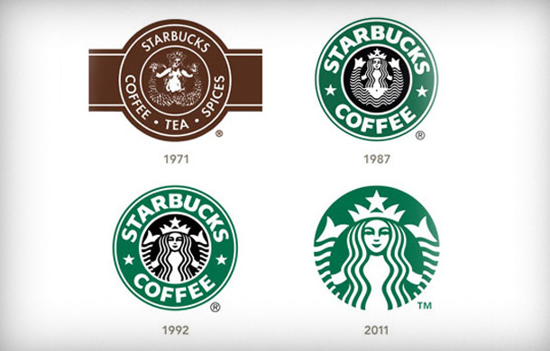
Historical Background
2002: The first Starbucks Coffees were opened in Germany
2010: 17.000 stores in 50 countries; 140 in Germany
2011:

Slide 8
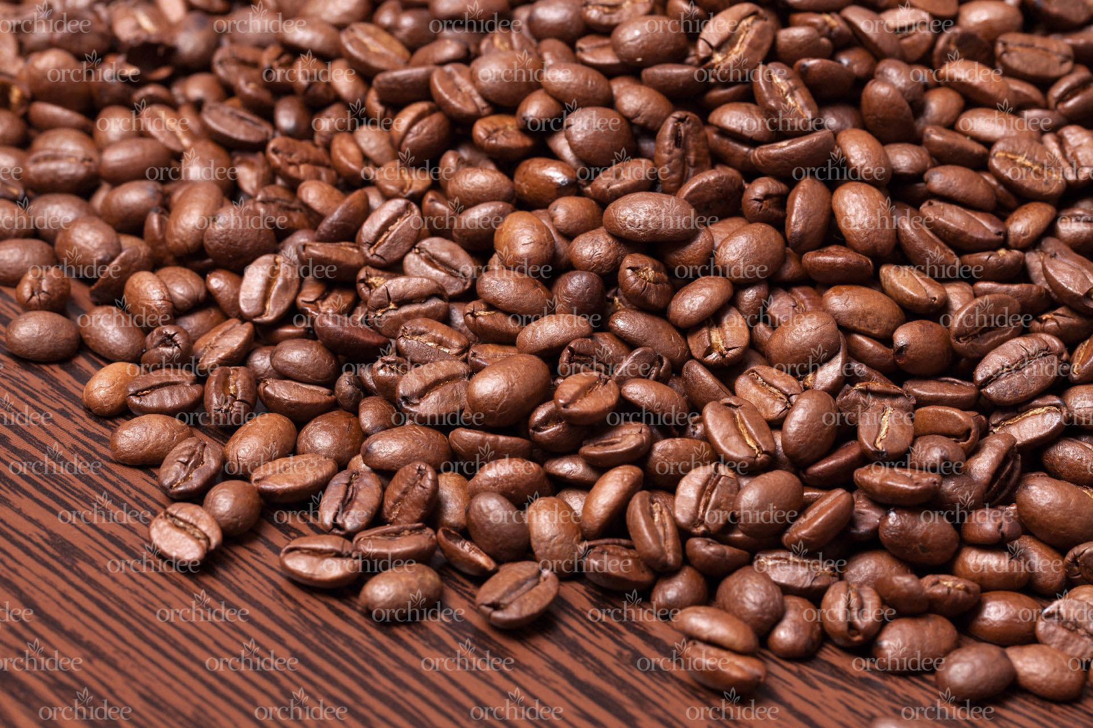
2) Coffee Industry

Slide 9
Climate Change
„The steps we're taking to address climate change not only reduce our environmental footprint, they also help ensure the supply of high-quality coffee that our customers expect from us into the future.“
Increase investments in solutions and strategies – both in stores and at the farm level – that helps to tackle this crisis

Slide 10
Targets
Programms that farmes could supplement their income
Counteract the destruction of rain forests

Slide 11
What have they done?
Starbucks has been implementing a climate change strategy since 2004, focusing on renewable energy, energy conservation, and climate adaptation and mitigation efforts
Climate protection policy
Starbucks stands for globalization

Slide 12
Coffee crisis
International agreement
1989: The agreement was finally suspended; each country could produce and export any amount of coffee
Biggest coffee producer: Brazil, Columbia, Indonesia
To much produced

Slide 13
Consequences
25. million coffee farmer lost their work
2006: The situation calm down. The demand for coffee surged especially in China and the Eastern European countries

Slide 14
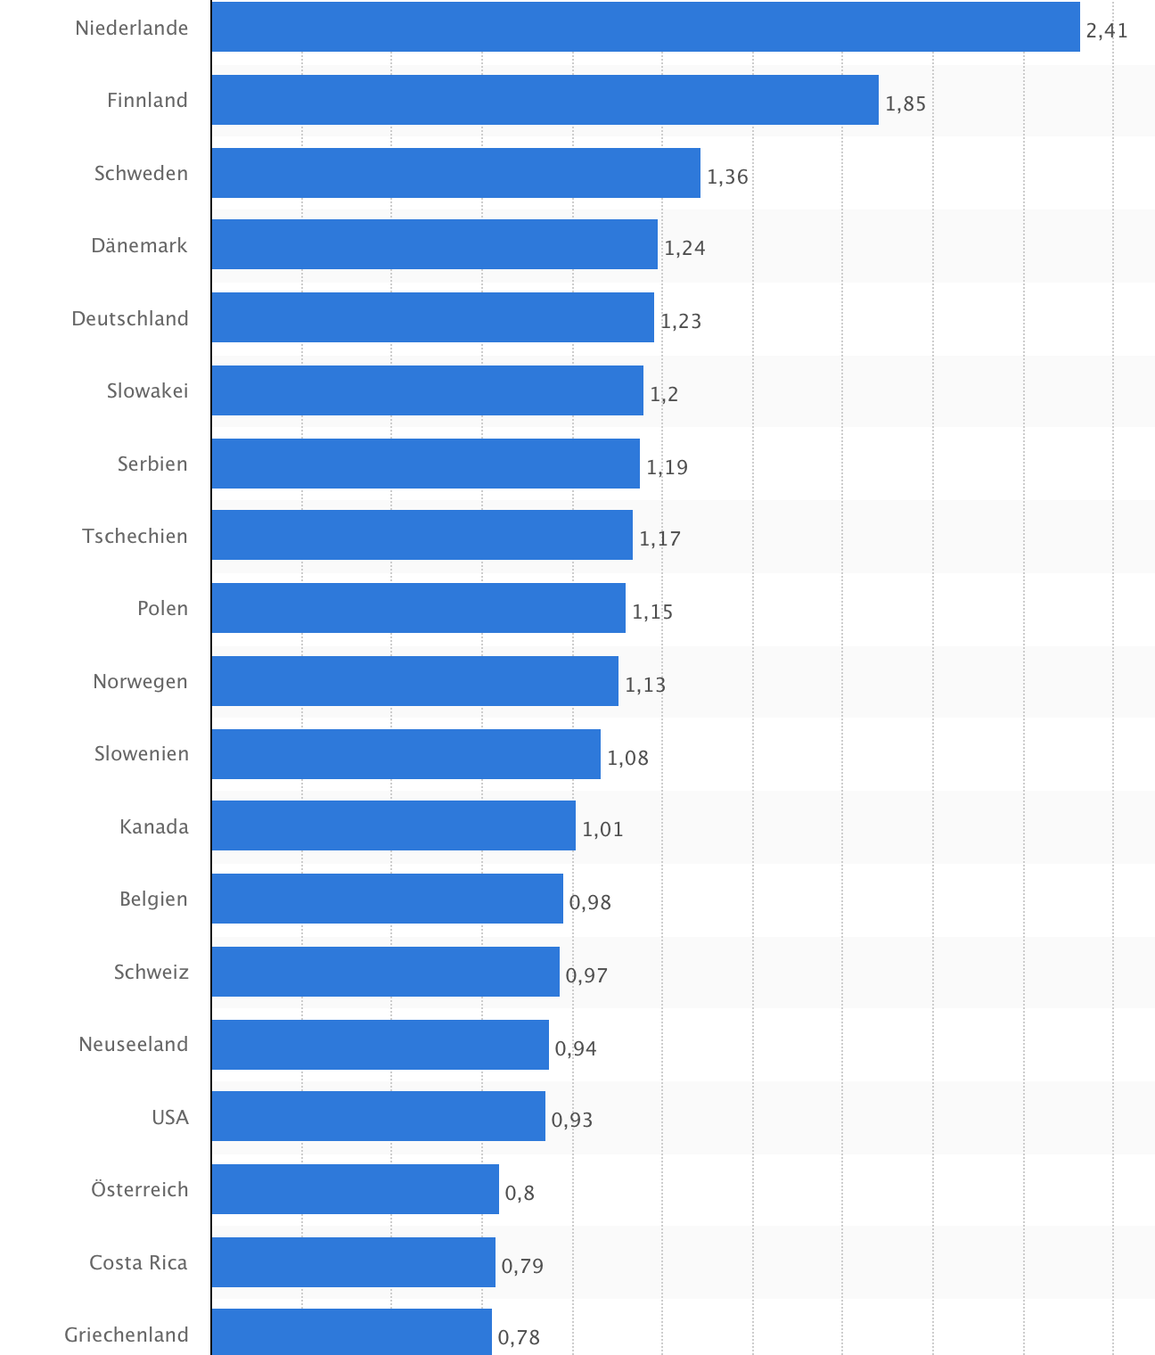
Coffee-Consumption

Slide 15
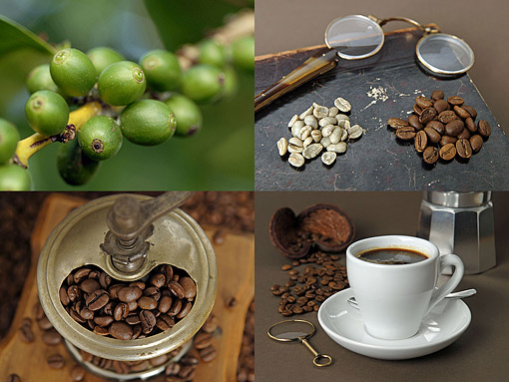
3) Supply Chain

Slide 16
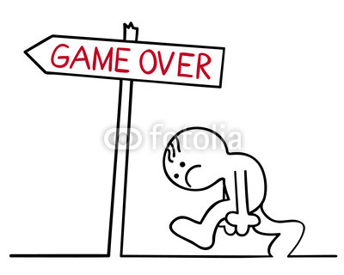
What Do you have to know (Basics)
Price slump
Unfair payment
Bad working standards
No involvement in Sustainability and Responsibility

Slide 17
What Do you have to know (Basics)
The Targets of Starbucks
Quality on the highest level
Fair Payments
Friendly Contacts (long-term-relationships)
Protect the environment, the workers and the farmers → in whole good CS&R-program

Slide 18
The five driving forces
Potential Entrants
Suppliers
Industry Rivalry
Buyers
Substitutes

Slide 19
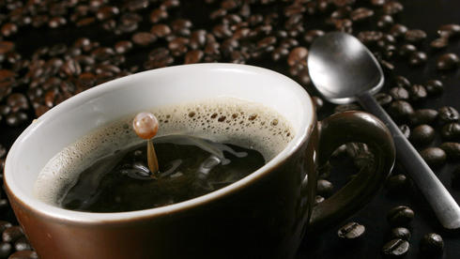
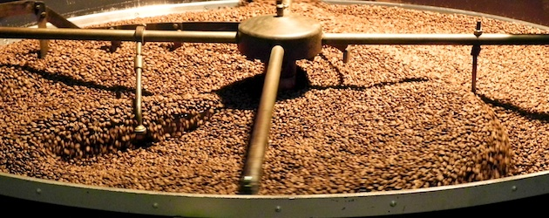
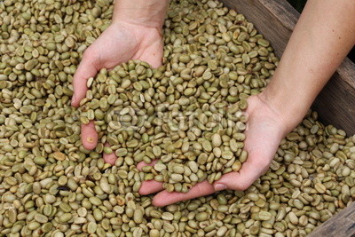
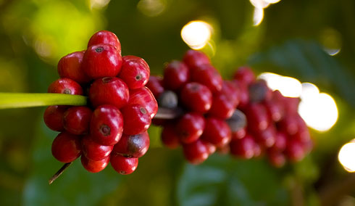
Supply Chain at Starbucks
4 http://www.handelsblatt.com/images/kaffeepreise-ruecklaeufig/7316428/2-format3.jpg
3 https://www.green-cup-coffee.de/blog/wp-content/uploads/2012/04/kaffeeroestung2.jpg
2 https://t1.ftcdn.net/jpg/00/64/87/76/400_F_64877648_sHVWiD4h58jL2nUKqz0H0kvMQ63NJv72.jpg
1 http://www.natur-image.com/Kuba/Pflanzen/pflanzen_38.jpg

Slide 20
Supply Chain at Starbucks
Shop
Delivering
Delivering
Roasting
Roasting
Roasting
Conditioning
Conditioning
Conditioning
Conditioning
Farming
Farming
Farming
Farming
Farming

Slide 21
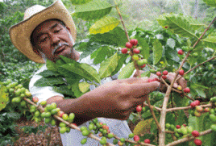
The four main tasks
1 http://www.jjay.cuny.edu/sites/default/files/Academic_Advising/plan.jpg
Deliver
2 http://www.umweltdialog.de/de-wAssets/img/archiv/wirtschaft/weblication/wThumbnails/Kaffee_Farmer_Bauer.klein_von_Nestle_flickr-65e48390f7e548af80bce5450008771c.gif
3 https://www.green-cup-coffee.de/blog/wp-content/uploads/2012/04/kaffeeroestung2.jpg
4 http://innovateltc.com/wp-content/uploads/2011/08/deliver-300x300.jpg

Slide 22
C.A.F.E.-Practices
Coffee And Farmer Equity - Practices
Sustainability and Responsibility program
Guidelines and regulations for the farmers
Ecologic, economic and social Aspects

Slide 23
C.A.F.E.-Practices
Targets
Support of Coffeefarmers
Fair wages and payments
High quality coffee
Long-term and friendly interactions

Slide 24
C.A.F.E.-Practices
How to find the right one?
Classification | Score | Collaboration | Source of Supply
A | 80 < | strategic | primary
B | 65-80 | tactical | secondary
C | 59-64 | operative | tertiary

Slide 25
What is a fair coffee price?
What do you personally think is the average-price of 500 gram coffee
0,90 US-Cent per 500 gram
What was the lowest price ever?
0,41 US-Cent per 500 gram (2001)
What pays Starbucks averagely?
1,47 USD-Dollar per 500 gram

Slide 26
And who earns what?

Slide 27
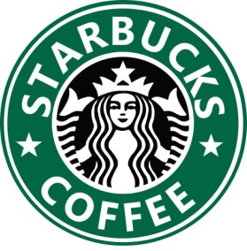
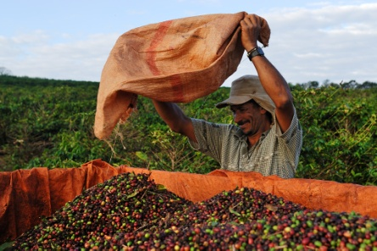
Relationship between Starbucks and farmers
Push the buying prices (high-price-segment)
Give them easy credits
Consulting centre
Advise in political and governmental questions
Team of agriculture specialists

Slide 28
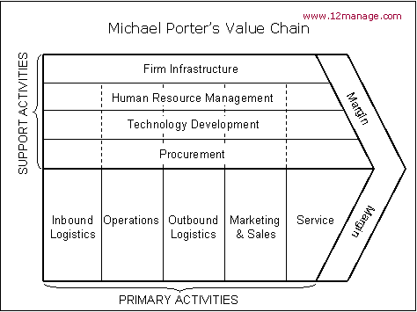
The Value Chain of M. Porter

Slide 29
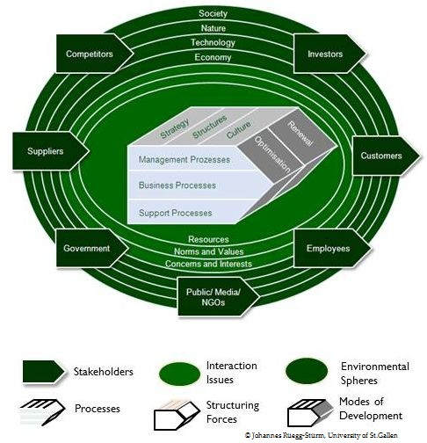
The model of St. Gallen

Slide 30
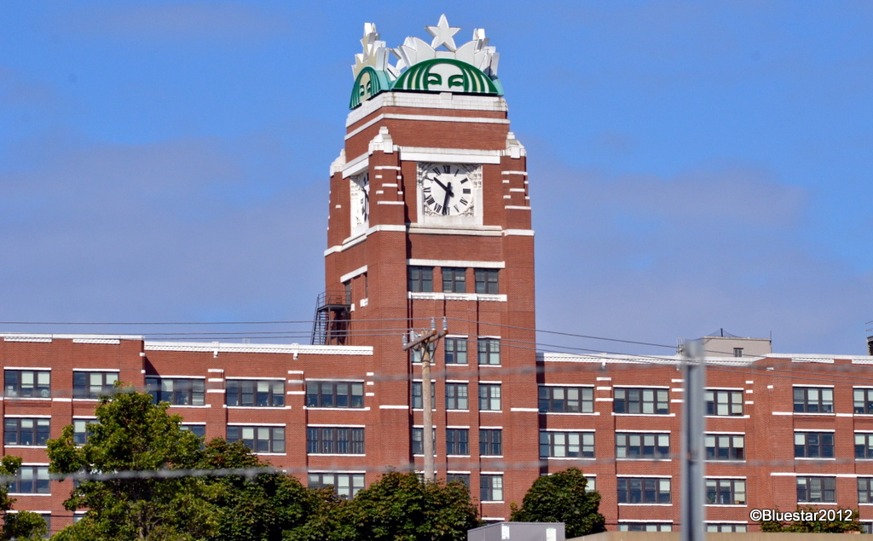
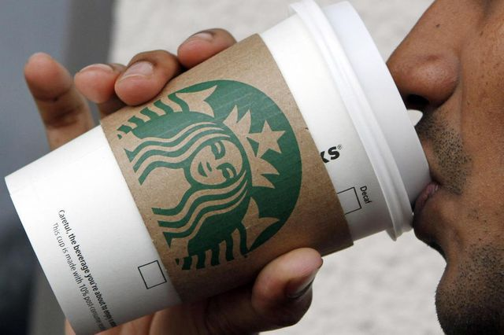
Unique selling proposition
What:
wants my customer?
are the actual trends?
pays my costumer for high quality coffee and for a clean environment?
Information flow
Good flow

Slide 31
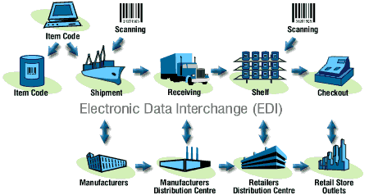
Major-Challenges
Improve the Information flow
Electronic Data Interchange
Standardisierter Datenaustausch
Product and Process-informations
Daten enthalten Produkt und Prozessbezogene Informationen
Zeitreduzierter und verlässlicher Infofluss
Beschleunigung der Geschätfsprozesse, Senkung der Lagerkosten
Erhöhung des Servicegrades
Automatisierte Datenerfassung (keine Mehrfacherfassung der Daten

Slide 32
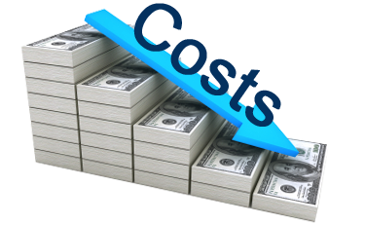
Major-Challenges
Improve the processes and the operational organisation
Who makes what, when, how and with what?
Costs → time → quality

Slide 33
Major-Challenges
Improve the processes and the operational organisation
Beispiele | Fall 1: | Fall 2:
EK-Preis | 1,50 | 1,35
Bezugskosten | 0,20 | 0,20
Handlungskosten | 0,90 | 0,90
Kundenskonto | 0,10 | 0,10
Gewinnzuschlag | 0,50 | 0,65
VK-Preis | 3,20 | 3,20
10 %
30 %

Slide 34
4) Competitors

Slide 35
Competitive Environment
Facts:
Starbucks Corp. is using an agressive expansion strategy to push out much of it´s competition
Sells coffee for premium prices to increase their profitability
Dense network of stores all around the world
Problems:
Will the allure of gourmet Starbucks coffee be maintained ?

Slide 36
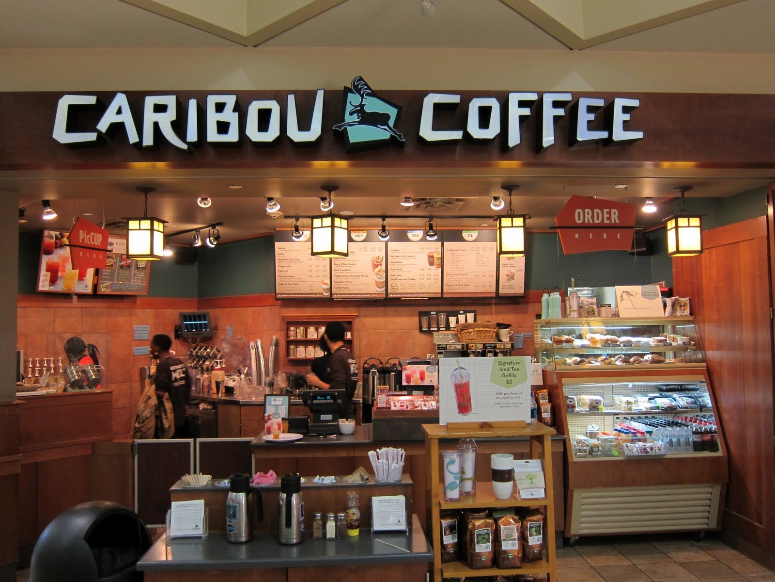
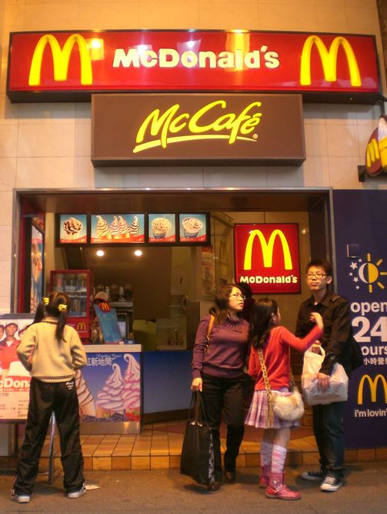
Major Competitors Worldwide

Slide 37
Major Competitors Worldwide

Slide 38
Starbucks vs. Dunkin Donuts

Slide 39
Facts about Dunkin Donuts
Part of the Dunkin Brands Concern (12,000 stores worldwide)
Founded in 1950, Massachussets
Revenue 6.9 Mrd. US$
7,309 stores in 55 countries
60 stores in germany

Slide 41
Each company dominates the region where it was founded
Starbucks on the
West Coast
Dunkin Donuts in the Northeast
- Both are expanding across the country, from opposite directions
- In New York City there are about 240 Starbucks and 350 Dunkins
-In the State there are more than 500 Starbucks and 1,200 Dunkins
Starbucks Dominates the areas of Manhattan = Image Booster!
Elsewhere in the City it´s Dunkin Donuts

Slide 43
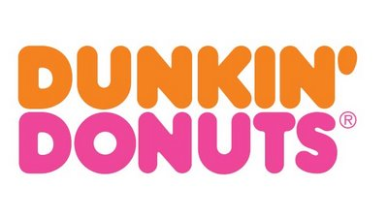
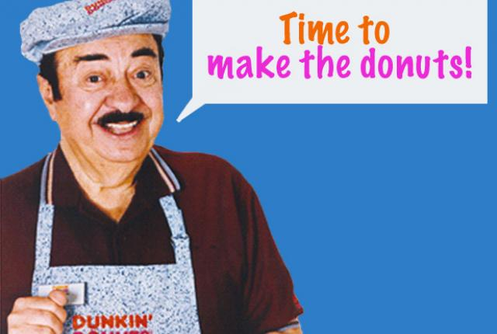
Marketing strategy of Dunkin Donuts
Target Group:
- Sport fanatics
Family
- Travelers
Sponsors the Boston Red Sox and New England Patriots, Liverpool
Spents 83% of its budget on TV

Slide 44
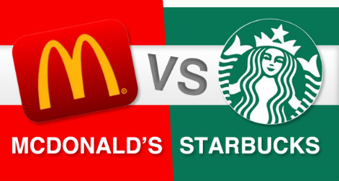

Slide 45
Facts about Mc Donalds
Founded in 1940
Price leader
Innovation leader in the coffee sector
Revenue about 27.44 Mrd. US$
About 36,628 Stores in 118 countries
Over 1,400 Stores in germany (817 contain Mc Café)

Slide 46
Starbucks vs. Mc Donald´s
Strengthen of Mc Donald´s
Is offering breakfast for years
Heavily marketing it´s Mc Café
Has got an agressive marketing strategy
Is losing market share in germany

Slide 47
Starbucks vs. Caribou Coffee

Slide 48
Starbucks vs. Caribou Coffee
Revenue: 326.5 million US$

Slide 49
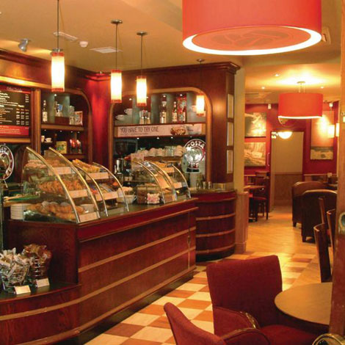
Starbucks vs. Costa Coffee

Slide 50
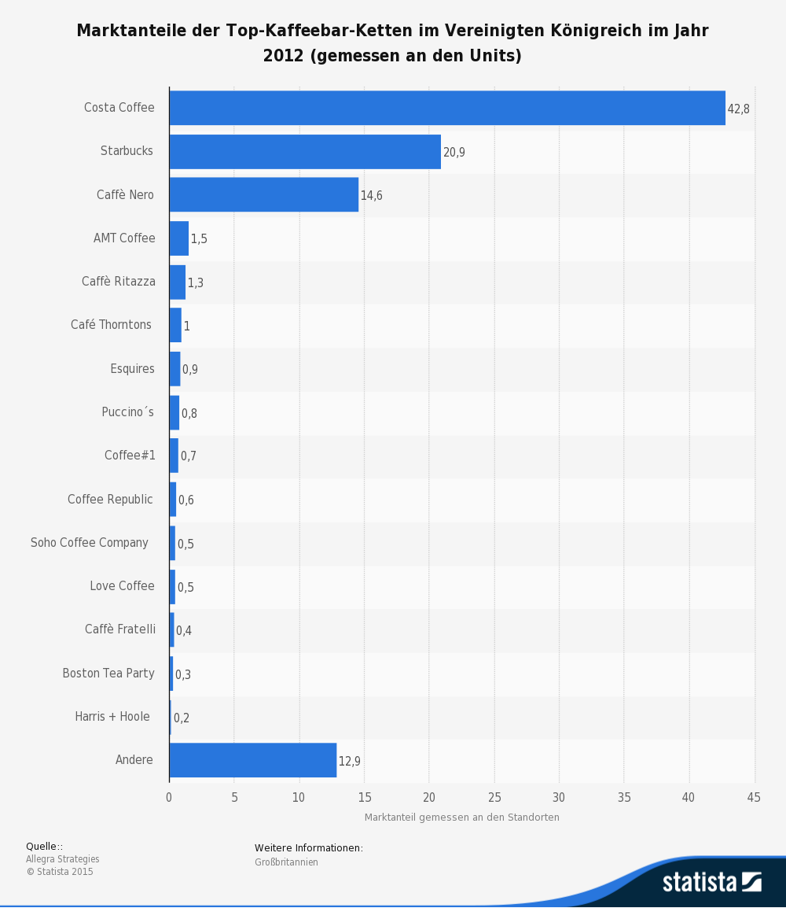
Starbucks vs. Costa Coffee

Slide 51
The german market
Starbucks entranced in 2002 (Berlin)
Over 150 stores in germany
Was unprofitable for a long time
Appreciates in germany not the position of the pioneer
Competitors are:
Local coffe houses and bakeries
San Francisco Coffee Company
Tschibo

Slide 52
5) Starbucks Today

Slide 53
Starbucks Today
Is the world´s most powerful and recognizable company with high quality standards and an unique – Starbucks Experience
Revolutionized the coffehouse industry with stores that mediate a sense of home
Clustering stores helped Starbucks to achieve market dominance. Over 20million regular customers visit Starbucks per week

Slide 54
Starbucks
Facts and future prospects

Slide 55
6) Conclusion

Slide 56
6) Conclusion
Coffee Industry
Supply Chain Management
Competitors

Slide 57
Questions / Discussion

Slide 58
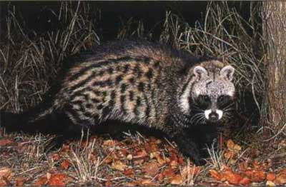
https://www.youtube.com/watch?v=mayPKmT7-CE

