Slide 1
ZARA – Leader Of Best Practices in Fast Fashion
Dong Chen Ceyla Özdemir Xin Chen

Slide 2
Agenda
1- Overview of ‘Fast Fashion’
2- Facts & Figures – Historic development of Zara
3- Zara’s Organization of Operations & Supply Chain
4- Comparison with H&M
5- Assessment of best practices in SCM
6- Future Development
7- Conclusion

Slide 3
1- Fast Fashion
Short life-cycles 3. Low predictability
2. High volatility 4. High impulse purchasing
• Consumers are empowered and demand a continuous supply of new products
• Empty shelves channels consumers to other products in the store
• Perception of a small purchasing window motivates people to visit frequently
• Avoidance of costly overproduction and subsequent sales and discounting
“This business is all about reducing stock time. In fashion stock is like food. It goes bad quick.”
- Former CEO of Inditex, Jose Maria Castellano

Slide 4
1- Concepts of Fast Fashion
Push
Execution initiated in anticipation of customer orders
Demand is not known and must be forecast
Pull
Customer demand is known with certainty
Clothing is ordered by retail stores to replenish garments or order
Order for new season clothes
New collections based on the individual demand of the store

Slide 5
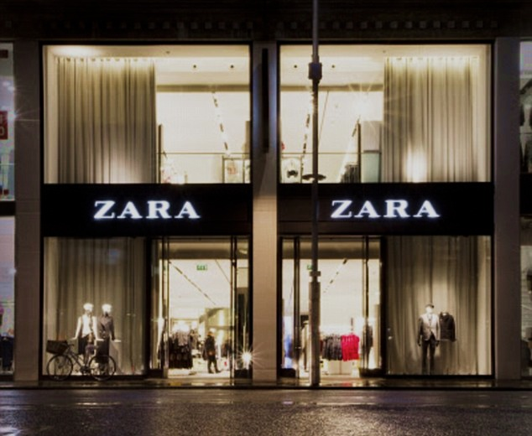
2- Historical Development
1963-1974
Amancio Ortega Gaona, chairman and founder of Inditex, begins his career as a clothing manufacturer
1975
Zara’s extend its network of stores to major Spanish cities
Amancio Ortega and his then wife open first Zara store in A Coruña , Spain
1976-1984
1988
First store outside of Spain in Oporto, Portugal
2000+ stores globally
2005
Only Spanish brand in the list of “The 100Top Global Brands”
2014

Slide 6
3- Zara’s Operations & SCM

Slide 7
Creative departments: 3 areas, 300 + staff
Samples:
prototypes made in-house and by suppliers
Mattress: material for garments laid out in layers and marked
Cutting: a machine cuts the fabric according to the patterns (own automated facilities)
Sewing: cut fabric is shipped to workshops to be stitched (outsourced)
Delivery: garments arrive in store within 48 hours of ordering
Finishing: garments are pressed, dressed and quality checked
Shipping: from logistic centers to stores via planes and trucks (3 in Spain)
DESIGN/PRODUCT/MARKET CYCLE:
Final Design = 1 day
Manufacture = 3-8 days
Transport = 1-2 days
Selling = 17-20 days
Total = 22-30 days

Slide 8
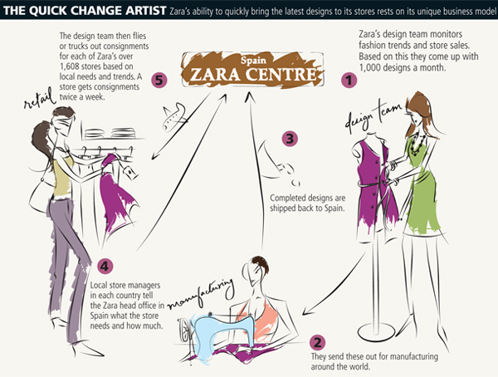
Vertical Integration Model
“The customer is at the heart of our unique business model, which includes design, production, distribution and sales through our extensive retail network.”

Slide 9
VIDEO:
https://www.youtube.com/watch?v=qhCM0F81vEg

Slide 11
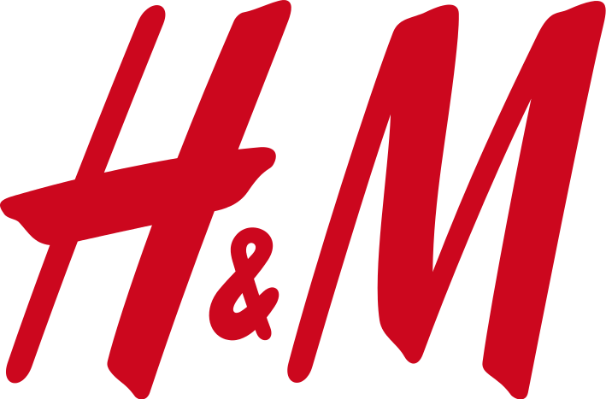
4- Comparison
 | (Inditex Group) | (H&M Group)
Headquarter | Arteixo, Spain | Stockholm, Sweden
Founded | 1975 | 1947
Countries | 84 (2014) | 56 (2014)
Online Shops | 27 | 13
Retail Stores | 2000+ | 3500
Employees | 128 000 (2013, Group) | 116 000 (2013, Group)
In House Designers | 300 | 160 (+100 Pattern Makers)
Total Revenue | € 16.274 B (2013, Group) | €15.28 B (2013, Group)
Net Profit | € 2.832 B (2013, Group) | € 1.803 B (2013, Group)

Slide 12
104 Seasons (Twice a week x 52 )
No collaboration (average age 29)
2 Main seasons with some sub-collections
Each year collaboration with major designers
60% outsourced, 40% In House
100% outsourced
Low Quality Control
High Quality Control
Stores designed to feel like luxury stores
Chain Feel
Mass production
Product supply low: scarcity
Distribution by planes & trucks
Mainly by ships & trucks
Quick Response to customer demands (constant store feedback)
Annual evaluation of customer demands
Idea to Appearance in Store: 15 Days max
3-5 months

Slide 13
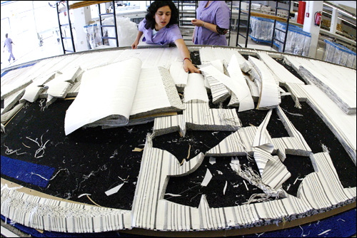
5- Assessment of best SCM practices
Automated Layouts
The design team electronically sends the patterns to the production facility, where a prototype is made. The patterns are optimized via computer so that no fabric is wasted.

Slide 14
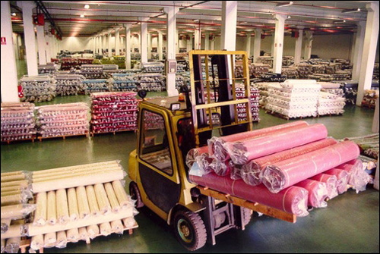
Material Supply
Massive rolls of fabric are moved in the factory

Slide 15
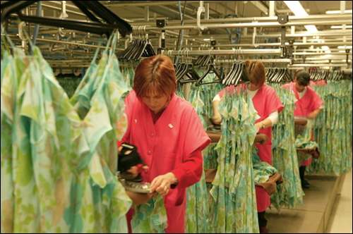
Press & Go
Once the finished clothing is back at the Arteixo factory, workers handle finishing touches, such as adding buttons and detailing.

Slide 16
Tagging
Labels for each country are attached. (This used to be a task of store managers once the product reached the store)

Slide 17
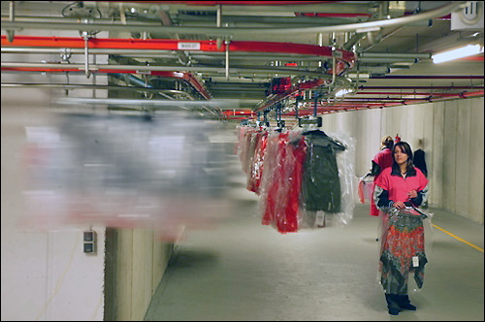
Underground Journey
Once tagged, the garments are sent to Zara’s nearby distribution center via tunnel.

Slide 18
Quick Processes
More than 2.6 million items move through the distribution center each week, and most spend little more than a few hours at the center.

Slide 19
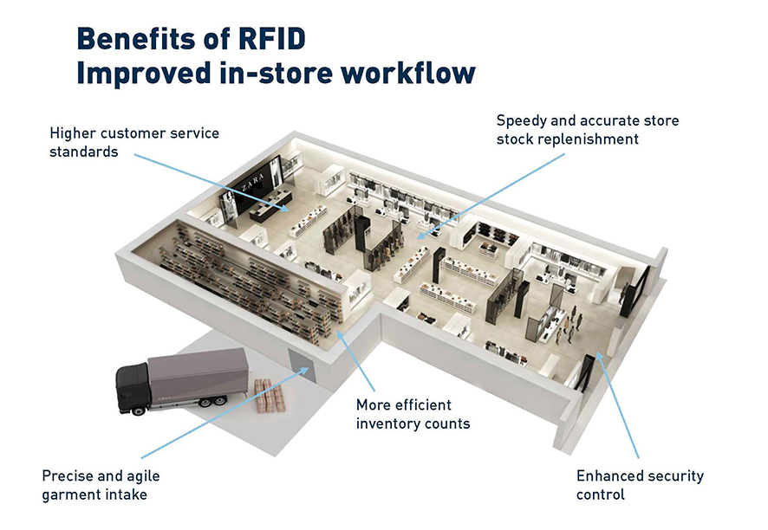
RFID
By the end of 2014, more than 1,000 of the 2,000+ Zara stores will have RFID, for inventory tracking, with the rollout completed by 2016.

Slide 20
6- Future Recommendations
Setting up local design centers to design products for the own region - product with regional Aesthetic and cut. eg. ZARA is not that successful in China although they expanded fast in China.
Setup own production center with high effiency and high speed operation nearby important market like Asia and America.
Setup local distribution centers to save the expensive air freight costs and custom taxes. eg in China ZARA is 30% more expensive than in Europe.
Marketing and advertisement in a unkown market like China and US.

Slide 21
7- Conclusion
Design, speed and responsiveness are more important than costs
Centralized production nearby Spain was the key for speed
Creating more and more the look/feel of luxury stores
Smart marketing concept, no more than 2 extra orders, even for best sellers.
Encourages customer to buy immediately
Creates scarcity of its products and therefore can maintain the price
No advertisement on public channel, only through the store and the loyal customers
Small production volume leads to less than 10% of leftover stock
High cost Supply chain management with low inventory and higher profit margins, which maximizes revenues

