Slide 1
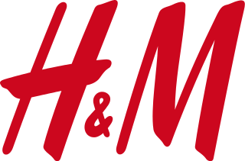
INTRODUCTION
PROCESS
SCM
BCG
DIFFERENCES
CONCLUSION
H&M’s competitive advantage:
SUPPLY
CHAIN
MANAGEMENT
Golara Safari
Nikhila Yadavalli
Eduardo Rodriguez
SUPPLY CHAIN MANAGEMENT
November
17, 2015

Slide 2
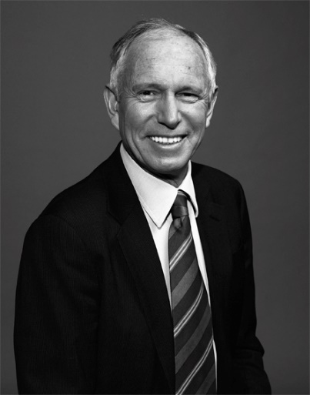
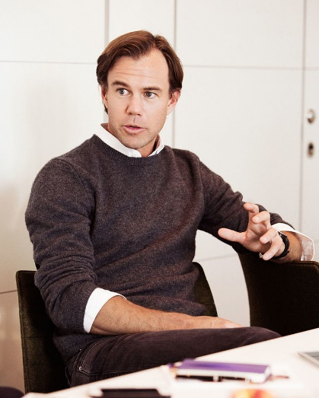
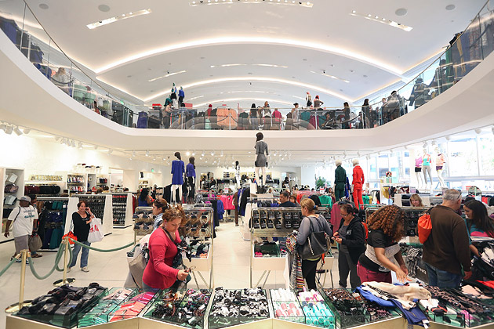
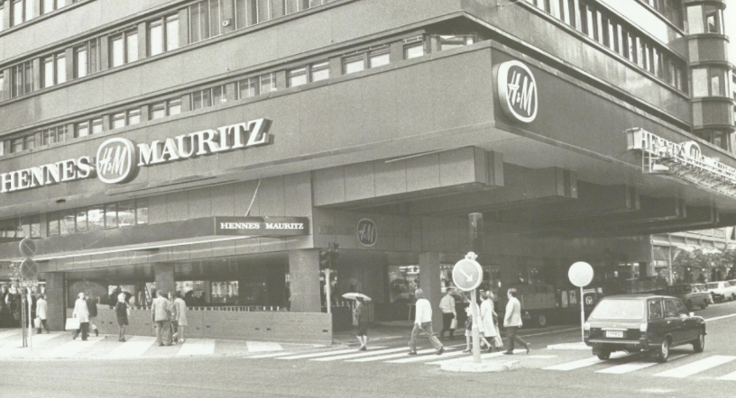
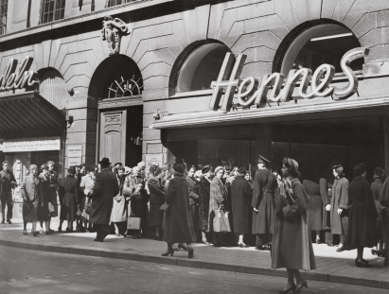
INTRODUCTION
PROCESS
SCM
BCG
DIFFERENCES
CONCLUSION
Introduction and history
Erling
Persson
Stefan
Persson
Rolf
Erikssen
Karl-Johan
Persson
1947 - 1982
1982 - 2000
2000 - 2009
2009 to date
Notes:
H & M (Hennes & Mauritz AB). A Swedish multinational retail-clothing company, founded in 1947 in Vasteras, Sweden.
Employs 132,000 people worldwide. Has almost 4,000 stores around the globe.
HENNES means “for her” in swedish. And in 1968 Erling bought rival Mauritz Widforss and then changed the name to Hennes & Mauritz.
Erling Persson ,a former pen salesman, opened H&M’s first store in Sweden in 1947 to provide women’s fashionable clothes at very low prices.
Company public: 1974 but family kept control of the firm. Erling focused so much on costs.
Stefan Persson (Son of Erling): Sales of $330 million a year. (1982) and operated 147 stores. EXPANSION, low costs.
Fabian Mansson (33 year old) joins in 1998 and leaves in 2000.
Rolf Erikssen takes over in 2000 with 550 stores and $2.8 in sales. 70% of sales were from Outside Sweden.
He was the CEO of H&M Denmark. Objective: Basic low priced clothing. “ All young people are the same all over”.
One size fits all became a problem. Growth continued and in 2004 there were 1,000 stores worldwide.
Karl-Johan Persson. Low prices, aggressive expansion but asked for help from fashion titans such as Karl Lagerfeld and also brought in socialite and stars such as David Beckham to increase brand awareness and show that they not only focused on low prices but also on high fashion. Sales are now 18 billion dollars a year and there are around 3950 stores.

Slide 3
INTRODUCTION
PROCESS
SCM
BCG
DIFFERENCES
CONCLUSION
Company profile and business concept
Multinational retailer based in Sweden established in 1947
Reaches a wide variety of consumers mostly ranging from 18 to 30 years old
Business Concept: Combines Fashion and Quality at the Best Price
High focus on sustainability in their supply chain
H&M tries to run operations in a way that is economically, socially and environmentally sustainable

Slide 4
INTRODUCTION
PROCESS
SCM
BCG
DIFFERENCES
CONCLUSION
Idea to store process
Design
Planning and buying
Production Offices
Suppliers
Warehouses
Technology
Stores
Reverse Logistics

Slide 5
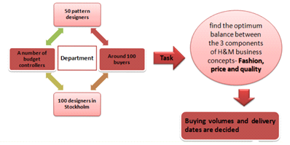
INTRODUCTION
PROCESS
SCM
BCG
DIFFERENCES
CONCLUSION
Design
Design is essential to success in the industry
Been able to hire successful designers and do several collaborations
160 in-house designers, 100 pattern makers
Moved away from only 2 seasonal collections per year

Slide 6
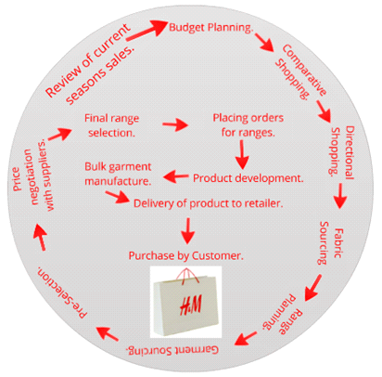
INTRODUCTION
PROCESS
SCM
BCG
DIFFERENCES
CONCLUSION
Planning and buying
H & M forecasts. However, they put less focus on it due to variability in demand such as:
Short selling seasons
Levels of uncertainty
Lack of historical data for trendy products

Slide 7
INTRODUCTION
PROCESS
SCM
BCG
DIFFERENCES
CONCLUSION
Production offices
15 production offices are strategically located to help manage over 900 suppliers
Work with buyers in Sweden and suppliers manufacturing product to review samples,check quality and choose the right suppliers
Transport times, import quotas and quality aspects are taken into account when deciding a supplier
Facilitates seamless collaboration between the 2 parties

Slide 8
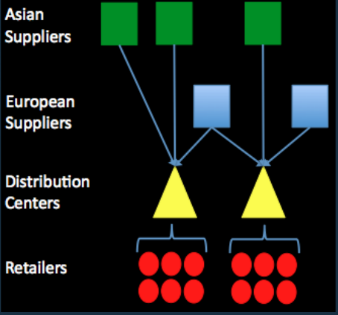
INTRODUCTION
PROCESS
SCM
BCG
DIFFERENCES
CONCLUSION
Suppliers
H&M does not own its factories
Fast Fashion – Europe: Less lead time , more trendy
Basics – Asia: longer lead time but it‘s cost efficient
Goods are typically transported either directly to stores or replenishment centers by sea and rail(90%), but ocassionally move by road and air

Slide 9
INTRODUCTION
PROCESS
SCM
BCG
DIFFERENCES
CONCLUSION
Warehousing
Replenishment Facilities
“Call off warehouse“
Goods that do not go to the centralized stock room
Goal of centralized stock room is to replenish item levels in stores according to selling trends
ERP system delivers rapid replenishment

Slide 10
INTRODUCTION
PROCESS
SCM
BCG
DIFFERENCES
CONCLUSION
Technology
Each store is linked to a global ERP system that delivers key up-to-date information to the organization delivering all encompassing visibility.
H&M also shares its information with its suppliers on latest fashion trends and the internal matters allowing them to forecast.
Their uniform IT platform allows the company to react quickly to new trends and avoid overstocking.

Slide 11
INTRODUCTION
PROCESS
SCM
BCG
DIFFERENCES
CONCLUSION
Stores worldwide & subsidiaries
Store floor is replenished using EPOS system
EPOS(electronic point of sale) connects store floor to stock room
Stores have uniform layout
hm.com
cosstores.com
monki.com
weekday.com
cheapmonday.com
stories.com

Slide 12
INTRODUCTION
PROCESS
SCM
BCG
DIFFERENCES
CONCLUSION
Reverse logistics
Customers can hand in unwanted clothing
Collect, re-use and turn into something new to avoid wasting materials
Dramatically reduces how much resources are used
20% of specific clothing line is made entirely from recyclables

Slide 13
INTRODUCTION
PROCESS
SCM
BCG
DIFFERENCES
CONCLUSION
Levels of SCM usage
Strategic Planning
Tactical management
Operational level

Slide 14
INTRODUCTION
PROCESS
SCM
BCG
DIFFERENCES
CONCLUSION
Levels of SCM usage
Strategic Planning
Sites and Target
Suppliers, Transport, Logistic
Innovations
Product Management
IT System

Slide 15
INTRODUCTION
PROCESS
SCM
BCG
DIFFERENCES
CONCLUSION
Levels of SCM usage
Strategic Planning
Sites and Target
Suppliers, Transport, Logistic
Innovations
Product Management
IT System
Tactical Management
Making Contracts
Defining Standards
Transportation Options
Inventory Logistics
Practices

Slide 16
INTRODUCTION
PROCESS
SCM
BCG
DIFFERENCES
CONCLUSION
Levels of SCM usage
Strategic Planning
Sites and Target
Suppliers, Transport, Logistic
Innovations
Product Management
IT System
Tactical Management
Making Contracts
Defining Standards
Transportation Options
Inventory Logistics
Practices
Operational Level
Forecasting
Production Status
Monitoring logistics
Settling damages
Monitoring Input/Output

Slide 17
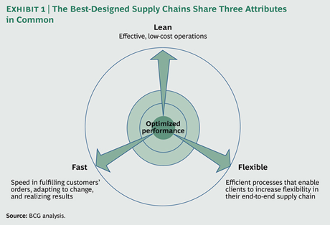
INTRODUCTION
PROCESS
SCM
BCG
DIFFERENCES
CONCLUSION
Supply Chain characteristics – BCG analysis
BCG’s analysis has found that the best-designed supply chains share three common characteristics:
Fast. Speed in fulfilling customer orders, adapting to change, and realizing results.
Flexible. They create efficient processes that give flexibility to the end-to-end supply chain.
Lean. They emphasize effective, low-cost operations.

Slide 18
INTRODUCTION
PROCESS
SCM
BCG
DIFFERENCES
CONCLUSION
H&M: Fast and lean
A quick response supply chain produces goods only when there is enough evidence for demand
Quick reponse proves most effective in this constantly changing industry
Products created, manufactured and delivered in as little as 2-6 weeks
Technology
Outsourced Production Offices
Vertically Integrated

Slide 19
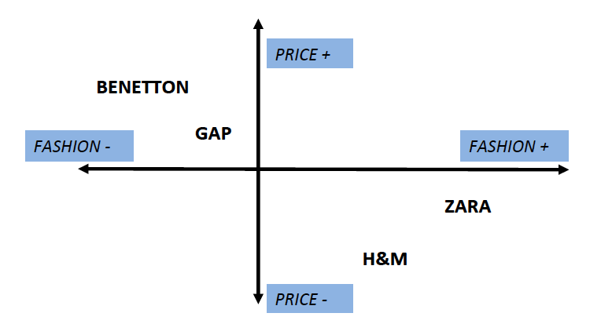
INTRODUCTION
PROCESS
SCM
BCG
DIFFERENCES
CONCLUSION
Differences between H&M and competitors

Slide 20
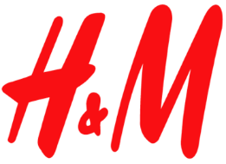
INTRODUCTION
PROCESS
SCM
BCG
DIFFERENCES
CONCLUSION
Cost Efficiency
Less Investments
Long Supply Chain → long Lead-Time
Necessity of Advanced IT System
Centralizing Production Activities
Short, Manageable, Responsive Supply Chain
Quick Reactions To Market Demand Change
Higher Costs and Investments

Slide 21
INTRODUCTION
PROCESS
SCM
BCG
DIFFERENCES
CONCLUSION
 | Production Strategy | Focus and Power | Approximate Lead-Time | Design Policy | Success Core | Investm-ents | Advertise-ments
 | Outsourcing | -Core Activities(design,Quality,innovation,IT) -Cost efficiency | 2-6 weeks | Cooperating and hiring world-class designers | Wide-spread manufacturers And strong IT | Leases stores outsourcing production | Advertising Campaigns
 | In-house production | -Timing -Fastest retailer | 2-3 weeks | Art-school designs refined by shopper-feedback | centralized enterprise | owns stores and production plants | Stores next to luxury brands
Benetton | Outsourcing labor-intensive or scaleinsensitive activities | -Social Issues -United Colors | 5-6 months | postponement strategy | Emphasising on commitment, involvement and solidarity | licensees for stores owns production plants | Shockvertising - campaigns

Slide 22
INTRODUCTION
PROCESS
SCM
BCG
DIFFERENCES
CONCLUSION
H&M financial strength
Sales of US$4 billion in 2000 compared to sale of US$18 in 2012.
Growth in number of stores: 600 stores in 2000 compared to 3,950 stores in 2015.
Company’s gross margin: 51% in 2000 compared to 60% in 2012.
Sales per employee: US$ 0.14 million in 2000 compared to US$ 0.25 million in 2012.
Stock Price: US $78 in 2000 compared to US$ 318 in 2015.
Notes:
H&M plans to open 400 new stores this year, mostly in China and the US. Last year it opened 379 outlets and this year’s expansion plans would push the number of stores worldwide to around 3,950. The retailer is pushing into new markets including Peru, Macau, South Africa and India. In February it opened its first store in Taipei, Taiwan.

Slide 23
INTRODUCTION
PROCESS
SCM
BCG
DIFFERENCES
CONCLUSION
*
SWOT and conclusion
H&M needs to keep its focus to continue to differentiate from other brands.
Its customers like fashion at low prices.
The Company needs to work on integrating its channels, and get an edge
in the fast fashion e-commerce world before their competitors do.
H&M needs to continue its expansion to other markets where demand could grow
Planning could be descentralized to be faster and to better understand customers.
Notes:
Tip: Beware of Primark
H&M – employees : 132,000
Primark: 51,250

