Slide 1
Supply Chain Management Case Study
Lihuan Li - 314005
Sabarinath Pathanoor Mukundan - 314149
Swetha Vasudevan - 314105

Slide 2
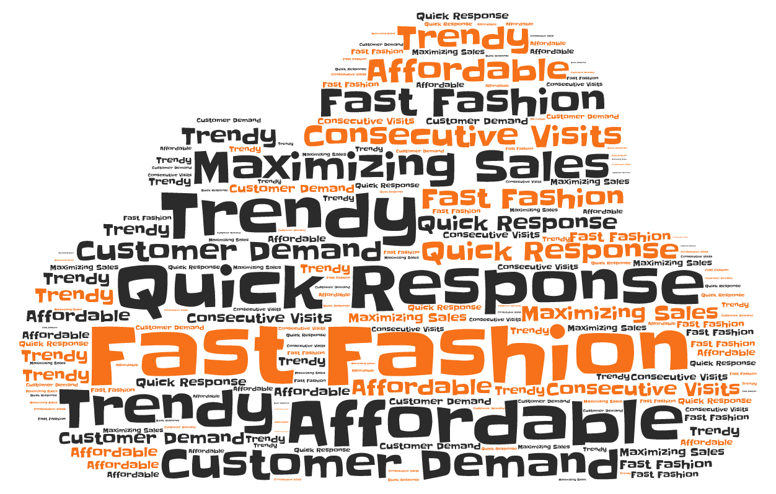
Fast Fashion Concept
=

Slide 3
Inditex
Zara
Business Model
Design
Manufacturing
Logistics
Stores
Customers
Technology
Summary
SCM
Strategy
Analysis
Comparison – Zara, H&M, Benetton
Future Developments
A
G
E
N
D
A

Slide 4
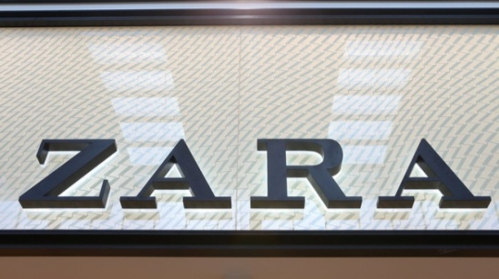
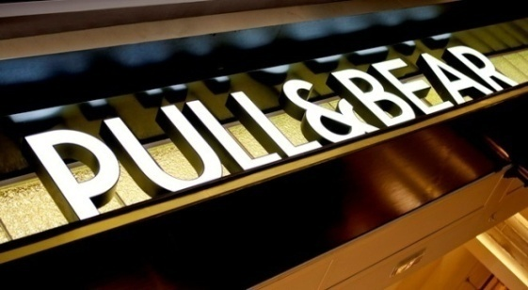
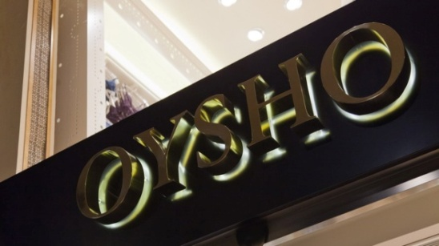
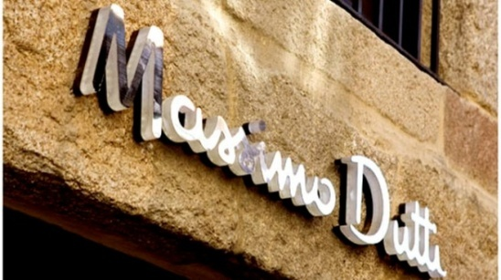
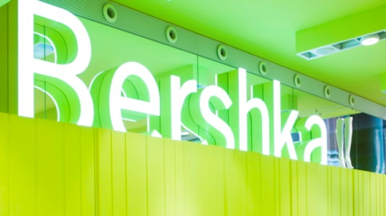
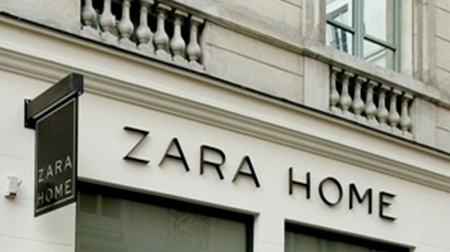
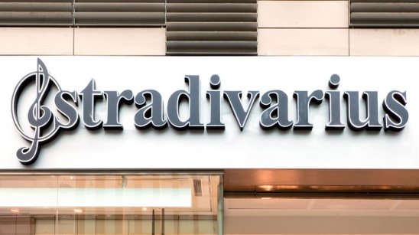
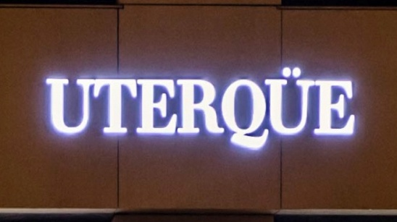
Inditex

Slide 5
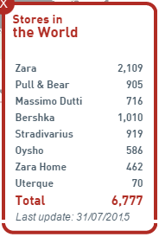
ZARA
“To bring high fashion apparel to the market at an affordable price”
Amancio Ortega Gaono

Slide 6
Zara - History
Ortega started business as a dress-maker
Expanded internationally and diversified brand portfolio
2,019 stores worldwide
First Zara store opened in La Coruña
Zara extended presence in major Spanish cities
First store outside Spain was opened in Porto, Portugal
1963
1975
1976-84
1988
1990’s
2015

Slide 7
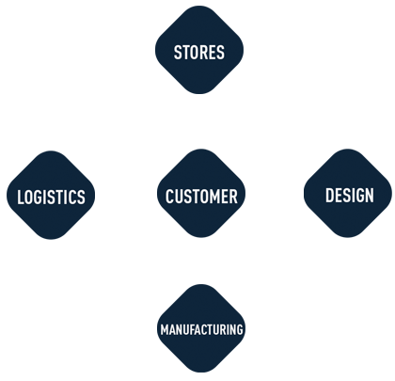
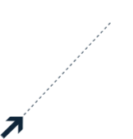
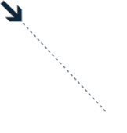
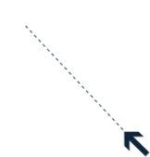
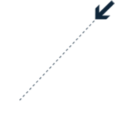
Business Model
Daily sales analysis
Customer feedback
Delivery twice per week
Constant changes to the initial collection based on demand
Small production batches

Slide 8
Design
Customer Demands from Stores
Travel Across The World
Fashion Show, University, Movie, MV, etc.
250 designers in headquarter

Slide 9
Design
Store Specialist: outlines of style/fabric/color based on customer demand
Procurement Manager: inputs regarding capacity & cost
Designers: design specifications
Prototype ready in few hours
Adapt swiftly to changes within each season
Design constantly to satisfy customer

Slide 10
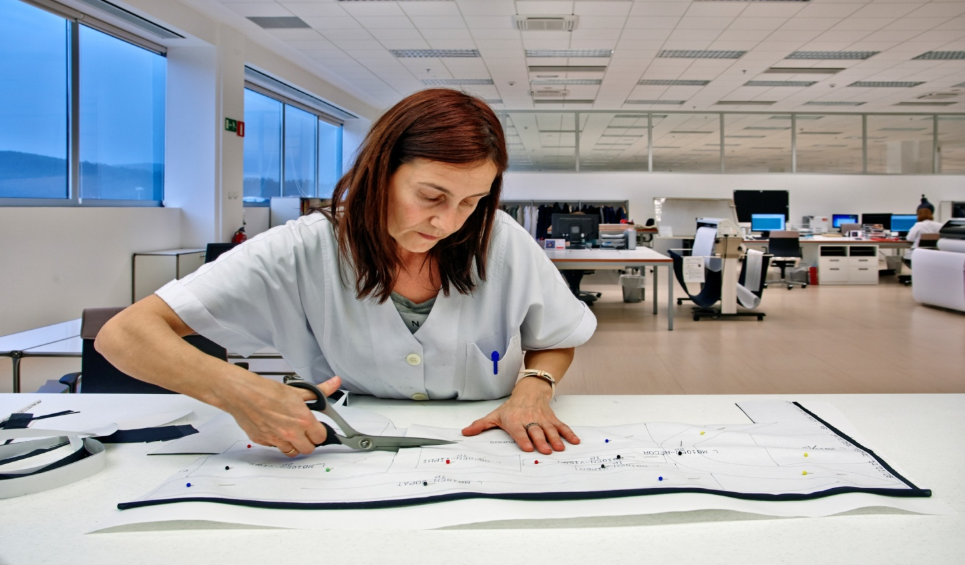
Manufacturing
60% of total production carried out in Spain and Portugal
More fashion-forward/detailed items - produced in-house
Less time-sensitive pieces - outsourced
Subcontracts some stages of process

Slide 11
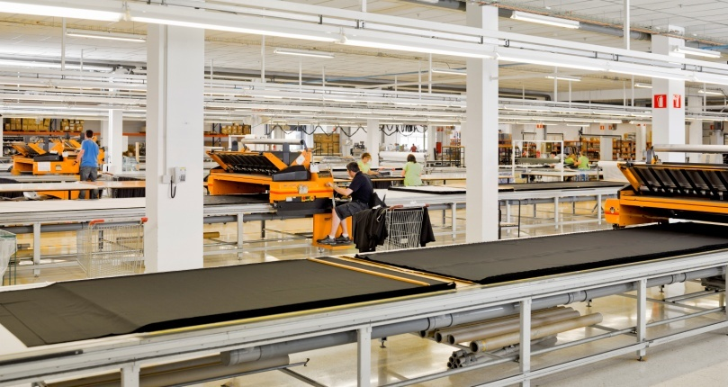
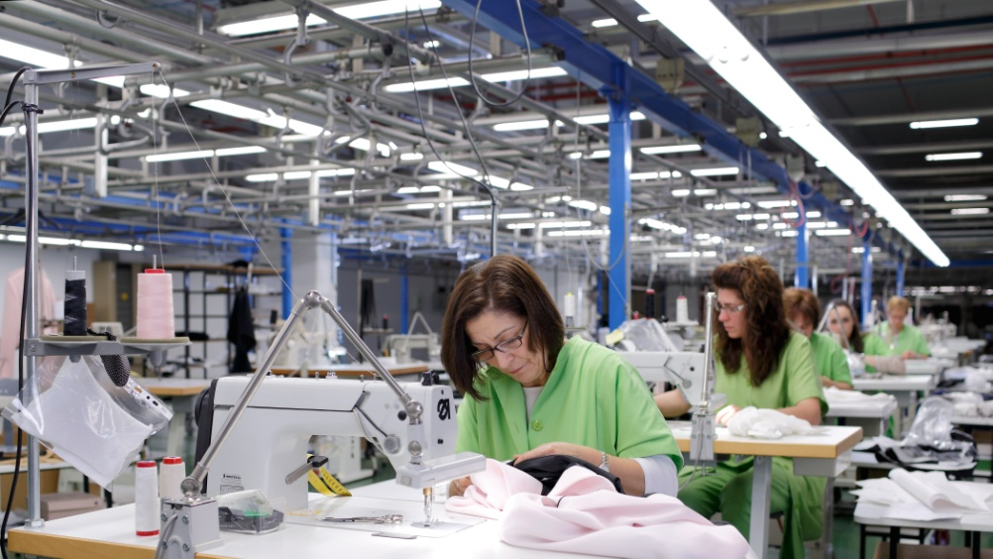
Manufacturing
Manufacturing
The cut pieces are bar-coded and distributed among 350 small workshops in Spain and northern Portugal for sewing
Fabrics are cut according to the prototype by automated cutting facilities

Slide 12
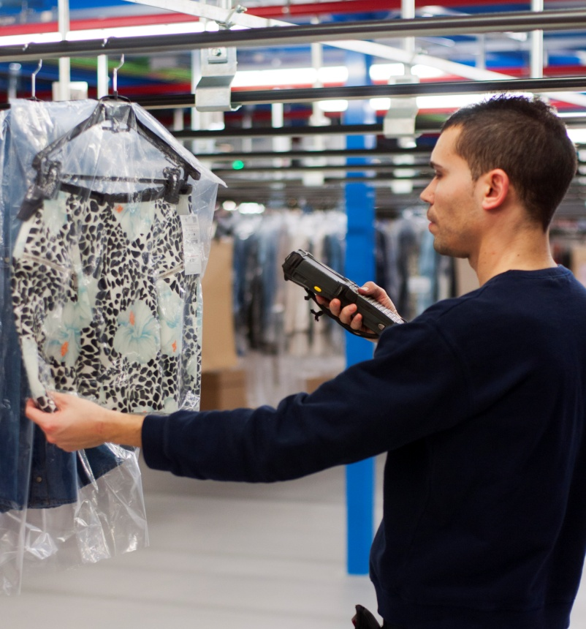
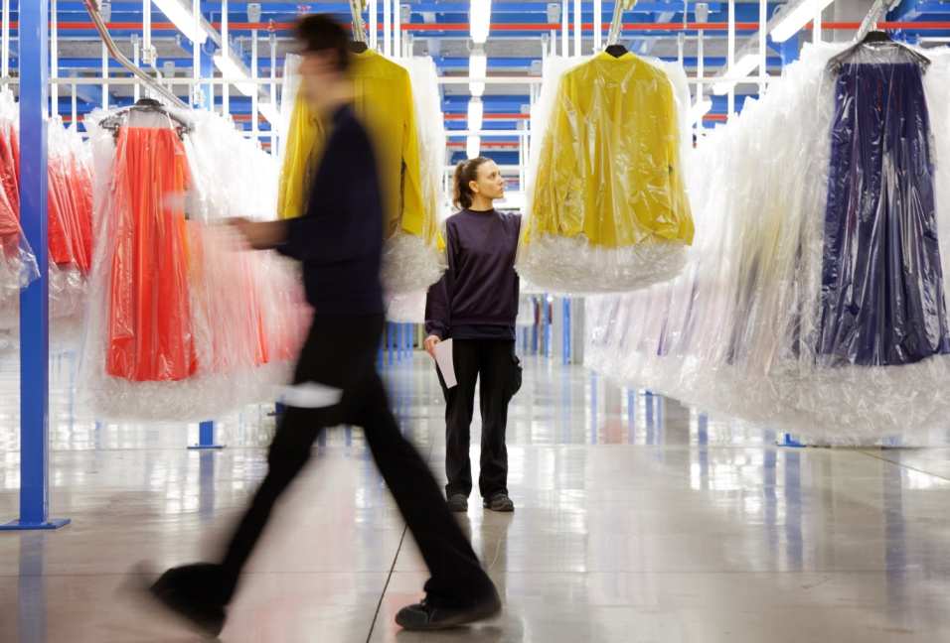
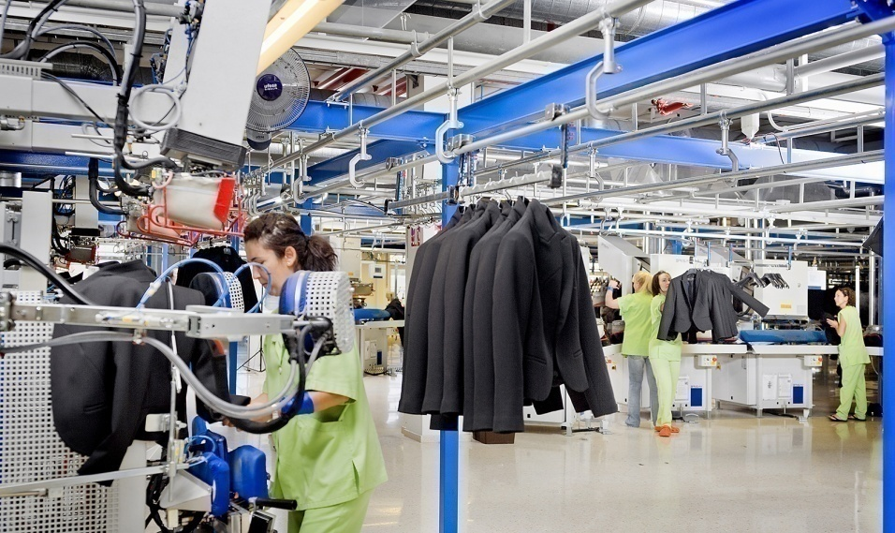
Manufacturing
Manufacturing
The stitched garments are checked for quality, pressed, tagged, wrapped or kept on hangers, then sent to distribution centres

Slide 13
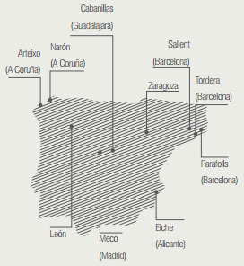
Logistics
Zara Logistics, Arteixo
500,000 ㎡
Located centrally among 14 manufacturing plants
Own railway track of 211km
Manages 50% of women’s and men’s merchandise
Serves Spain, Portugal, the Americans and Middle East
Platform Europe, Zaragoza
Manages the remaining 50% of women’s and men’s merchandise
Serves non-Iberian Europe, Russia, and Asia
Meco, Madrid
Manages children’s wear for all Zara stores
Delivers all over the world
Notes:
Zara Logistics, in Arteixo
Platform Europe, in Zaragoza
Opened in 2002
Meco, in Madrid
Most countries have small warehouses for extra or extra returned merchandise and inter-store transfers

Slide 14
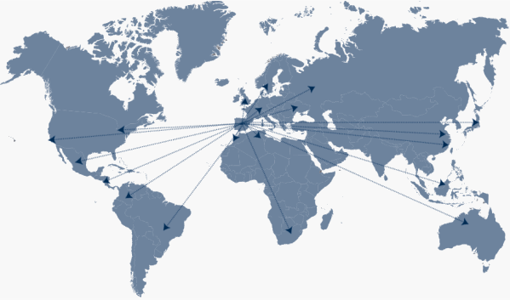
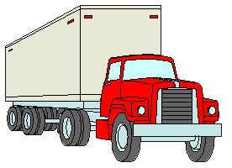
Logistics
FIGURES
Strategy
3 separate product lines(women, men, children)
Frequency
Twice a week
Duration
Europe: within 24h by truck
Others: within 2d by flight
Shipping Accuracy
98.9%
All products, regardless of their origin or destination, come to logistics centers in Spain before being sent to the stores
Notes:
Optical scanning devices sorting out more than 6000 items per hour
Higher level -> folded apparel in boxes -> belt system1
Lower level -> garments on hangers, sorted based on styles -> belt system2
routed by automatic routing devices
pre-priced and labeled according to destination
Items have codes conveying to the staff where they need to be placed
Garments are shipped out twice a week

Slide 15
Logistics
ORDERING CYCLE
Season Beginning
Person in charge: Headquarters
Item: new collections
Quantity: 25,000 units
During Season
Person in charge : Store Manager
Item: replenishments
Quantity: 12,000 units/week
( 8,000 for women’s
2,000 for men’s
2,000 for children’s )
All products, regardless of their origin or destination, come to logistics centers in Spain before being sent to the stores

Slide 16
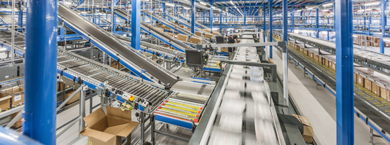
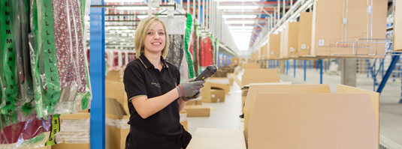
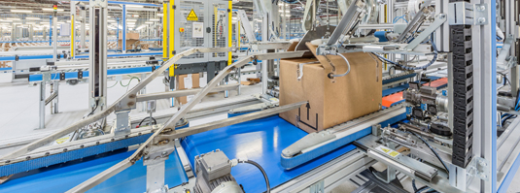
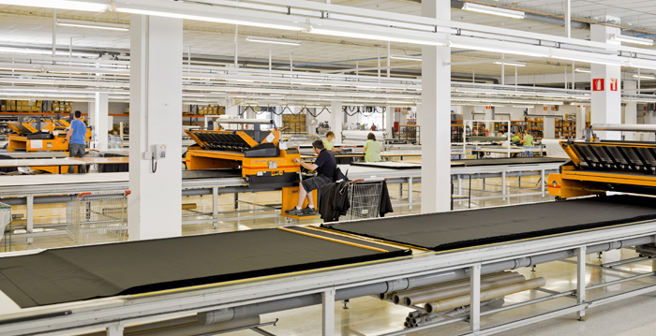
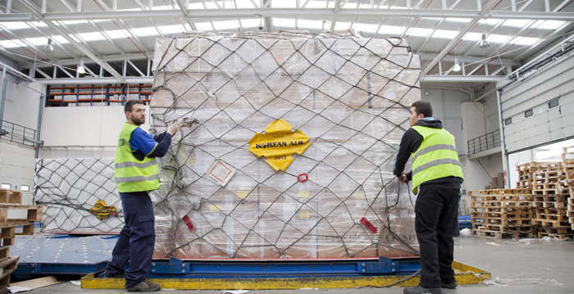
Logistics
Highly Automated
RFID
Optical scanning device -> sorting 6000 items/h
Two levels of automated systems
Automatic routing device
Notes:
Optical scanning devices sorting out more than 6000 items per hour
Higher level -> folded apparel in boxes -> belt system1
Lower level -> garments on hangers, sorted based on styles -> belt system2
routed by automatic routing devices
pre-priced and labeled according to destination
Items have codes conveying to the staff where they need to be placed
Garments are shipped out twice a week

Slide 17
Logistics
OBJECTIVES
To ensure that there is always something new to offer
To respond to demand shifts during one season
To encourage consecutive visits
(Zara customer:17 visits/year
Others :4 visits/year)
To pursue speed in sacrifice of freighting cost
All products, regardless of their origin or destination, come to logistics centers in Spain before being sent to the stores

Slide 18
Logistics
Notes:
https://www.youtube.com/watch?v=iKUmOsmh-Gs

Slide 19
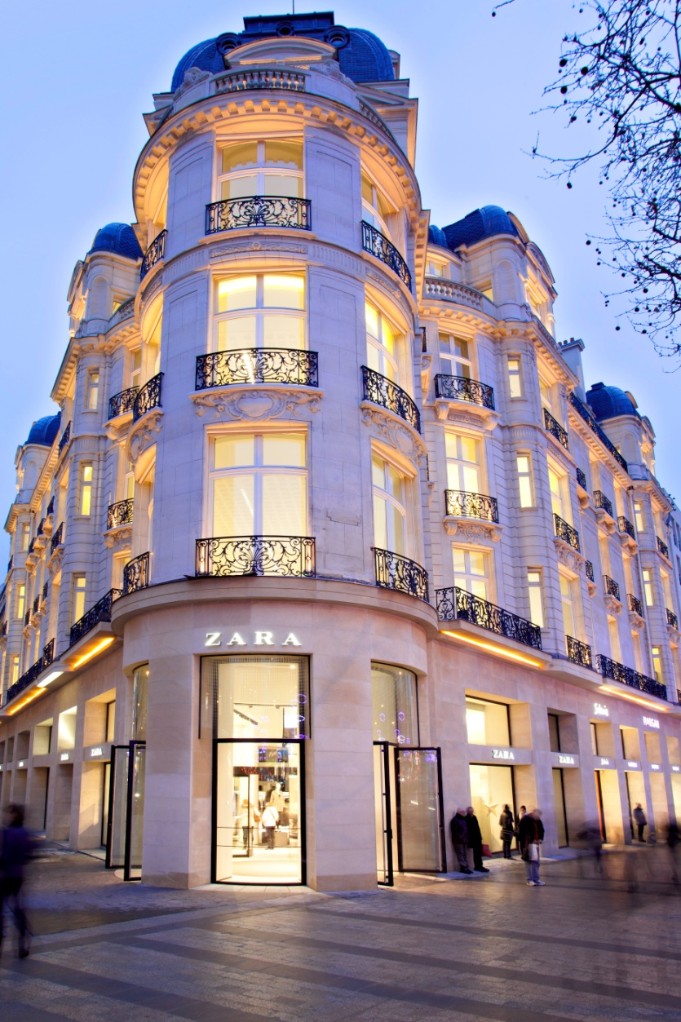
Organization Structure
Stores
Stores located in prime locations
Most of the stores owned by the company
Stores all over the globe identical and modelled off of central designs
Window display crucial for attracting customers
Display of clothes given prominence

Slide 20
Stores - Inventory Management
Organization Structure
Store managers select about 800 designs out of the 2000 offered at the beginning of the season
Customer opinion
Sales success
Constant feedback on customer opinion and sales success given to the design team

Slide 21
Stores - Inventory Management
Organization Structure
Each item stocked in small quantities (3-5 units per size, per design)
Inventories not renewed when an item is sold out
Fewer merchandize on discount

Slide 22
In-store Logistics Management
Organization Structure
Products are not kept on the selling floor unless all sizes are available
Sales Associate
Processing Deliveries
Managing Backroom Replenishment
Managing Display Areas & Fitting Rooms
Physical Audits

Slide 23
Organization Structure
Country Head
Commercials
DTs/Regional Managers
HR Directors
Store Managers
Section Managers
Non Operations Issues
Sales Associates

Slide 24
Organization Structure
Country Head
Commercials
DTs/Regional Managers
HR Directors
Store Managers
Section Managers
Non Operations Issues
Sales Associates

Slide 25
Organization Structure
Country Head
Commercials
DTs/Regional Managers
HR Directors
Store Managers
Section Managers
Non Operations Issues
Sales Associates

Slide 26
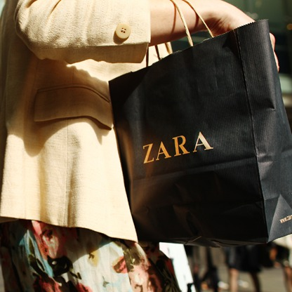
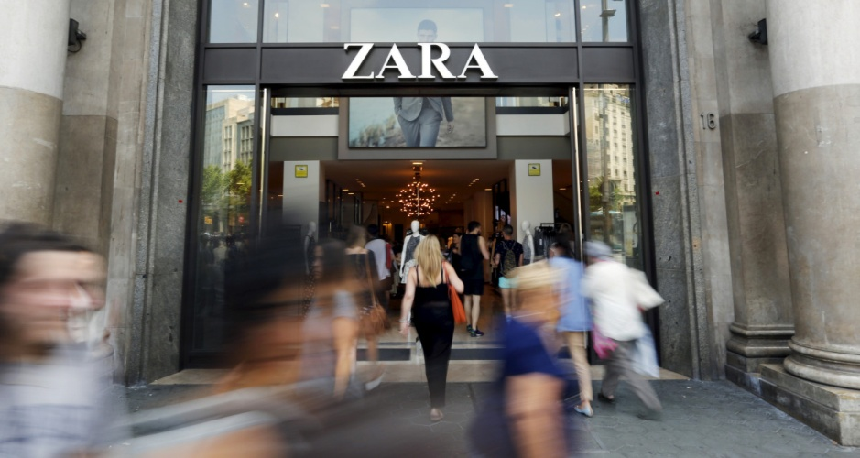
Customers
Centre of the Business model
Target customers – Young, fashion conscious people interested in buying inexpensive clothes
Product Inventories fresh and scarce to encourage more visits

Slide 27
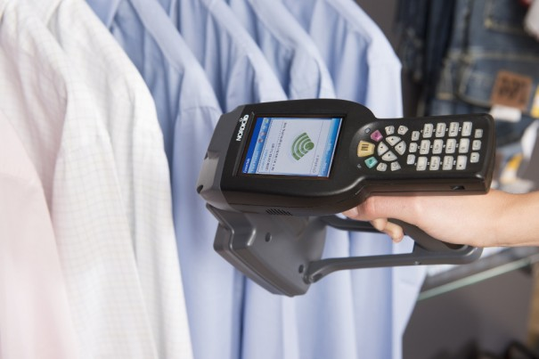
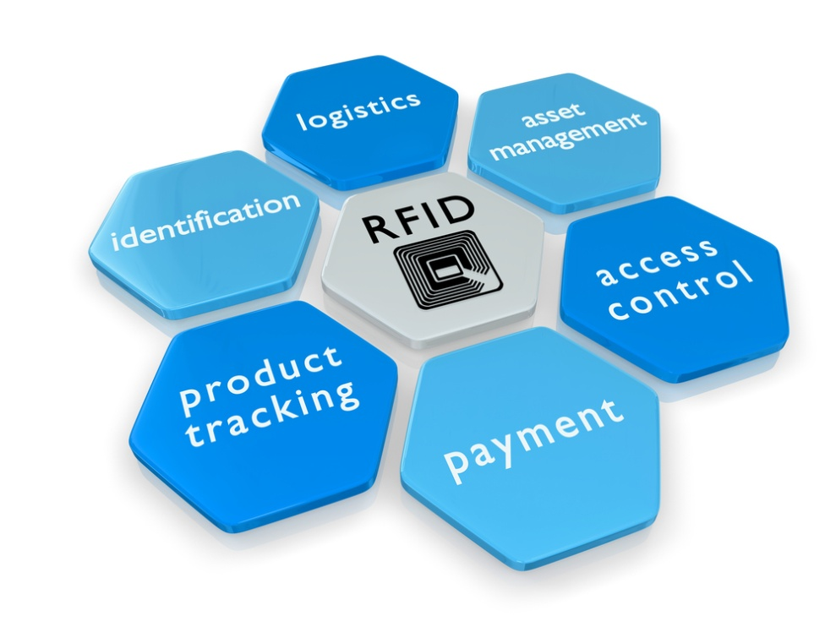
Technology
Hybrid Model : IT + Human Intelligence
Computer Aided Design and Manufacturing
RFID Technology

Slide 28
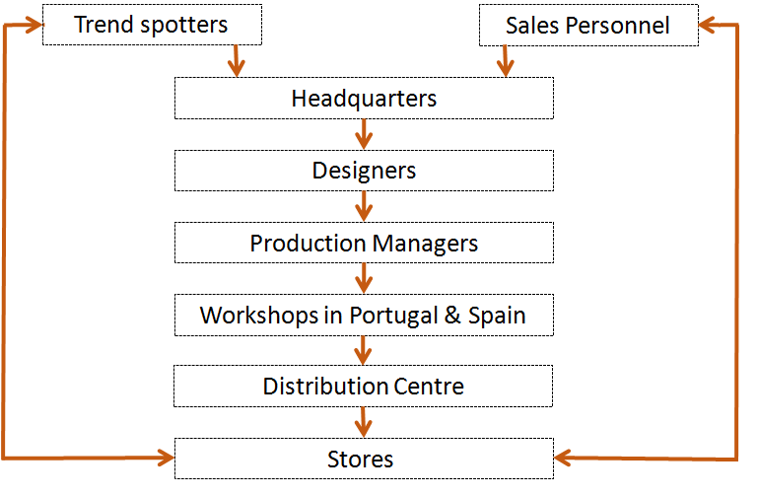
Summary - SCM

Slide 29
Summary - Strategy
Business Model
Customers
Vertical Integration – Forward & Backward
Speed and Decision Making
Marketing ,Merchandising and Advertising

Slide 30
Analysis
Better control and more responsive
Highly flexible and fast
Constant flow of Information
Global sourcing strategy
Limited quantity production benefits
Centralised distribution centre benefits
Economies of scale not possible
Increasing costs
International expansion cautioned

Slide 31
Comparison
 | Inditex Group (ZARA) | H&M Group (H&M) | Benetton Group (Benetton)
No. of stores (2014) | 6,683 in 88 markets (Zara - 2014) | 3,511 in 55 markets (H&M - 3261) | 6000 stores
Business Strategy | Time based | Cost based (price leaders) | Worldwide brand
Production | Produce small batches， Global Sourcing | Low cost country sourcing | Full control of Production Facilities
Distribution | Automated Centralized Distribution | Distribution centres in all countries | Logistics hub in Europe and Asia
Retail | Ownership of Stores and Merchandising Strategy | Eliminate middle-man to consolidate volume | Outsource Retail Operation

Slide 32
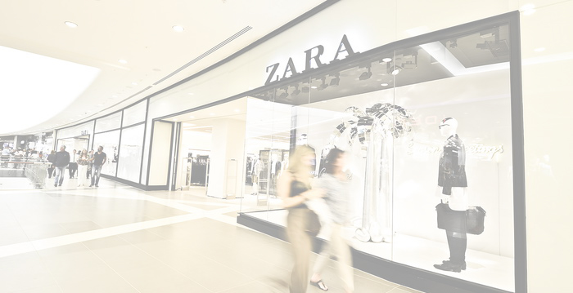
Future Development
1. Establish logistic center to be near areas with rich supply & low cost & big market & special aesthetic
-> e.g. Asia/South America, to reach lower price by saving freighting cost
2. Consolidate transportation across different product lines
-> arrange logistic center by destination instead of product line
3. Automatic replenishment
-> for basic products and special ones based on specific market characteristics, to leave more focus on fashionable items

Slide 33
Future Development
4. Advertising investment for market penetration and building up positive brand image
-> penetration in big potential market like Asia/America
5. Outsource time-consuming work from store employees
-> e.g. processing deliveries
6. Continuously work with academics in operation management and IT support
-> to find the most efficient practice

Slide 34
References
https://www.inditex.com/en/home
http://www.slideshare.net/chspravin/supply-chain-management-of-zara-28247084
https://en.wikipedia.org/wiki/Zara_(retailer)

