Slide 1
Best Practices in Supply Chain Management at H&M
Fawad Zahir
Adil Zhantilessov

Slide 2
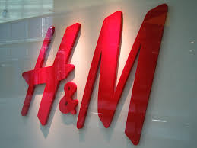
H&M: Content
History
Supply Chain
Comparison with ZARA’s Supply Chain
Strengths of H&M Supply Chain
Future development

Slide 3
H&M Today, the second largest global clothing retailer
Origin | Swedish
Business | Multinational retail clothing
Market | 53 countries
Stores | More than 3000
Number of employees | More than 116 000
Suppliers | More than 800
Revenue | 150 billion SEK
Profit after Tax | 17,2 billion SEK
Figures of 2013

Slide 4
H&M Brands

Slide 5
How to characterize H&M Supply Chain Management
“ A short lead time is not an end in itself, since it is always a matter of getting the right balance between price, time and quality”
H&M Annual Report, 2006

Slide 6
H&M History
Established as a store selling clothes for women by Erling Persson in Vasteras, Sweden in 1947
Expanded into Stockholm, Sweden, after acquiring Mauritz Widforss and stocked men’s clothing in 1968
Expanded during 1960s in Europe
Opened the store in 1976 in the UK
Introduced clothes for teenagers and babies in 1977-78

Slide 7
H&M History
Acquired Rowell’s mail order company in 1980 after which it started selling clothes through catalogues
Changed the concept from “cheap clothes” to “fashioned garments at a low price” since1982
Began selling clothes through the Internet in the end of 90s

Slide 8
H&M International Expansion
Year | Markets
1947 | Sweden
1964 | Norway
1967 | Denmark
1976 | United Kingdom
1978 | Switzerland
1980 | Germany
1989 | Netherlands
1992 | Belguim
1994 | Austria
1996 | Luxembourg
1997 | Finland
1998 | France
2000 | USA, Spain
2003 | Poland, Czech Republic, Portugal, Italy

Slide 9
H&M International Expansion
Year | Markets
2004 | Canada, Slovenia
2005 | Ireland, Hungary
2006 | Franchisee (Dubai & Kuwait)
2007 | Hong Kong, China
2008 | Japan, countries of Middle East
2010 | South Korea
2011 | Singapore
2012 | Malaysia, Thailand, Mexico
2013 | Indonesia, Chile, Estonia, Lithuania, Serbia
2014 | Philippines, Australia

Slide 10
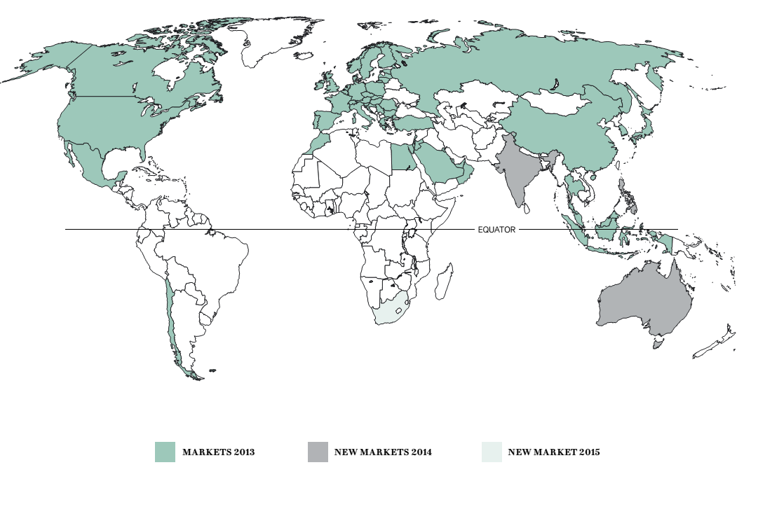

Slide 11
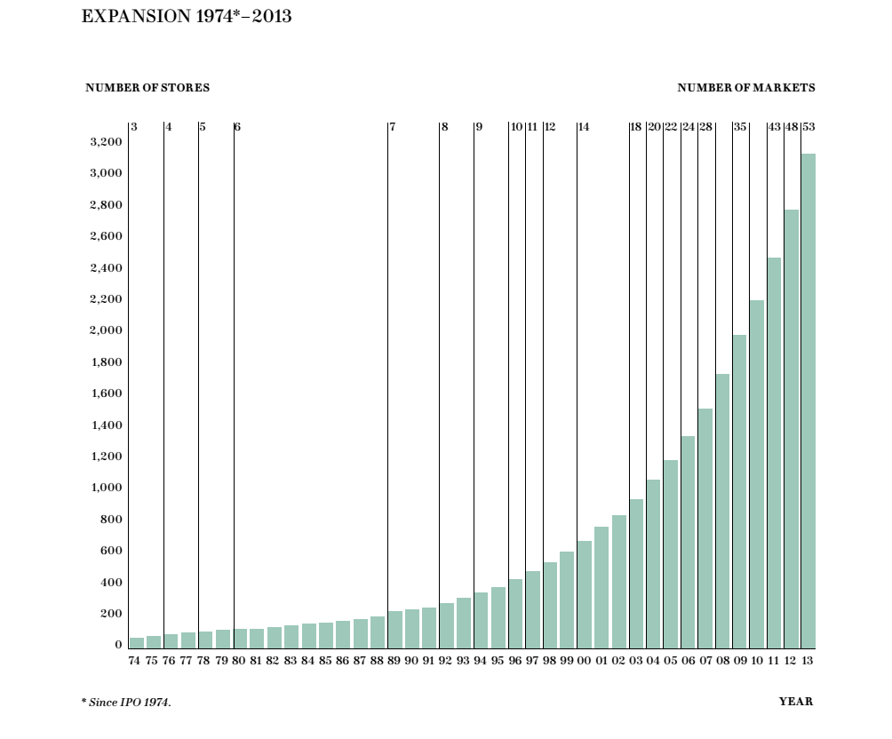

Slide 12
H&M, Revenue and Net Profit, 2009-2013
Data is given in Million SEK
 | 2009 | 2010 | 2011 | 2012 | 2013
Revenue | 118 697 | 126 966 | 128 810 | 140 948 | 150 090
Net Profit | 16 384 | 16 798 | 15 703 | 15 454 | 17 136

Slide 13
H&M, Revenue and Net Profit, 2009-2013
Data is given in Million SEK

Slide 14
H&M: Organization of Supply Chain
The company has well integrated Supply Chain consisting of the following processes:
Design
Production
Distribution
The complete cycle takes 21 days.

Slide 15
H&M, Design
The collection is designed centrally by the purchasing design department
Trying to find the balance between viable and latest designs
Inspiration of designs came from the trends
The collection in collaboration with renowed designer
Analysis of styles and designs of previous year

Slide 16
H&M, Production
Production is outsourced because H&M does not own the factories or manufacturing units
60% of the items are produced in Asia
European suppliers are for fashion sensitive clothes
The suppliers are selected on efficiency and working conditions
Flexible purchasing
Economy of scale

Slide 17
H&M, Distribution
Cost-effective mode of transportation (ships, trains)
Central and local distribution centers
Stores restocking every day
Best available location for stores
Huge number of stores around the world

Slide 18
Comparison between Supply Chains of ZARA and H&M
ZARA
H&M
Vertically integrated Supply Chain
Inspiration comes mainly from the stores
Own production capacities but outsourced sewing
Production mainly in Spain and Portugal
Dual Supply Chain
Inspiration comes from trends and designers
The production is outsourced fully to suppliers
Fast fashioned clothes are produced in Europe

Slide 19
Comparison between Supply Chains of ZARA and H&M
ZARA
H&M
Own railway track and the fastest types of the transport (trucks, planes)
Centralized distribution
The prime location of the stores
The cheapest types of the transport (ships, trains)
Centralized and local distribution
The best available locations

Slide 20
Comparison between Supply Chains of ZARA and H&M
ZARA, 2013
H&M, 2013
Markets - 87
Stores - more than 6 000
Employees- more 128 000
Revenue – 16 274 Mln. Euro
Net Profit – 2 382 Mln. euro
Markets - 53
Stores - more than 3 000
Employees- more 116 000
Revenue – 15 790 Mln. Euro
Net Profit – 1 803 Mln. euro

Slide 21
ZARA’s Supply Chain

Slide 22
H&M’s Supply Chain

Slide 23
Strengths of H&M Supply Chain Management
The entire operations (from the designing to the store management) are conducted via a common IT platform.
Procurement analyzes the sales by item, country, store.
Two Manufacturing Supply Chains (“cost optimizing” from Asia and “rapid reaction” from Europe) bring price and quantity advantage.
A range of stylish apparel for each customer group.
The big distribution net including more than 1 500 stores worldwide owned by the company.
Collaboration with well-known designers and its own strong design team. Outstanding advertisement campaign.

Slide 24
Future Development
New markets: India, South Africa
Expansion in the presenting markets: new 375 shops in 2015
Promoting the new brands
4 new online stores in 2014
Operations in sustainable way

Slide 25
References
Indu P., Supply Chain Practices of three european apparel companies: ZARA, H&M and Benetton, IBS Center for Management Research, 2008.
Indu P., H&M Supply Chain Management Practices, ICFAI Center for Management Research, 2008.
H&M Annual report 2013, http://about.hm.com/content/dam/hm/about/documents/en/Annual%20Report/Annual-Report-2013_en.pdf
Zara Annual report 2013, http://www.inditex.com/documents/10279/18789/Inditex_Group_Annual_Report_2013.pdf/88b623b8-b6b0-4d38-b45e-45822932ff72
Bloomberg, H&M November Sales Beat Estimates on Online-Retail Growth, http://www.bloomberg.com/news/2014-12-15/h-m-november-sales-beat-estimates-helping-quarterly-jump.html
Bloomberg, H&M’s Accelerating Sales Growth Eases Mild Weather Concern, http://www.bloomberg.com/news/2014-11-17/h-m-revenue-growth-accelerates-in-october-surpassing-estimates.html

Slide 26
References
7. Economic Times, H&M's October sales up 14 per cent; beats forecasts, http://economictimes.indiatimes.com/news/international/business/hms-october-sales-up-14-per-cent-beats-forecasts/articleshow/45174922.cms,
8. H&M Annual report 2012, http://about.hm.com/content/dam/hm/about/documents/en/Annual%20Report/Annual-Report-2012_en.pdf
9. Official website of H&M, www.hm.com
10. Deutsche Welle, Ethiopia - next stop for textile industry?, http://www.dw.de/ethiopia-next-stop-for-textile-industry/a-17043826

